Slide 1
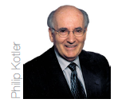

Slide 2
Instructor
Morteza Maleki Minbashrazgah
PhD in Business Administration

Slide 3
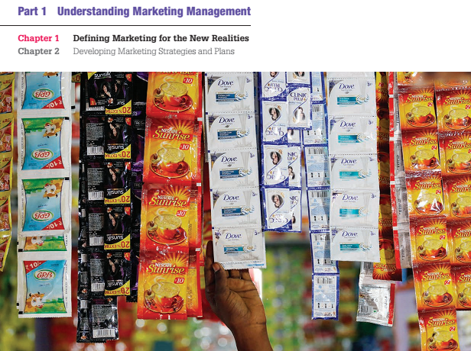

Slide 4
Subject covered in this chapter:
The importance of Marketing (5-6)
The Scope of Marketing (7-19)
Key Customer Markets (20-24)
Marketing in Practice (25-28)
Core Marketing Concepts (29-37)
New Marketing Realities (38-43)
Companies Orientation towards Marketing (44-65)
Marketing Management Tasks (66)

Slide 5
The Importance of Marketing
Financial success often depends on marketing ability.
Finance, operations, accounting and other business functions will not really matter if there is not sufficient demand for products and services so the company can make a profit.
Making the right decisions about change is not always easy.
Marketing managers must decide what features to design into a new product, what prices to offer customers, where to sell the products, and how much to spend on advertising, sales, or the Internet.

Slide 6
The Importance of Marketing
The companies at greatest risk are those that fail to carefully monitor their customers and competitors and to continuously improve their value offerings.
They take a short-term, sales-driven view of their business and ultimately they fail to satisfy their stockholders, employees, suppliers, and channel members.

Slide 7
The Scope of Marketing
To prepare to be a marketer, you need to understand
What marketing is,
How it works,
What is marketed, &
Who does the marketing

Slide 8
The Scope of Marketing
What is Marketing?
Marketing is about identifying and meeting human and social needs; it is “meeting needs profitably”.
American Marketing Association
Marketing is the activity, set of institutions, and processes for creating, communicating, delivering, and exchanging offerings that have value for customers, clients, partners, and society at large.
Marketing management is the art and science of choosing target markets and getting, keeping, and growing customers through creating, delivering and communicating superior customer value.

Slide 9
The Scope of Marketing
Social Definition of Marketing
A social definition shows the role marketing plays in society;
Marketing’s role is to “deliver a higher standard of living.”
Marketing is a societal process by which individuals and groups obtain what they need and want through creating, offering, and freely exchanging products and services of values with others.
Cocreation of value among consumers and with businesses and the importance of value creation and sharing have become important themes in the development of modern marketing thought

Slide 10
The Scope of Marketing
What is marketed?
Marketing people market 10 types of entities, namely,
Goods; physical goods constitute the bulk of most countries production and marketing efforts.
Services; as economies advance, a growing proportion of their activities focuses on the production of services.
Events; marketers promote time-based events, such as major trade shows, artistic performances, and company anniversaries.

Slide 11
The Scope of Marketing
Persons; celebrity marketing is a major business. Artists, musicians, CEOs, physicians, high profile lawyers and financiers, and other professionals all get help from celebrity marketers.
Places; cities, states, regions, and whole nations compete actively to attract tourists, factories, company headquarters, and new residents.
Place marketers include economic development specialists, real state agents, commercial banks, local business associations, and advertising and public relations agencies.

Slide 12
The Scope of Marketing
Experiences; by orchestrating several services and goods, a firm can create, stage, and market experience. An amusement part or water park represent experiential marketing.
Properties; properties are intangible rights of ownership of either real property (real state) or financial property (stocks and bonds). Properties are bought and sold, and these exchanges require marketing.
Organizations; organizations actively work to build a strong, favourable and unique image in the minds of their target publics. Universities, museums, performing arts organizations, and nonprofits all use marketing to boost their public images and to compete for audiences and funds.

Slide 13
The Scope of Marketing
Information; information is essentially what books, schools, and universities produce, market, and distribute at a price to parents, students, and communities.
The production, packaging, and distribution of information are some of our society’s major industries.
Even companies selling physical products attempt to add value through the use of information.
Ideas; every market offering includes a basic idea.
Charles Revson of Revlon once observed; “in the factory we make cosmetics; in the store we sell hope.”
products and services are platforms for delivering some idea or benefits.

Slide 14
The Scope of Marketing
Who Markets?
Marketers & Prospects
A marketer is someone who seeks a response—attention, a purchase, a vote, a donation—from another party, called the prospect. If two parties are seeking to sell something to each other, we call them both marketers.
Marketers are indeed skilled at stimulating demand for their company’s product, but that’s too limited a view of the tasks they perform.
Just as production and logistics professionals are responsible for supply management, marketers are responsible for demand management.
Marketing managers seek to influence the level, timing, and composition of demand to meet the organization’s objectives.

Slide 15
The Scope of Marketing
Market
Traditionally, a market was a physical place where buyers and sellers gathered to buy and sell goods.
Economists describe a market as a collection of buyers and sellers who transact over a particular product or product class.
Five basic markets and their connecting flows are shown in the following figure;

Slide 16
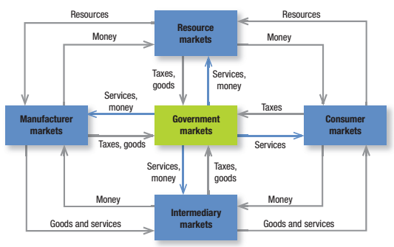
The Scope of Marketing

Slide 17
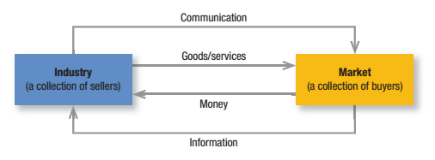
The Scope of Marketing
Marketers often use the term market to cover various groupings of customers; they view sellers as constituting the industry and buyers as constituting the market.

Slide 18
The Scope of Marketing
Sellers & buyers are connected by four flows;
The sellers send goods and services & communications such as ads & direct mail to the market.
In return, they receive money & information such as customers’ attitudes & sales data.
The inner loop shows an exchange of money for goods & services; the outer loop shows an exchange of information.

Slide 19
The Scope of Marketing
Marketers talk about
Need Markets (the Diet-Seeking Market)
Product Markets (the Shoe Market)
Demographic Markets (the Youth Market), &
Geographic Markets (the French Market)

Slide 20
Key Customer Markets
Consumer Markets
Companies selling mass consumer goods and services like drinks, cosmetics, etc., spend a great deal of time trying to establish a superior brand image.
Much of the brand’s strength depends on developing a superior product & packaging, ensuring its availability, and backing it with engaging communications & reliable services.

Slide 21
Key Customer Markets
Business Markets
Companies selling business goods and services often face well-trained & well-informed professional buyers who are skilled at evaluating competitive offerings.
Business buyers buy goods in order to make or resell a product to others at a profit.
Business marketers must demonstrate how their products will help these buyers achieve higher revenue or lower costs.
Advertising can play a role, but the sales force, price & the company’s reputation for reliability & quality may play a stronger one.

Slide 22
Key Customer Markets
Global Markets
Companies that sell goods & services in a global marketplace face additional decisions & challenges.
They must decide which country to enter; how to enter; how to adapt their product or service features to each country; how to price their products in different countries; & how to adapt their communications to fit different cultures.
They make these decisions in the face of different requirements for buying, negotiating, owning, & disposing of property; different culture, language, & legal & political systems; & currencies that might fluctuate in value.

Slide 23
Key Customer Markets
Nonprofit & Governmental Markets
Companies selling their goods to nonprofit organizations such as churches, universities, charitable organizations, & government agencies need to price carefully because these buyers have limited purchasing power.
Lower selling prices affect the features and quality the seller can built into the offering.
Much governments purchasing calls for bids, and buyers often favors the lowest bid in the absence of extenuating factors.

Slide 24
Key Customer Markets
Marketplace, Marketspaces, & Metamarkets
Marketplaces is physical, such as a store one shop in.
Marketspace is digital, as when one shops on the Internet.
Metamarket is a cluster of complementary products and services that are closely related in the minds of consumers, but spread across a diverse set of industries.
The Automobile Metamarket consists of automobile manufacturers, new car & used car dealers, finance companies, mechanics, spare parts dealers, service shops, auto magazines, classified auto ads in newspapers, and auto sites on the Internet.

Slide 25
Subject covered in this chapter:
The importance of Marketing (5-6)
The Scope of Marketing (7-19)
Key Customer Markets (20-24)
Marketing in Practice (26-29)
Core Marketing Concepts (30-38)
New Marketing Realities (39-44)
Companies Orientation towards Marketing (45-66)
Marketing Management Tasks (67)

Slide 26
Marketing in Practice
Marketing is not done only by marketing department.
Marketing needs to affect every aspect of the customer experience, meaning that marketers must properly manage all possible touch points
Store layouts, package designs, product functions, employee training, & shipping & logistics methods.
Marketing must be heavily involved in key general management activities, such as product innovation & new-business development.

Slide 27
Marketing in Practice
To create a strong marketing organization, marketers must think like executives in other departments, & executive in other departments must think more like marketers.
Companies generally establish a marketing department to be responsible for creating & delivering customer value, but,
Marketing is far too important to leave to the marketing department.
Every employee has an impact on the customer & must see the customer as the source of company’s prosperity.
Hence, companies are starting to emphasize on interdepartmental teamwork to manage key processes.

Slide 28
Marketing in Practice
In practice, marketing flows a logical process.
The marketing planning process consists of
Analyzing marketing opportunities,
Selecting target markets,
Designing marketing strategies,
Developing marketing programs, &
Managing the marketing effort.

Slide 29
Marketing in Practice
The changing new marketing environment is putting considerable demands on marketing executives. Marketers must have
Diverse quantitative & qualitative skills,
An entrepreneurial attitude, &
A keen understanding of how marketing can create value within their organizations.
There are five key functions for Chief Marketing Officer (CMO)
Strengthening the brands,
Measuring marketing effectiveness
Driving new product development based on customer needs
Gathering meaningful customer insights, &
Utilizing new marketing technologies.

Slide 30
Core Marketing Concepts
Needs, Wants, & Demands
Needs are the basic human requirements. People need air, food, water, clothing, & shelter to survive.
People also have strong needs for recreation, education, & entertainment.
These needs becomes wants when they are directed to specific objects that might satisfy the need.
A consumer in the United States needs food, but may want a hamburger, French fries, & a soft drink.
Demands are wants for specific products backed by an ability to pay. Many people want a Mercedes; only a few are willing a able to buy one.
Companies must measure not only how many people want their product, but also how many would actually be willing & able to buy it.

Slide 31
Core Marketing Concepts
These distinctions shed light on the frequent criticism that “marketers create needs????” or “marketers get people to buy things they do not want????”.
Marketers do not create needs; needs preexist marketers; marketers, along with other societal factors, influence wants.
Marketers might promote the idea that a Mercedes would satisfy the people’s need the social status; they do not, however, create the need for social status.

Slide 32
Core Marketing Concepts
Target Markets, Positioning, & Segmentation
A marketer can rarely satisfy everyone in the market; hence, marketers start by dividing the market into segments.
They identify and profile distinct groups of buyers who might prefer or require varying product or service mixes by examining demographic, psychographic, & behavioral differences among buyers.
After identifying market segments, the marketers then decide which present the greatest opportunity—which are its target markets.
For each, the firm develops a market offering that it positions in the minds of target buyers as delivering some central benefit(s).

Slide 33
Core Marketing Concepts
Offerings & Brands
Companies address needs by putting forth a value proposition, a set of benefits that they offer to customers to satisfy their needs.
The intangible value proposition is made physical by an offering which can be a combination of products, services, information, & experiences.
A brand is an offering from a known source.
All companies strive to build a strong, favorable, and unique brand image.

Slide 34
Core Marketing Concepts
Value & Satisfaction
The buyer chooses between different offerings based on which she perceives to deliver the most value.
Value reflects the sum of the perceived tangible & intangible benefits & costs to customers
It’s primarily a combination of quality, service, & price (qsp), called the “customer value triad.”
Value increases with quality & services, & decreases with price.
Marketing is the identification, creation, communication, delivery, & monitoring of customer value.

Slide 35
Core Marketing Concepts
Satisfaction reflects a person’s judgment of a product’s perceived performance in relation to expectations.
If the performance falls short of the expectations, the customer is dissatisfied and disappointed.
If it matches expectations, the customer is satisfied.
If it exceeds them, the customer is delighted.

Slide 36
Core Marketing Concepts
Marketing Channels
To reach a target market, the marketers use three marketing channels;
Communication Channels deliver & receive messages from target buyers, like magazines, television ,the Internet, etc.
The marketer uses distribution channels to display, sell, or deliver the physical product or service(s) to the buyer or user. They include distributors, wholesalers, retailers & agents.
The marketer also uses service channels to carry out transactions with potential buyers. Service channels include warehouses, transportation companies, banks & insurance companies that facilitate transactions.

Slide 37
Core Marketing Concepts
Supply Chain
The supply chain is a longer channel stretching from raw materials to components to final products that are carried to final buyers.
Each company captures only a certain percentage of the total value generated by the supply chain’s value delivery system.
When a company acquires competitors or expands upstream or downstream, its aim is to capture a higher percentage of supply chain value.
Competition
Competition includes all the actual & potential rival offerings and substitutes a buyer might consider.

Slide 38
Core Marketing Concepts
Marketing Environment
The marketing environment consists of the task environment and broad environment.
The task environment includes the actors engaged in producing, distributing, & promoting the offering.
These are the company, suppliers, distributors, dealers, & the target customers.
The broad environment consists of six components; demographic environment, economic environment, physical environment, technological environment, political-legal environment, & social-cultural environment.

Slide 39
New Marketing Realities
Major Societal Forces
Network Information Technology
Globalization
Deregulation
Privatization
Heightened Competition
Industry Convergent
Consumer Resistance
Retail Transformation
Disintermediation

Slide 40
New Marketing Realities
New Consumer Capabilities
A substantial increase in buying power
A greater variety of available goods & services
A greater amount of information about practically anything
Greater ease in interacting & placing & receiving orders
An ability to compare notes on products & services
An amplified voice to influence peer & public opinion

Slide 41
New Marketing Realities
New Company Capabilities
Marketers can use the Internet as a powerful information & sales channel, augmenting their geographical reach to inform customers and promote their businesses & products worldwide.
Researchers can collect fuller & richer information about markets, customers, prospects, & competitors.
Managers can facilitate & speed internal communication among their employees by using the Internet as a private intranet.
Companies can facilitate & speed external communication among customers by creating online & offline “buzz” through brand advocates & user community.

Slide 42
New Marketing Realities
New Company Capabilities (con…)
Target marketing & two-way communication are easier, thanks to the proliferation of special-interest magazines, TV channels, & Internet newsgroups, social media.
Extranets linking suppliers & distributors let firms send & receive info, place orders, & make payments more efficiently.
Marketers can send ads, coupons, samples, & info to customers who have requested them or have given the company permission to send them.

Slide 43
New Marketing Realities
New Company Capabilities (con…)
Companies can reach consumers on the move with the mobile marketing.
Firms can produce individually differentiated goods, whether they’re ordered in person, on the phone, or online
Managers can improve purchasing, recruiting, training, & internal & external communications.

Slide 44
New Marketing Realities
New Company Capabilities (con…)
Corporate buyers can achieve substantial savings by using the Internet to compare seller’s prices and to purchase materials at auction or by posting their own terms.
Firms can also recruit new employees online, and many are also preparing Internet training products for download to employees, dealers, and agents.

Slide 45
Subject covered in this chapter:
The importance of Marketing (5-6)
The Scope of Marketing (7-19)
Key Customer Markets (20-24)
Marketing in Practice (26-29)
Core Marketing Concepts (30-38)
New Marketing Realities (39-44)
Companies Orientation towards Marketing (46-67)
Marketing Management Tasks (68)

Slide 46
Companies Orientation Towards Marketing
The Production Concept
It holds that consumers will prefer products that are widely available and inexpensive.
Managers of production-oriented businesses concentrate on achieving high production efficiency, low costs, & mass distribution.
The Product Concept
It proposes that consumers favor products that offer the most quality, performance, & innovative features.
Managers in these organizations focus on making superior products & improve them over time.

Slide 47
Companies Orientation Towards Marketing
The Selling Concept
It holds that consumers & businesses, if left alone, won’t buy enough of the organization products; the organization must undertake and aggressive selling & promotion effort.
The selling concept is practiced most aggressively with unsold goods, goods that buyers normally do not think of buying, such as insurance.
Most firms also practice the selling concept when they have overcapacity; their aim is to sell what they make, rather than make what the market wants.

Slide 48
Companies Orientation Towards Marketing
The Marketing Concept
Instead of product-centered, “make-&-sell” philosophy, business shifted to customer-centered, “sense-&-Respond” philosophy.
The job is not to find the right customers for your products, but to find the right products for your customers.
The marketing concept holds that the key to achieving organizational goals is being more effective than competitors in creating, delivering, & communicating superior customer value to your chosen target markets.

Slide 49
Companies Orientation Towards Marketing
The Holistic Marketing Concept
The holistic marketing concept is based on the development, design & implementation of marketing programs, processes, & activities that recognizes their breadth and interdependencies.
It recognizes that “everything matters” in marketing—and that a broad, integrated perspective is often necessary.
It is thus and approach that attempts to recognize and reconcile the scope & complexities of marketing activities, consisting of four broad components, namely,
Relationship Marketing,
Integrated Marketing,
Internal Marketing, &
Performance Marketing

Slide 50
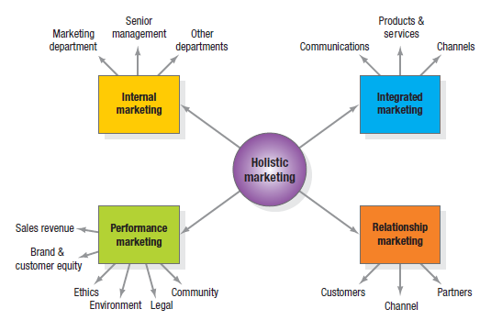
Companies Orientation Towards Marketing

Slide 51
Companies Orientation Towards Marketing
Relationship Marketing
A key goal of marketing is to develop deep, enduring relationships with people & organizations that could directly or indirectly affect the success of the firm’s marketing activities.
Relationship marketing aims to build mutually satisfying long term relationships with key constituents to earn & retain their businesses.
Four key constituents for relationship marketing are
Customers,
Employees,
Marketing partners—channels, suppliers, distributors, dealers, agencies
Members of financial communities—shareholders, investors, analysts

Slide 52
Companies Orientation Towards Marketing
The ultimate outcome of relationship marketing is a unique company asset called a marketing network.
It consists of the company and its supporting stakeholders with whom it has built mutually profitable business relationships.
The operating principle is simple; build an effective network of relationships with key stakeholders, & profits will follow.

Slide 53
Companies Orientation Towards Marketing
Integrated Marketing
The marketer’s task is to devise marketing activities and assemble fully integrated marketing programs to create, communicate, and deliver value for consumers.
Marketing activities come in all forms; McCarthy classified these activities as marketing Mix tools of four broad kinds, which he called the four Ps of marketing;
Product,
Price,
Place/Physical Distribution, &
Promotion

Slide 54
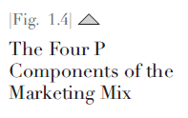
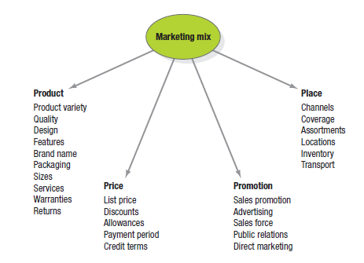
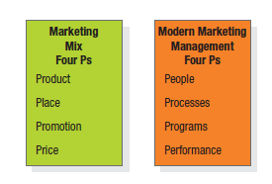
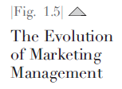
Companies Orientation Towards Marketing

Slide 55
Companies Orientation Towards Marketing
People reflects, in part, internal marketing and the fact that employees are critical to marketing success.
Marketing will only be as good as the people inside the organization.
It also reflects the fact that marketers must view consumers as people to understand their lives more broadly, and not just as shoppers who consume products and services.
Processes reflects all the creativity, discipline, and structure brought to marketing management.
Marketers must avoid ad hoc planning and decision making and ensure that state-of-the-art marketing ideas and concepts play an appropriate role in all they do, including creating mutually beneficial long term relationships and imaginatively generating insights and breakthrough products, services, and marketing activities.

Slide 56
Companies Orientation Towards Marketing
Programs reflects all the firm’s consumer-directed activities.
It encompasses the old four Ps as well as a range of other marketing activities that might not fit as neatly into the old view of marketing.
Regardless of whether they are online or offline, traditional or nontraditional, these activities must be integrated such that their whole is greater than the sum of their parts and they accomplish multiple objectives for the firm.
Performance in holistic marketing is to capture the range of possible outcome measures that have financial and nonfinancial implications (profitability as well as brand and customer equity) and implications beyond the company itself (social responsibility, legal, ethical, and the environment).

Slide 57
Companies Orientation Towards Marketing
Understanding the 4 As of Marketing
According to Jagdish Sheth and Rajendra Sisodia (2012) poor management as a consequence of not knowing what drives consumers is behind the majority of marketing failures.
They make the case that consumer knowledge is a much more reliable route to success.
Their customer-centric marketing management framework emphasizes what they believe are the most important consumer values—acceptability, affordability, accessibility, and awareness—which they dub the four As.

Slide 58
Companies Orientation Towards Marketing
Acceptability
Acceptability is the extent to which a firm’s total product offering exceeds customer expectations.
Acceptability is their dominant component in the framework and that design, in turn, is at the root of acceptability.
Functional aspects of design can be boosted by enhancing the core benefit or increasing reliability of the product; psychological acceptability can be improved with changes to brand image, packing and design, and positioning.

Slide 59
Companies Orientation Towards Marketing
Affordability
Affordability is the extent to which customers in the target market are able and willing to pay the product’s price.
It has two dimensions: economic (ability to pay) and psychological (willingness to pay).
Acceptability combined with affordability determines the product’s value proposition.

Slide 60
Companies Orientation Towards Marketing
Accessibility
Accessibility is the extent to which customers are able to readily acquire the product and it has two dimensions: availability and convenience.

Slide 61
Companies Orientation Towards Marketing
Awareness
Awareness is the extent to which customers are informed regarding the product’s characteristics, persuaded to try it, and reminded to repurchase.
It has two dimensions: brand awareness and product knowledge.
Sheth and Sisodia say awareness is ripest for improvement because most companies are either ineffectual or inefficient at developing it.
For instance, properly done advertising can be incredibly powerful, but word-of-mouth marketing and co marketing can more effectively reach potential customers.

Slide 62
Companies Orientation Towards Marketing
Sheth and Sisodia base the 4 As framework on the four distinctive roles a consumer plays in the marketplace—seeker, buyer, payer, and user.
A fifth consumer role—evangelizer—captures the fact that consumers often recommend products to others and are increasingly critical with the advent of the Internet and social media platforms.
Notes:
Evangelizer = بشارت دهنده

Slide 63
Companies Orientation Towards Marketing
We can relate the 4 As to the traditional 4 Ps.
Marketers set the product (which mainly influences acceptability), the price (which mainly influences affordability), the place (which mainly influences accessibility), and promotion (which mainly influences awareness).

Slide 64
Companies Orientation Towards Marketing
Marketers make marketing-mix decisions for influencing their trade channels as well as their final consumers.
Once they understand these groups, marketers make or customize an offering or solution (product), inform consumers (promotion)—recognizing that many other sources of information also exists—, set a price that offers a real value (pricing), & choose places where the offering will be accessible (Place/Physical Distribution).

Slide 65
Companies Orientation Towards Marketing
Internal Marketing
Holistic marketing incorporates internal marketing, ensuring that everyone in the organization embraces appropriate marketing principles.
Internal marketing is the task of hiring, training, and motivating able employees who want serve the customers well.
It must take place at two levels;
At one level, the various marketing functions—sales force, advertising, customer service, product management, marketing research—must work together.
At the second level, other departments must embrace marketing; they must also “think customers.”

Slide 66
Companies Orientation Towards Marketing
Performance Marketing
It tries to understand the returns to the business from marketing activities & programs, as well as addressing broader concerns & their legal, ethical, social, &environmental effects.
Top management is going beyond sales revenue to examine the marketing scorecard and interpret what is happening to market share, customer loss rate, customer satisfaction, product quality, & other measures.
FINANCIAL ACCOUNTABILITY
SOCIAL RESPONSIBILITY MARKETING

Slide 67
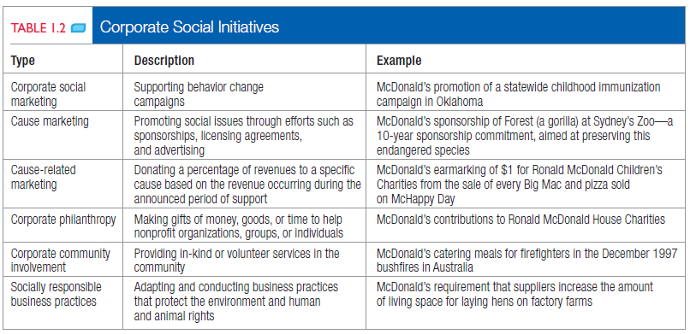
Companies Orientation Towards Marketing

Slide 68
Marketing Management Tasks
Developing Marketing Strategies & Plans
Capturing Marketing Insights
Connecting with Customers
Building Strong Brands
Creating Value
Delivering Value
Communicating Value
Conducting Marketing Responsibility for Long-term Success

Slide 69
The End

