Slide 1
Instructor
Morteza Maleki, PhD

Slide 3
Subjects to be covered in this chapter:
Marketing and Consumer value (4-14)
Corporate and Division Strategic Planning (15-51)
Business Unit Strategic Planning (52-73)
The Nature and Contents of Marketing Plan (74-84)

Slide 4
Marketing and Consumer Value
In a hypercompetitive economy with increasingly rational buyers faced with abundant choices, a company can win only by fine tuning the value delivery process & choosing, providing, & communicating superior value.

Slide 5
Marketing and Consumer Value

Slide 6
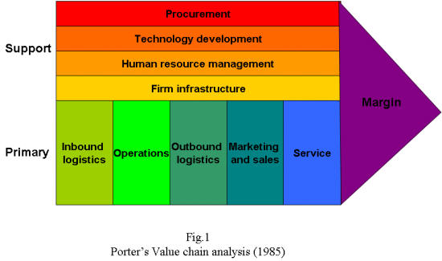
Marketing and Consumer Value
The Value Chain
Michael Porter of Harvard proposed the value chain as a tool for identifying ways to create more customer value.
Every firm is a synthesis of activities performed to design, produce, market, delver, & support its product.
The value chain identifies nine strategically relevant activities, shown in the figure;

Slide 7
Marketing and Consumer Value
The firm’s task is to examine its costs and performance in each value-creating activity, benchmarking against competitors, and look for ways to improve.
Managers can identify the “best of class” practices of the world’s best companies by consulting customers, suppliers, distributors, financial analysts, trade associations, and the media to see who seems to be doing the best job.

Slide 8
Marketing and Consumer Value
A firm’s success depends not only on how well each department performs its work, but also on how well the company coordinates departmental activities to conduct core business processes, which include
THE MARKET-SENSING PROCESS
All the activities in gathering market intelligence, disseminating it within the organization, & acting on the info.
THE NEW-OFFERING REALIZATION PROCESS
All the activities in researching, developing, & launching new high-quality offerings quickly & within budget.

Slide 9
Marketing and Consumer Value
THE CUSTOMER AQCUISITION PROCESS
All the activities in defining target markets & prospecting for new customers.
THE CUSTOMER RELATIONSHIP MANAGEMENT PROCESS
All the activities in building deeper understanding, relationships, & offerings to individual customers.
THE FULFILLMENT MANAGEMENT PROCESS
All the activities in receiving & approving orders, shipping the goods on time, & collecting payment.

Slide 10
Marketing and Consumer Value
Strong companies are reengineering their work flows & building across-functional teams to be responsible for each process.
To be successful, a firm needs to look for competitive advantages beyond its own operations into the value chains of suppliers, distributors, & customers.
Companies partner with specific suppliers & distributors to create superior value delivery network, also called a supply chain.

Slide 11
Marketing and Consumer Value
CORE COMPETENCIES
Many companies today outsource less-critical resources if they can obtain better quality or lower cost.
The key is to own & nurture the resources & competencies that make up the essence of the business.
A core competency has three features;
It is the source of competitive advantage in that it makes a significant contribution to perceived customer benefits,
It has applications in a wide variety of markets, &
It is difficult for competitors to imitate.

Slide 12
Marketing and Consumer Value
Marketing and Consumer Value
CORE COMPETENCIES (con…)
Competitive advantage also accrues to companies that possess distinctive capabilities;
Whereas core competencies refer to areas of special technical & production expertise, distinctive capabilities describe excellence in broader business processes.
Wharton’s George Day sees market-driven organizations as excelling in three distinctive capabilities: market sensing, customer linking, and channel bonding.
In terms of market sensing, tremendous opportunities and threats often begin as “weak signals” from the “periphery” of a business.
Systematically developing peripheral vision by asking three questions related to learning from the past, evaluating the present, and envisioning the future.

Slide 13
Marketing and Consumer Value
Businesses may need to realign themselves to maximize core competencies. Realignment has three steps:
(re)defining the business concept or “big idea”;
(re)shaping the business scope, sometimes geographically; and
(re)positioning the company’s brand identity.

Slide 14
Marketing and Consumer Value
A HOLISTIC MARKETING ORIENTATION & CUSTOMER VALUE
Holistic marketing is the process of “integrating the value exploration, value creation, & value delivery activities with the purpose of building long-term, mutually satisfying relationships & co-prosperity among key stakeholders”.
Holistic marketers succeed by managing a superior value chain that delivers a high level of product quality, service, & speed.
They achieve profitable growth by expanding customer share, building customer loyalty, & capturing customer lifetime value.

Slide 15
Subjects to be covered in this chapter:
Marketing and Consumer value (4-14)
Corporate and Division Strategic Planning (16-52)
Business Unit Strategic Planning (52-73)
The Nature and Contents of Marketing Plan (74-84)

Slide 16
Corporate & Division Strategic Planning
THE CENTRAL ROLE OF STRATEGIC PLANNING
To ensure that companies select & execute the right activities, marketers must give priority to strategic planning in three key areas;
Managing a company’s businesses as an investment portfolio,
Assessing each business’s strength by considering the market’s growth rate & the company’s position & fit in that market, &
Establishing a strategy
The company must develop a game plan for achieving each business’s long-run objectives.

Slide 17
Corporate & Division Strategic Planning
THE CENTRAL ROLE OF STRATEGIC PLANNING (con…)
Most large companies consist of four organizational levels;
The corporate level,
The division level,
The business unit level, &
The product level

Slide 18
Corporate & Division Strategic Planning
Corporate headquarter is responsible for designing a corporate strategic plan to guide the whole enterprise;
It makes decisions on the amount of resources to allocate to each division, as well as on which businesses to start or eliminate.
Each division establishes a plan covering the allocation of funds to each business unit within the division;
Each business unit develops a strategic plan to carry that business unit into a profitable future;
Finally, each product level (product line/brand) within a business unit develops a marketing plan for achieving its objectives in its product market.

Slide 19
Corporate & Division Strategic Planning
The MARKETING PLAN is the central instrument for directing & coordinating the marketing effort.
The marketing plan operates at two levels;
Strategic,
Tactical

Slide 20
Corporate & Division Strategic Planning
The Strategic Marketing Plan
It lays out the target markets & the value proposition the firm will offer, based on an analysis of the best market opportunities.
The Tactical Marketing Plan
It specifies the marketing tactics, including product features, promotion, merchandising, pricing, sales channels, & service.

Slide 22
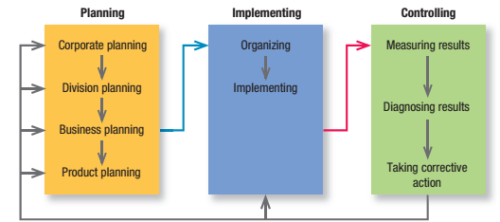
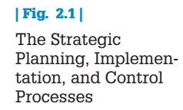
Corporate & Division Strategic Planning

Slide 23
Corporate & Division Strategic Planning
Some firms give their business units a lot of freedom to set their own sales & profit goals & strategies.
Others set goals for their business units but let them develop their own strategies.
Still others set the goals & participate in developing individual business unit strategies.

Slide 24
Corporate & Division Strategic Planning
All corporate headquarters undertake four planning activities;
Defining the corporate missions,
Establishing strategic business units,
Assigning resources to each SBU, &
Assessing growth opportunities

Slide 25
Corporate & Division Strategic Planning
DEFINING THE CORPORATE MISSION
An org exists to accomplish something;
To make cars, provide a night’s lodging, lend money, etc.
Overtime, the mission may change to take advantage of new opportunities or respond to new market conditions.
Amazon.com changed its mission from being the world’s largest bookstore to aspiring to become the world’s largest online store.
Organizations develop mission statement to share with managers, employees, & customers.
A clear, thoughtful mission statement provides employees with a shared sense of purpose, direction & opportunities.

Slide 26
Corporate & Division Strategic Planning
To define its mission, a company should address Peter Drucker’s classic questions:
What is our business?
Who is the customer?
What is of value to the customer?
What will our business be?
What should our business be?
These simple-sounding questions are among the most difficult a company will ever face.

Slide 27
Corporate & Division Strategic Planning
Business Definition
Companies often define themselves in terms of products: They are in the “auto business” or the “clothing business.”
Market definitions of a business, however, describe the business as a customer-satisfying process.
Products are transient; basic needs and customer groups endure forever.
Transportation is a need: the horse and carriage, automobile, railroad, airline, ship, and truck are products that meet that need.

Slide 28
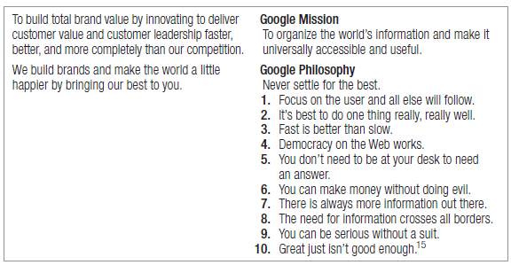
Corporate & Division Strategic Planning
DEFINING THE CORPORATE MISSION (con…)
Mission statements are at their best when they reflect a vision, and almost “impossible dream” that provides a direction for the company for the next 10 to 20 years.

Slide 29
Corporate & Division Strategic Planning
Good mission statements have five major characteristics;
They focus on a limited number of goals;
The statement “we want to produce the highest-quality products, offer the most service, achieve the widest distribution, & sell at the lowest price” claims too much.
Mission statements stress the company’s major policies & values;
They narrow the range of individual discretion so that employees act consistently on important issues.

Slide 30
Corporate & Division Strategic Planning
They define the major competitive spheres within which the company will operate;
Industry, product & applications, competence, market segment, vertical, geographical
They make a long-term view;
They should be enduring; management should change the mission only when it ceases to be relevant.
A good mission statement is as short, memorable, & meaningful as possible.

Slide 31
Corporate & Division Strategic Planning
Defining Competitive Territory and Boundaries in Mission Statements
Industry. Some companies operate in only one industry; some only in a set of related industries; some only in industrial goods, consumer goods, or services; and some in any industry.
Caterpillar focuses on the industrial market; John Deere operates in the industrial and consumer markets.

Slide 32
Corporate & Division Strategic Planning
Products and applications. Firms define the range of products and applications they will supply.
St. Jude Medical’s mission is “develop medical technology and services that put more control into the hands of those who treat cardiac, neurological and chronic pain patients, worldwide.
We do this because we are dedicated to advancing the practice of medicine by reducing risk wherever possible and contributing to successful outcomes for every patient.”

Slide 33
Corporate & Division Strategic Planning
Competence. The firm identifies the range of technological and other core competencies it will master and leverage.
Japan’s NEC has built its core competencies in computing, communications, and components to support production of laptop computers, television receivers, and handheld telephones.
Market segment. The type of market or customers a company will serve is the market segment.
Aston Martin makes only high-performance sports cars.
Gerber serves primarily the baby market.

Slide 34
Corporate & Division Strategic Planning
Vertical. The vertical sphere is the number of channel levels, from raw material to final product and distribution, in which a company will participate.
At one extreme are companies with a large vertical scope.
American Apparel dyes, designs, sews, markets, and distributes its line of clothing apparel out of a single building in downtown Los Angeles.
At the other extreme are “hollow corporations,” which outsource the production of nearly all goods and services to suppliers.
Metro newspaper is published in 56 editions in 22 countries on four continents and is read by more than 17 million people every day.
It employs few reporters and owns no printing presses; instead it purchases its articles from other news sources and outsources all its printing and much of its distribution to third parties.

Slide 35
Corporate & Division Strategic Planning
Geographical. The range of regions, countries, or country groups in which a company will operate defines its geographical sphere.
Some companies operate in a specific city or state.
Others are multinationals like Deutsche Post DHL and Royal Dutch/Shell, which each operate in more than 100 countries.

Slide 36
Corporate & Division Strategic Planning
ESTABLISHING STRATEGIC BUSINESS UNITS
Companies often define their businesses in terms of products—they are in “auto business”, or the “clothing business”.
Market definitions of business are superior to product definitions (Ted Levitt)
Companies must see their business as a customer-satisfying process, not a goods-producing process.
Products are transient; basic needs & consumer groups are enduring forever.

Slide 37
Corporate & Division Strategic Planning
A target market definition tends to focus on selling a product or service to a current market;
Pepsi could define its target market as everyone who drinks a Cola beverage, & competitors could therefore be other Cola companies.
A strategic market definition focuses also on the potential markets.
If Pepsi considered everyone who might drink something to quench their thirst, their competition would also include non-cola soft drinks, bottled water, fruit juices, tea, & coffee.
To better compete, Pepsi might decide to sell additional beverages whose growth rate appears to be promising.

Slide 38
Corporate & Division Strategic Planning
A business can define itself in terms of three dimensions;
Customer groups,
Customer needs, &
Technology
Large companies normally manage quite different businesses, each requiring its own strategy.
General Electric has classified its businesses into 49 strategic business units (SBUs).

Slide 39
Corporate & Division Strategic Planning
An SBU has three characteristics;
It is a single business, or a collection of related businesses, that can be planned separately from the rest of the company.
It has its own set of competitors.
It has a manager responsible for strategic planning & profit performance, who controls most of the factors affecting profit.
The purpose of identifying the company’s SBUs is to develop separate strategies & assign appropriate funding.

Slide 40
Corporate & Division Strategic Planning
ASSIGNING RESOURCES TO EACH SBU
Once it has defined SBUs, management must decide how to allocate corporate resources to each.

Slide 41
Corporate & Division Strategic Planning
Portfolio Planning Models
The GE/McKinsey Matrix classifies each SBU according to the extent of its competitive advantage & the attractiveness of its industry.
The management would want to grow, “harvest”, or draw cash from, or hold on to the business.
The BCG’s Growth –Share Matrix uses relative market share & annual rate of market growth as criteria to make investment decisions.
More recent methods firms use the make internal investment decisions are based on shareholder value analysis (SVA), & whether the market value of a company is greater with an SBU or without it (whether it is sold or spun off).

Slide 42
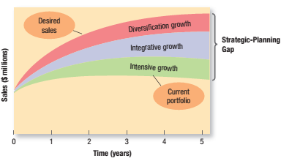
Corporate & Division Strategic Planning
ASSESSING GROWTH OPPORTUNITIES
Assessing growth opportunities includes planning new businesses, downsizing, & terminating older businesses.
If there is a gap between future desired sales & projected sales, corporate management will need to develop or acquire new businesses to fill in.

Slide 43
Corporate & Division Strategic Planning
The companies want to grow much faster than its current businesses will permit.
The first option is to identify opportunities to achieve further growth within current businesses—INTENSIVE OPPORTUNITIES.
The second is to identify opportunities to build or acquire businesses that are related to current businesses—INTEGRATIVE OPPORTUNITIES.
The third option is to identify opportunities to add attractive businesses unrelated to current businesses—DIVERSIFICATION OPPORTUNITIES.

Slide 44
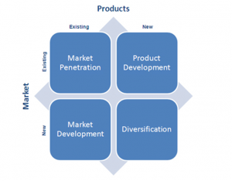
Corporate & Division Strategic Planning
Intensive Growth
Corporate management’s first course of action should be a review of opportunities for improving existing businesses.
One useful framework for detecting new intensive growth opportunities is called a “product-market expansion growth”.

Slide 45
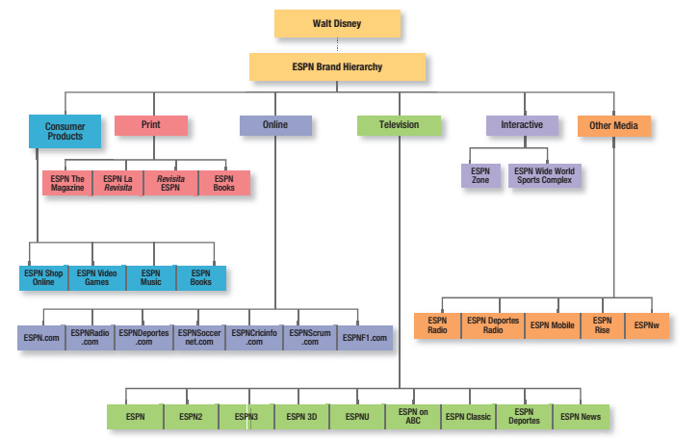

Slide 46
Corporate & Division Strategic Planning
Integrative Growth
Sales & profits of a business can be increased through backward, forward, or horizontal integration within its industries.
A company can acquire one or more of its suppliers—backward integration.
The company can enter the distribution , wholesale, or retail sector—forward integration.
It can acquire one or more of its competitors—horizontal integration.

Slide 47
Corporate & Division Strategic Planning
Diversification
It makes sense when a company finds a highly attractive new industry where it can leverage its strengths.
Three types of diversifications are possible;
CONCENTRIC DIVERSIFICATION
The company could seek new products that have technological or marketing synergies with existing product lines appealing to a new group of customers
HORIZONTAL DIVERSIFICATION
The company can develop new products that are technologically unrelated to its current product line & could appeal to its current customers.
CONGLOMERATE DIVERSIFICATION
The company may seek new opportunities that have no relations with its current technology, product or markets.

Slide 48
Corporate & Division Strategic Planning
Downsizing & Divesting Older Businesses
Weak businesses require a disproportionate amount of managerial attention.
Companies must carefully prune, harvest, or divest tired old businesses in order to release needed resources to other uses & reduce costs.

Slide 49
Corporate & Division Strategic Planning
ORGANIZATION & ORGANIZATIONAL CULTURE
Strategic planning happens within the context of the organization.
A company’s organization consists of its structures, policies, & corporate culture, all of which can become dysfunctional in a rapidly changing business environment.
Although managers can change structures & policies (with difficulty), the company’s culture is very hard to change.
Adapting to culture is often the key to successfully implementing a new strategy.

Slide 50
Corporate & Division Strategic Planning
ORGANIZATION & ORGANIZATIONAL CULTURE …
The Corporate Culture is the shared experiences, stories, beliefs, & norms that characterize an organization.
It is the way people dress, talk to one another, & greet customers within the organization.

Slide 51
Corporate & Division Strategic Planning
MARKETING INNOVATION
Imaginative ideas on strategy exist in many places within a company.
Managers should identify & encourage fresh ideas from three groups that tend to be underrepresented in strategy making;
Employees with youthful perspectives,
Employees who are far removed from company headquarters, &
Employees who are new to the industry

Slide 52
Corporate & Division Strategic Planning
Firms develop strategy by identifying & selecting among different views of the future.
SCENARIO ANALYSIS consists of developing plausible representations of a firm’s possible future that make different assumptions about forces driving the market & that include different uncertainties.
Managers need to think through each scenario with the question;
WHAT WILL WE DO IF IT HAPPENS?
They need to adopt one scenario as the most probable & watch for signposts that might confirm or disconfirm it.

Slide 53
Subjects to be covered in this chapter:
Marketing and Consumer value (4-14)
Corporate and Division Strategic Planning (16-52)
Business Unit Strategic Planning (54-75)
The Nature and Contents of Marketing Plan (74-84)

Slide 54
Business Unit Strategic Planning

Slide 55
Business Unit Strategic Planning
THE BUSINESS MISSION
Each business unit needs to define its specific mission within the boarder company mission.
SWOT ANALYSIS
The overall evaluation of company’s strengths, weaknesses, opportunities, & threats is called SWOT analysis.
It is a way of monitoring the external & internal marketing environment.

Slide 56
Business Unit Strategic Planning
External Environment (opportunities & Threats) Analysis
A business unit must monitor key macro-environment forces & significant micro-environment factors that affect its ability to earn profits.
The business unit should set up a marketing intelligence system to track trends & important developments & any related opportunities & threats.

Slide 57
Business Unit Strategic Planning
Good marketing is the art of finding, developing, & profiting from these opportunities & threats;
A MARKETING OPPORTUNITY is an area of buyer need & interest that a company has a high probability of profitably satisfying.
AN ENVIRONMENTAL THREAT is a challenge posed by an unfavorable trend or development that would lead, in the absence of defensive marketing action, to lower sales or profit.

Slide 58
Business Unit Strategic Planning
To evaluate opportunities, companies can use market opportunity analysis (MOA) to ask questions like:
Can we articulate the benefits convincingly to a defined target market(s)?
Can we locate the target market(s) and reach them with cost-effective media and trade channels?
Does our company possess or have access to the critical capabilities and resources we need to deliver the customer benefits?
Can we deliver the benefits better than any actual or potential competitors?
Will the financial rate of return meet or exceed our required threshold for investment?

Slide 59
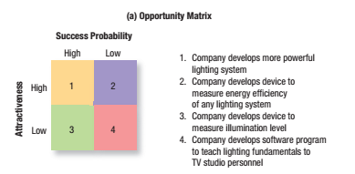
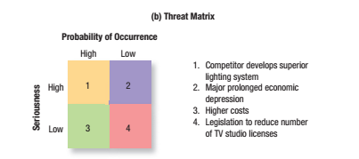
Business Unit Strategic Planning

Slide 60
Business Unit Strategic Planning
Internal Environment (strength & weaknesses) Analysis
Businesses can evaluate their own strength & weaknesses by using a “Checklist for Performing Strengths/Weaknesses Analysis”.
The business doesn’t have to correct all its weaknesses, nor should it gloat about all its strengths.
The big question is whether the firm should limit itself to those opportunities for which it possesses the required strengths, or consider those that might require it to find or develop new strengths.

Slide 61
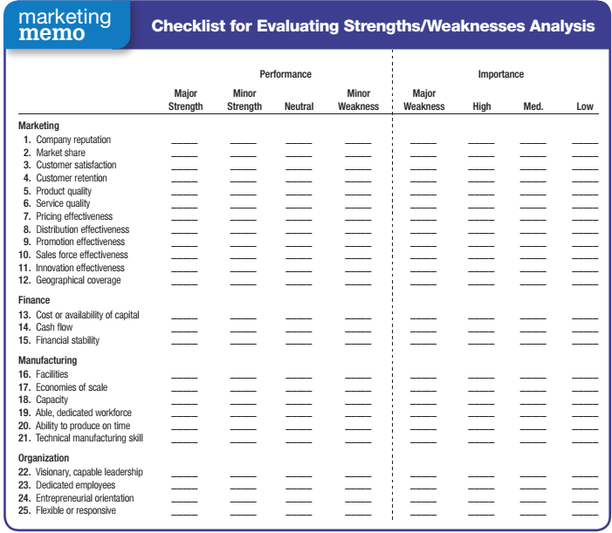

Slide 62
Business Unit Strategic Planning
GOAL FORMULATION
Goals are objectives that are specific with respect to magnitude & time.
Most business units pursue a mix of objectives, including profitability, sales growth, market share improvement, etc.
The business unit sets these objectives and then Management by Objectives (MBO).

Slide 63
Business Unit Strategic Planning
For an MBO system to work, the unit’s objectives must meet four criteria;
They must be arranged hierarchically, from the most to the least important.
Objectives should be quantitative whenever possible.
Objectives should be realistic.
Objectives must be consistent.

Slide 64
Business Unit Strategic Planning
There are important trade-offs in goal formulation, like
Short-term profit vs. Long-term growth,
Deep penetration of existing markets vs. developing new markets,
Profit goals vs. nonprofit goals,
High-growth vs. low risks, etc.
EACH OF THE ABOVE SHOICE REQUIRES A DIFFERENT MARKETING STRATEGY.

Slide 65
Business Unit Strategic Planning
STRATEGY FORMULATION
Goals indicate what a business unit wants to achieve; strategy is a game plan for getting there.
Every business must design a strategy for achieving its goals, consisting of a marketing strategy, & a compatible technology strategy & sourcing strategy.

Slide 66
Business Unit Strategic Planning
Porter’s Generic Strategies
Michael Porter has proposed three generic strategies;
OVERALL COST LEADERSHIP
Firms pursuing this strategy work hard to achieve the lowest production & distribution costs so they can price lower than their competitors & win a large market share.
DIFFERENTIATION
The business concentrates on uniquely achieving superior performance in an important customer benefit area valued by a large part of the market.
FOCUS
The business focuses on one or more narrow market segments.
The firm gets to know these segments intimately & pursues either cost leadership or differentiation within the target segment.

Slide 67
Business Unit Strategic Planning
Strategic Alliances
Doing business in another country require the firm to license its products, form a joint venture with a local firm, or buy from local suppliers to meet “domestic content” requirements.
Many strategic alliances take the form of marketing alliances, falling into four main categories;
Product or service alliances
Promotional alliances
Logistic alliances, &
Pricing collaborations

Slide 68
Business Unit Strategic Planning
To keep their strategic alliances thriving, corporations have begun to develop organizational structures to support them, & many have come to view the ability to form & manage partnerships as core skills called partnership relationship management, PRM.

Slide 69
Business Unit Strategic Planning
PROGRAM FORMULATION & IMPLEMENTATION
Even a great marketing strategy can be sabotaged by poor implementation.
If the unit has decided to attain technological leadership, for instance, it should do as follows;
It must strengthen its R&D department,
It must gather technological intelligence,
It must develop leading-edge products,
It must train technical sales force, &
It must develop ads to communicate its technological leadership.

Slide 70
Business Unit Strategic Planning
Once they have formulated marketing programs, the marketing people must estimate their costs.
Is participating in a particular trade show worth it?
Will a specific sales contest pay for itself?
Will hiring another salesperson contribute to the bottom line?
Activity-based cost (ABC) accounting can help determine whether each marketing program is likely to produce sufficient results to justify its costs?

Slide 71
Business Unit Strategic Planning
PROGRAM FORMULATION & IMPLEMENTATION …
Unless businesses nurture other stakeholders—customers, employees, suppliers, distributors—they may never earn sufficient profits for the stockholders.
A company might aim to delight its customers, perform well for its employees, and deliver a threshold level of satisfaction to its suppliers.
It must not violate any stakeholder group’s sense of fairness about the treatment it is receiving relative to the others.

Slide 72
Business Unit Strategic Planning
PROGRAM FORMULATION & IMPLEMENTATION …
According to McKinsey & Company, strategy is only one of seven elements—all of which start with the letter s—in successful business practice.
The first three—strategy, structure, and systems—are considered the “hardware” of success.
The next four—style, skills, staff, and shared values—are the “software.”

Slide 73
Business Unit Strategic Planning
PROGRAM FORMULATION & IMPLEMENTATION …
Style means company employees share a common way of thinking and behaving.
Skills means employees have the skills needed to carry out the company’s strategy.
Staffing means the company has hired able people, trained them well, and assigned them to the right jobs.
shared values means employees share the same guiding values.
When these elements are present, companies are usually more successful at strategy implementation.

Slide 74
Business Unit Strategic Planning
FEEDBACK & CONTROL
A company’s strategic fit with the environment will inevitably erode, because the market environment changes faster than the companies internal affairs.
The company may remain efficient while it losses effectiveness.
Yet, according to Peter Drucker, it is more important “to do the right thing”—to be effective—than “to do things right”—to be efficient.
The most successful companies excel at both.

Slide 75
Business Unit Strategic Planning
Once an org fails to respond to a changed environment, it becomes increasingly hard to recapture its lost position.
Orgs are subject to inertia; it’s difficult to change one part without adjusting everything else.
Yet, orgs can be changed through strong leadership, preferably in advance of a crisis.
The key to orgal health is willingness to examine the changing environment & adopt new goals & behaviors.

Slide 76
Subjects to be covered in this chapter:
Marketing and Consumer value (4-14)
Corporate and Division Strategic Planning (16-52)
Business Unit Strategic Planning (54-75)
The Nature and Contents of Marketing Plan (77-87)

Slide 77
The Nature and Contents of a Marketing Plan
Working with the plans set by higher levels, product managers come up with a marketing plan for individual products, lines, brands, channels, or customer groups.
Each product level, whether product line or brand, must develop a marketing plan for achieving its goals.

Slide 78
The Nature and Contents of a Marketing Plan
A MARKETING PLAN is a written document that summarizes what the marketer has learned about the marketplace & indicates how the firm plans to reach its marketing objectives.
It contains tactical guidelines for the marketing programs & financial allocations over a planning period.
More limited in scope than a business plan, the marketing plan documents how the organization will achieve its strategic objectives through specific marketing strategies and tactics, with the customer as the starting point.
It is also linked to the plans of other departments.

Slide 79
The Nature and Contents of a Marketing Plan
Some questions to ask in evaluating a marketing plan;
Is the plan simple and succinct?
Is it easy to understand and act on?
Does it communicate its content clearly and practically?
Is it not unnecessarily long?
Is the plan complete?
Does it include all the necessary elements?
Does it have the right breadth and depth?
Achieving the right balance between completeness and lots of detail and simplicity and clear focus is often the key to a well-constructed marketing plan.

Slide 80
The Nature and Contents of a Marketing Plan
Some questions to ask in evaluating a marketing plan …
Is the plan specific?
Are its objectives concrete and measurable?
Does it provide a clear course of action?
Does it include specific activities, each with specific dates of completion, specific persons responsible, and specific budgets?
Is the plan realistic?
Are the sales goals, expense budgets, and milestone dates realistic?
Has a frank and honest self-critique been conducted to raise possible concerns and objections?

Slide 81
The Nature and Contents of a Marketing Plan
What does a marketing plan contain?
Executive summary & table of contents,
Situation analysis,
Marketing strategy,
Financial projections,
Implementation controls

Slide 82
The Nature and Contents of a Marketing Plan
What does a marketing plan contain?
Executive summary & table of contents,
Situation analysis:
This section presents relevant background data on sales, costs, the market, competitors, and the macro-environment.
How do we define the market, how big is it, and how fast is it growing?
What are the relevant trends and critical issues?
Firms will use all this information to carry out a SWOT analysis.

Slide 83
The Nature and Contents of a Marketing Plan
What does a marketing plan contain? …
Marketing strategy:
Here the marketing manager defines the mission, marketing and financial objectives.
All this requires inputs from other areas, such as purchasing, manufacturing, sales, finance, and human resources.

Slide 84
The Nature and Contents of a Marketing Plan
What does a marketing plan contain? …
Marketing Tactics:
Here the marketing manager outlines the marketing activities that will be undertaken to execute the marketing strategy.
The product or service offering section describes the key attributes and benefits that will appeal to target customers.
The pricing section specifies the general price range and how it might vary across different types of customers or channels, including any incentive or discount plans.
The channel section outlines the different forms of distribution, such as direct or indirect.
The communications section usually offers high-level guidance about the general message and media strategy.

Slide 85
The Nature and Contents of a Marketing Plan
What does a marketing plan contain? …
Financial projections:
Financial projections include a sales forecast, an expense forecast, and a break-even analysis.
On the revenue side is forecasted sales volume by month and product category, and on the expense side the expected costs of marketing, broken down into finer categories.
The break-even analysis estimates how many units the firm must sell monthly to offset its monthly fixed costs and average per-unit variable costs.

Slide 86
The Nature and Contents of a Marketing Plan
A more complex method of estimating profit is risk analysis.
We obtain three estimates (optimistic, pessimistic, and most likely) for each uncertain variable affecting profitability, under an assumed marketing environment and marketing strategy for the planning period.
The computer simulates possible outcomes and computes a distribution showing the range of possible rates of returns and their probabilities.

Slide 87
The Nature and Contents of a Marketing Plan
What does a marketing plan contain? …
Implementation controls:
The last section outlines the controls for monitoring and adjusting implementation of the plan.
Typically, it spells out the goals and budget for each month or quarter so management can review each period’s results and take corrective action as needed.

Slide 88
The End

