Slide 1
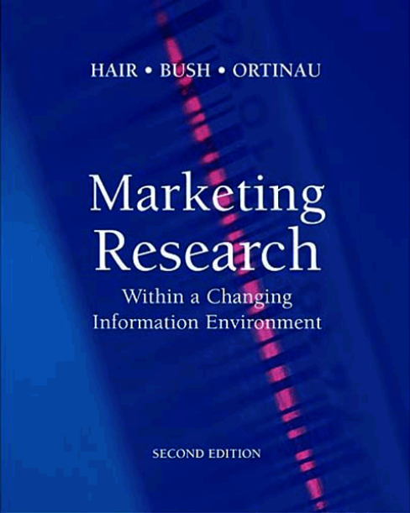
Instructor
Morteza Maleki MinbashRazgah, PhD
Associate Prof. @ Semnan University

Slide 2
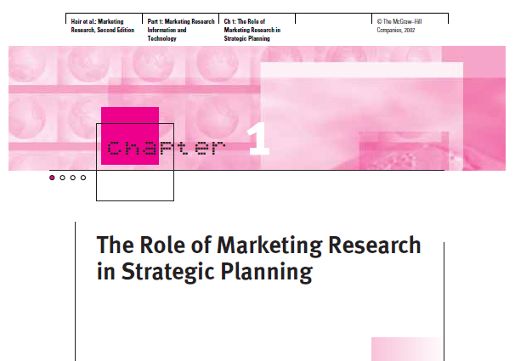

Slide 3
Value of Marketing Research Information
American Marketing Association (AMA)
Marketing research is a function that links an organization to its market through the gathering of information.
This information allows for the identification and definition of market-driven opportunities and problems.
The information allows for the generation, refinement, and evaluation of marketing actions.
It allows for the monitoring of marketing performance and improved understanding of marketing as a business process.

Slide 4
Value of Marketing Research Information
AMA defines marketing research as a process;
The collection of information as it applies to marketing research is a systematic process.
The specific tasks in this process include;
Designing methods for collecting information,
Managing the information collection process,
Analyzing & interpreting the results, &
Communicating findings to decision makers

Slide 5
Value of Marketing Research Information
The common denominator associated with each criterion is Uncertainty
Consumer behavior is unpredictable
To reduce that
Marketing managers must have accurate, relevant, & timely information

Slide 6
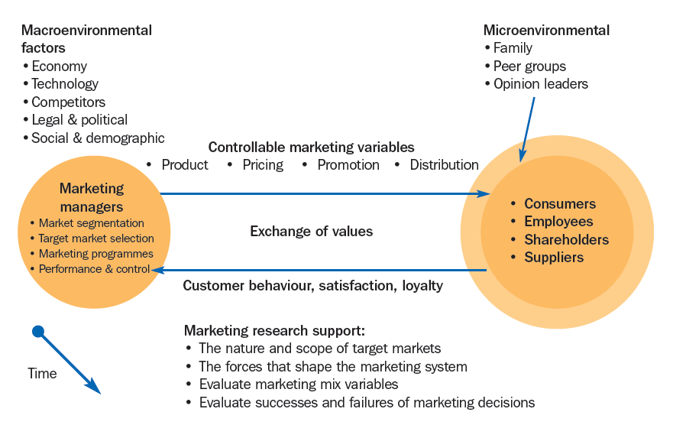
Value of Marketing Research Information
The Role of Marketing Research within the Marketing System

Slide 7
CRM & the Marketing Research Process
Marketing managers focus on getting the right goods and services
to the right people,
at the right place and time,
with the right price,
through the use of the right blend of promotional techniques

Slide 8
CRM & the Marketing Research Process
Relationship Marketing
Companies build long-term relationships with customers by offering value & providing customer satisfaction.
The company is rewarded with repeat sales, increases in sales & market share, & profits.

Slide 9
CRM & the Marketing Research Process
In order to succeed in relationship marketing program, companies should activate in three main areas;
Knowledge of the Market
The company must have an obsession with understanding customer needs & desires & using that info to deliver satisfaction to customers.
Effective Training Program
Building excellence in relationships begins with the employee; it is critical then that the actions & behaviors of employees be market oriented.

Slide 10
CRM & the Marketing Research Process
Employee Empowerment & Teamwork
Many successful companies encourage their employees to be more proactive in solving customer problems; on-the-spot problem solving is known as empowerment.
Moreover, orgs are now developing cross-functional teams dedicated to developing & delivering customer solutions.

Slide 11
Customer Relationship Management
Customer Relationship Management is the process used for implementing a relationship marketing strategy.
CRM is a process used to gather market-driven data in order to learn more about customer needs and behaviors for delivering added value & satisfaction to the customers.

Slide 12
Customer Relationship Management
CRM is based on a number of concepts;
Customer/Market Knowledge
The role of marketing research is to collect & gather info from multiple sources as it pertains to the customers.
Key data to be captured include demographics, psychographic data, buying & service history, preferences, complaints & all other communications the customers have with the company.

Slide 13
Customer Relationship Management
CRM is based on a number of concepts; …
Data Integration
This process entails the development of data warehouse to integrate data from multiple sources into a single shared data source depository.
These data are then made available to all functional areas of the company.

Slide 14
Customer Relationship Management
CRM is based on a number of concepts; …
Information Technology
The role of marketing research is to facilitate data integration through technology-driven techniques, performing functions like basic reporting on the customer, data mining, statistical analysis procedures, & data visualization.

Slide 15
Customer Relationship Management
CRM is based on a number of concepts; …
Creating Customer Profiles
Collected & integrated data are used to develop customer profiles, which are then made available to all functional areas of the company utilizing the appropriate information technology.

Slide 16
Strategic Marketing Planning
A sound marketing research process is the nucleus for strategic marketing planning, which must make decision on areas like;
Which new markets to penetrate
Which product to introduce, &
Which new business opportunities to pursue
The entire strategic marketing process is a series of decisions that must be made with high levels of confidence about the outcome.

Slide 17
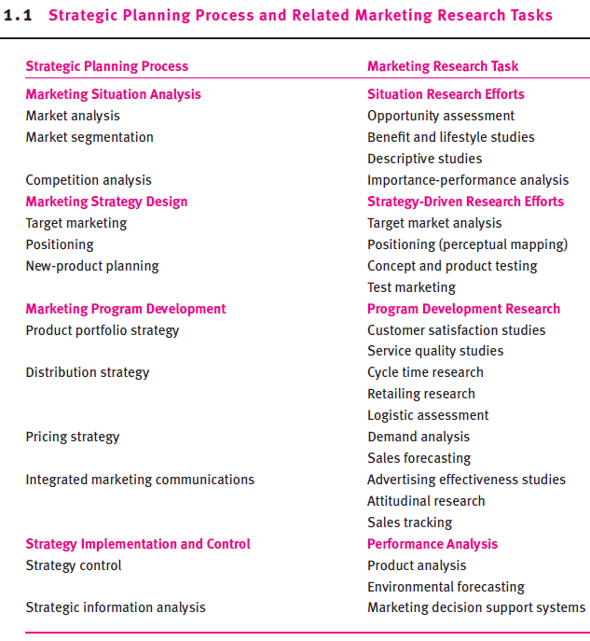

Slide 18
Marketing Situation Analysis
The purpose of situation analysis is to monitor the appropriateness of a firm’s marketing strategy & to determine whether changes to the strategy are necessary.
Locate & identify new marketing opportunities for a company
Identify groups of customers within the product-market who possess similar needs, characteristics, & preferences.
Identify existing & potential competitors’ strengths & weaknesses

Slide 19
Marketing Situation Analysis
Market Analysis
It involves collecting info on product markets for the purpose of forecasting how they will change.
The role of marketing research is to gather & categorize info pertaining to various macroenvironmental variable, like political & regulatory, economic & social, & cultural & technological.
It then interprets the collected data in the context of strategic consequences to the firm.

Slide 20
Marketing Situation Analysis
Market Segmentation
Called benefits & lifestyle studies, it examines similarities & differences in consumers’ needs.
The marketing research objective is to collect info about customer characteristics, product benefits, & brand preferences.
Such data, along with info on age, family size, income, & lifestyle are then related to the purchase patterns of particular products.
Based on such data, market segmentation profiles are developed.

Slide 21
Marketing Situation Analysis
Competition Analysis
Called importance-performance analysis, it is a commonly used research approach for evaluating competitor’s strategies, strengths, limitations, & future plans.
It asks consumers to identify key attributes that drive their purchase behavior within a given industry.
These attributes might include price, product performance, quality, accuracy of shipping & delivery, or convenience of store location.
Consumers are asked to rank such attributes in order of importance.
Then, researchers identify & evaluate competing firms’ performance, & compare them with their own performance.

Slide 22
Marketing Strategy Design
Info collected during situation analysis is subsequently used to design a marketing strategy.
Target Marketing
It provides useful info for identifying those people (or companies) that an org wishes to serve.
It also helps management determine the most efficient way of serving the targeted group.

Slide 23
Marketing Strategy Design
Target Marketing …
It attempts to provide info on the following issues;
New product opportunities
Demographics, including attitudinal or behavioral characteristics
User profiles, usage patterns, & attitudes
The effectiveness of a firm’s current marketing strategy

Slide 24
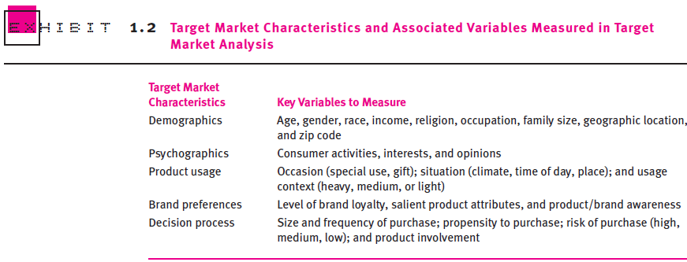
Marketing Strategy Design

Slide 25
Marketing Strategy Design
Positioning- Perceptual Mapping
A process in which a company seeks to establish a general meaning or definition of its product offering that is consistent with customers' needs and preferences.
Companies accomplish this by combining the elements of the marketing mix in a manner that meets or exceeds the expectations of targeted customers.

Slide 26
Marketing Strategy Design
The task of the marketing researcher is to provide a photograph of the relationship between competitive product offerings based on judgments of a sample of respondents who are familiar with the product category under investigation.
Consumers are asked to indicate how they view the similarities & dissimilarities among relevant product attributes for a set of competing brands.
This info is then used to construct perceptual maps, which transform the positioning data into “perceptual space”.

Slide 27
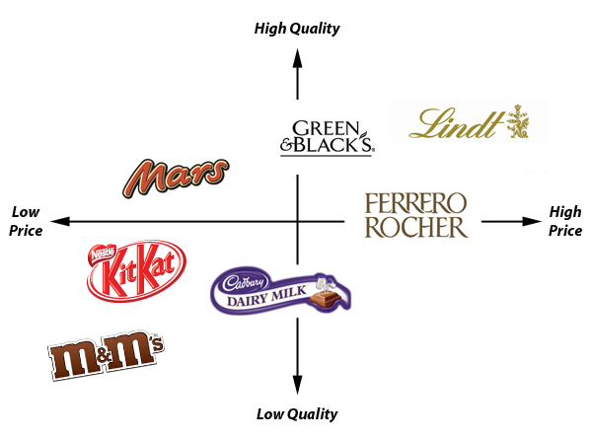
Marketing Strategy Design
Perceptual mapping reflects the dimensions on which brands are evaluated, typically representing product features or attributes judged as important in the customers’ selection process.

Slide 28
Marketing Strategy Design
New-product Planning
Covering the areas of concept & product testing and test marketing, they give management the necessary info for decisions on product improvements & new product introductions.
Product testing attempts to answer two questions;
How does a product perform for the customer?
How can a product be improved to exceed customer expectations?

Slide 29
Marketing Strategy Design
Product testers
Provide necessary info for designing & developing new products
Determine whether new or improved products should replace current products
Assess the appeal of alternative products for a new target segments
Seek to identify products that are most preferred or actively sought relative to existing competitive offerings

Slide 30
Marketing Program Development
Product Portfolio Strategy
Here, the total product line is typically the focal point of investigation.
Marketing research design studies that help conduct managers make decisions about
Reducing costs,
Altering marketing mixes, &
Changing or deleting product lines

Slide 31
Marketing Program Development
Two areas of studies here are;
CUSTOMER SATISFACTION STUDIES
Designed to assess the strengths and weaknesses customers perceive in a firm's marketing mix
These studies concentrate on measuring customer attitudes;
Attitude info allows management to make intelligent decisions regarding product or brand repositioning, new product introductions, new market segments, & the deletion of ineffective products.

Slide 32
Marketing Program Development
SERVICE QUALITY STUDIES
Designed to measure the degree to which an organization conforms the quality level customers expect
These studies concentrate on
Physical facilities & equipment,
Appearance & behavior of company’s personnel, &
Dependability of products & programs
Such studies allow the firm to anticipate any problem in its product or service offering before they become out of hand.
They allow firms to allow themselves relative to competitors on key strengths & weaknesses.

Slide 33
Marketing Program Development
Distribution Strategy
Distribution strategies take into account the distributors & retailors that link producers with end users.
The distribution channel used by producer can create strong influence on the buyers’ perception of the brand.

Slide 34
Marketing Program Development
Three types of distribution-related studies are;
CYCLE-TIME RESEARCH
It centers on reducing the time between the initial contact with a customer & the final delivery (or installation) of the product.
Two common research practices in this area are delivery expense studies & alternative delivery system studies.
RETAILING RESEARCH
Because retailing is a high-customer-contact activity, a majority of retailing research focuses on database development through optical scanning procedure (figure in next slide).
LOGISTIC ASSESSMENT
This type of info in logistics allows market researchers to conduct total cost analysis & sensitivity analysis.

Slide 35
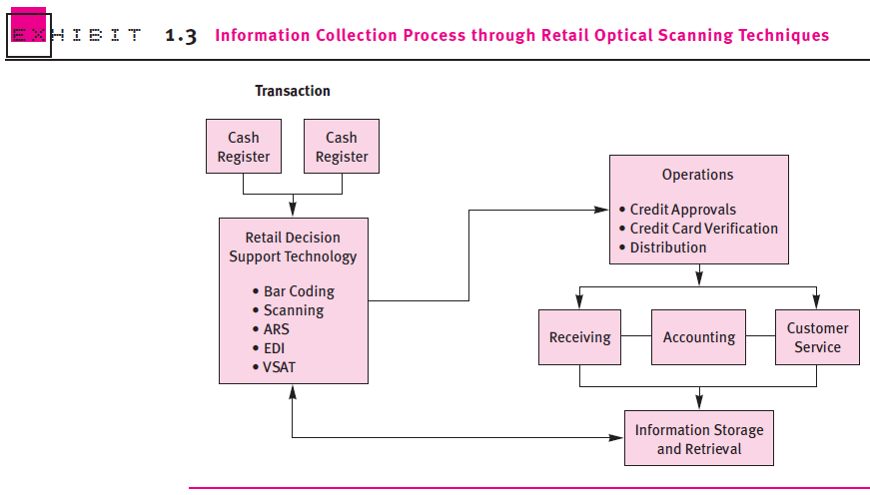

Slide 36
Marketing Program Development
Total Cost Analysis explores the alternative logistic system designs a firm can use to achieve its performance objective at the lowest total cost.
The role of marketing research is to develop an activity-based cost (ABC) info system by identifying key factors that affect transportation, inventory & warehousing costs.
Service Sensitivity Analysis helps organizations design basic customer service programs by evaluating cost-to-service trade-offs.
In conducting these studies, marketing researchers look for ways to increase various basic services by making adjustments in transportation activities, inventory levels, or location planning.

Slide 37
Marketing Program Development
Pricing Strategy
Pricing strategies involves pricing new products, establishing price levels in test market situations, & modifying prices for existing products.
Marketing research must provide answers to such fundamental questions as the following;
How large is the demand potential within the target market?
How sensitive is demand to changes in price levels?
What non-price factors are important to customers?
What are the sales forecasts at various price levels?

Slide 38
Marketing Program Development
Demand Analysis seeks to estimate the level of customer demand for a given product & the underlying reasons for that demand.
Sales Forecasting uses variable that affect customer demand identified by demand analysis to provide estimates of financial outcomes for different price strategies.

Slide 39
Marketing Program Development
Integrated Marketing Communication
Promotional strategies are important influences on any company’s sales.
Marketing research methods used to acquire info about the performance of promotional program must consider the entire program, which include;
Employing the appropriate methodology
Estimating the adequate sample size, &
Developing the proper scaling techniques, etc.

Slide 40
Marketing Program Development
Advertising Effectiveness Studies
They may be qualitative, quantitative, or both; yet, the key elements in such studies are what is being measured, when the measurement is made, & which medium is being used.
Attitudinal Research
These studies can be categorized into three;
First is the cognitive approach, which attempts to measure consumers’ knowledge & opinions about a given product or brand.
Second affect approaches measure consumers’ overall impressions of a product or brand.
Third, behavioral approaches seek to measure consumers’ specific behaviors—brand loyalty, brand switching, etc.

Slide 41
Marketing Program Development
Personal selling also plays a major role in a firm’s promotional mix.
The objectives assigned to salespeople involve expected sales results, like sales quotas.
Non-sales objectives may include increasing new accounts, evaluating middlemen, or achieving set levels of customer service.
Sales Tracking
Here, key info must be gathered on salespeople & placed into the proper units of analysis in order to provide adjustments for factors beyond the control of individual salespeople.

Slide 42
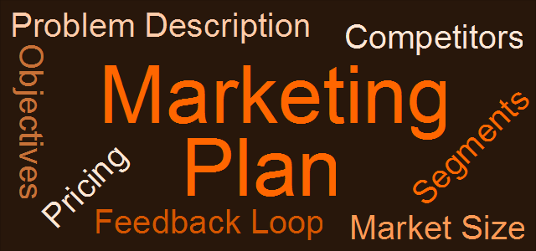
Strategy Implementation & Control
The key to strategy implementation & control for any org is the marketing plan.
Marketing research provides managers with the info they need to analyze product markets, competition, & product performance with regard to marketing plan.

Slide 43
Strategy Implementation & Control
Strategy Control
Product analysis
Attempts to identify the relative importance of product selection criteria to buyers and rate brands against these criteria, conducted throughout the life-cycle of the product or brand.
It is particularly useful when developing the strengths-&-weaknesses section of a marketing plan.
Environmental forecasting
Used to predict external occurrences that can affect the long-term strategy of a firm, resulting in an accumulation data pertaining to industry trends, customer profiles, & environmental changes.
It is particularly useful when developing the opportunities-&-threats section of a marketing plan.

Slide 44
Strategy Implementation & Control
Strategic Information Analysis
Info is vital to the strategic planning process; it is the key to the accuracy of the marketing plan.
The role of marketing research in not only to collect & analyze the data, but to categorize & process the data for maximum usage.

Slide 45
Strategy Implementation & Control
Marketing Decision Support Systems is a company-developed database used to analyze company's performance & control marketing activities.
It includes standardized marketing research reports, sales & cost data, product-line sales, advertising data, & price information.
This info is then organized to correspond to specific units of analysis—market segments, geographic locations, particular vendors—to be used for various decisions from reordering inventory to launching new products.

Slide 46
The Marketing Research Industry
As an industry, marketing research has experienced an unparalleled growth in recent years, attributed to
Post-sales customer satisfaction studies—claiming one-third of research company revenues
Retail driven product scanning systems—claiming an additional one-third of all revenues
Database development for long-term brand management, &
International research studies

Slide 47
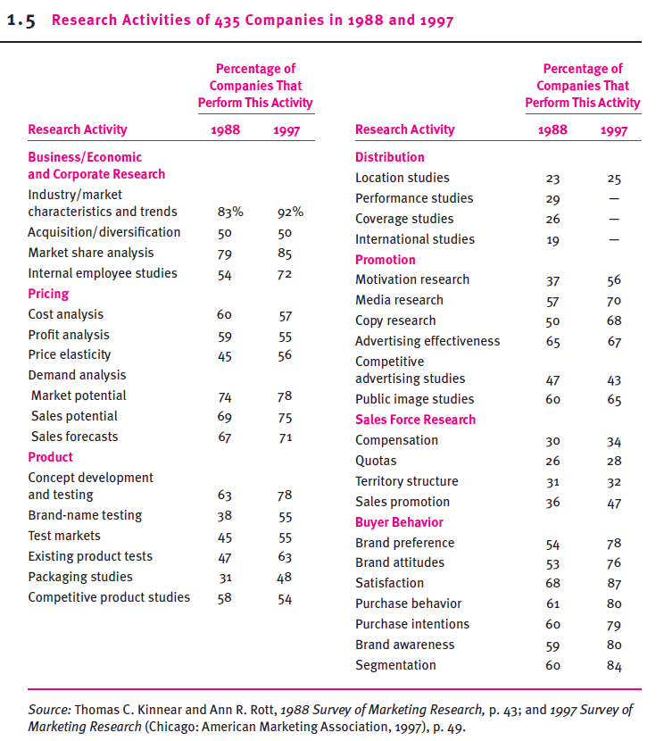

Slide 48
The Marketing Research Industry
Types of Marketing Research Firms
Internal or external
Custom or standardized
Brokers or facilitators

Slide 49
The Marketing Research Industry
Internal or External Marketing Research
Internal research providers are normally organizational units that reside within a company.
Benefits of having internal marketing research department;
Research method consistency,
Shared info across the company,
Minimized spending on research, &
Ability to produce actionable research results

Slide 50
The Marketing Research Industry
External sources of marketing research, usually referred to as marketing research suppliers, perform all aspects of the research, including study design, questionnaire production, interviewing, data analysis, & report preparation.
Benefits of using external marketing research providers;
They can be more objective & less subject to company politics & regulations than internal marketing department.
Many external suppliers provide specialized talent that, for the same cost, internal suppliers could not provide.
Companies can choose external suppliers on a study-by-study basis & thus gain greater flexibility in scheduling studies as well as match specific project requirements to the talents of specific research firms.

Slide 51
The Marketing Research Industry
Customized or Standardized Marketing Research
Customized research firms provide specialized, highly tailored services to the client,
They concentrate their research activities on one specific area such as brand-name testing, test marketing, or new-product development.
Standardized research firms provide more general services.
They follow a more common approach in research design so that the results of a study conducted for one client can be compared to norms established by studies done for other clients.

Slide 52
The Marketing Research Industry
A typical example of Standardized research activities is syndicated business services.
They include purchase diary panels, audits, and advertising recall data made or developed from a common data pool or database.
For example
Database established through retail optical scanner methods.
This database, available from ACNielsen, tracks the retail sales of thousands of brand-name products.
These data can be customized for a variety of industries (snack foods, over-the-counter drugs, etc.) to indicate purchase profiles and volume sales in a given industry.

Slide 53
The Marketing Research Industry
Brokers or Facilitators Marketing Research
Broker services provide the ancillary tasks that complement many marketing research studies.
For example, marketing research suppliers & clients who do not have the resource for data entry, tabulation, or analysis will typically use a broker service to facilitate the data management process.
For Example
P-Shat Inc. is a marketing research broker service that performs only three functions: data entry, data tabulation, and statistical analysis.

Slide 54
The Marketing Research Industry
Facilitating agencies or businesses, like advertising agencies, field services, or independent consultants, that perform marketing research functions as a complement to a broader marketing research project.
For example
Advertising agencies are in the business of designing, implementing, & evaluating advertising campaigns for individual clients.
They use their own research services to guide the development of campaign & test for effectiveness.
The ad agency provides marketing research to facilitate the ad campaign process.

Slide 55
The Marketing Research Industry
Changing Skills for a Changing Industry
Basic Fundamental Business Skills
Communication skills (verbal and written),
Interpersonal skills (ability to work with others)
Statistical skills
Specific Skills in the Position
The ability to understand and interpret secondary data
Presentation skills
Foreign-language competency
Negotiation skills, and
Computer proficiency

Slide 56
Emerging Trends
Five Major Trends in Marketing Research
An increased emphasis on secondary data collection methods
Movement toward technology-related data management (optical scanning data, database technology)
An increased use of computers for information acquisition and retrieval
A broader international client base
Movement away from pure data analysis and toward a data interpretation/information management environment

Slide 57
The End

