Slide 1
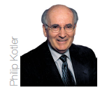
Instructor
Morteza Maleki, PhD

Slide 3
The Marketing Research Systems
It is the job of marketing researcher to produce insight into the customer’s attitudes & buying behavior.
Marketing Insights provide diagnostic info about how & why we observe certain effects in the market place, & what that means to marketers.
MARKETING RESEARCH is the systematic design, collection, analysis, & reporting of data & findings relevant to specific marketing situation facing the company.

Slide 4
The Marketing Research Systems
Marketing Research Firms fall into three categories;
SYNDICATED-SERVICE RESEARCH FIMS; they gather consumer & trade info, which they sell for a fee.
CUSTOM MARKETING RESEARCH FIRMS; they design & carry out research studies for various clients based on specific beliefs.
SPECIALITY-LINE MARKETING RESEARCH FIRMS; they provide specialized research services such as developing a research brief (for this they may hire academics and freelancers), collecting field data, & preparing data analysis & reports for other firms.

Slide 5
The Marketing Research Process
Effective marketing research follows six steps;
Define the Problem, the Decision Alternative, & the Research Objectives
Develop the Research Plan
Collect the Information
Analyze the Information
Present the Findings, &
Make the Decision

Slide 6
The Marketing Research Process
Step (1)
DEFINE THE PROBLEM, THE DECISION ALTERNATIVE, & THE RESEARCH OBJECTIVES
Problems should not be defined either too broadly or too narrowly;
A broad or vague definition leads to excessive wastage of resources.
Too narrow a definition leads to inadequate data or info required to make an effective decision.
Clarity on the following helps define the problem appropriately;
What is to be researched (the content, the scope)?
Why is it to be researched (the decisions that are to be made)?
The end product of this step has to be a clear definition of the problem & research objectives.

Slide 7
The Marketing Research Process
Step (2)
DEVELOP THE RESEARCH PLAN
The second steps in marketing research involves decisions on
Data Sources,
Research Approaches
Research Instruments
Sampling Plan, &
Contact Methods

Slide 8
The Marketing Research Process
Data Sources
The researcher can gather secondary data, primary data, or both.
SECONDARY DATA are data that were collected for another purpose, & already exist somewhere.
PRIMARY DATA are freshly gathered data for a specific purpose or for a specific research project.
Researchers usually start their investigation by examining secondary data to see whether the problem can be partly or wholly solved without collecting costly primary data.
When the required data do not exist or are dated, inaccurate, incomplete, or unreliable, the researcher will have to collect primary data.

Slide 9
The Marketing Research Process
Research Approach
Primary data can be collected in five ways;
OBSERVATION
FOCUS GROUPS
SURVEYS
BEHAVIORAL DATA, &
EXPERIMENTS

Slide 10
The Marketing Research Process
OBSERVATIONAL RESEARCH
Researchers can gather fresh data by observing the relevant actors & settings, unobtrusively observing as they shop or as they consume products.
Sometimes, they equip consumers with pagers & instruct them to write down what they’re doing whenever prompted, or they hold informal interviewed sessions at a café or bar.
Photographs can also provide a wealth of detailed info.

Slide 11
The Marketing Research Process
ETHNOGRAPHIC RESEARCH
It is a particular observational research approach that uses concepts & tools from anthropology and other social science disciplines to provide deep understanding of how people live or work.
The goal is to immerse the researcher into consumer’s lives to uncover unarticulated desires that might not surface to any other form of research.
Ethnographic research is not limited to consumer companies in developed markets.
GE’s ethnographic study into plastic industry is the case in industrial markets using this approach.
It is particularly useful in developing markets, especially far-flung areas, where companies do not know consumers as well.

Slide 12
The Marketing Research Process
FOCUS GROUP RESEARCH
A focus group is a gathering of six to ten people who are invited to spend a few hours with a skilled moderator in order to discuss a product, service, organization, or any other marketing entity.
The moderator needs to be objective, knowledgeable, & skilled in group dynamics.
Participants are normally offered some gifts or incentives for attending the meeting; the meeting is typically held in pleasant surroundings, & refreshments are served.

Slide 13
The Marketing Research Process
FOCUS GROUP RESEARCH (con…)
The moderator usually starts with a broad question & then helps the group move through various aspects of the entity being discussed, encouraging free & easy discussion.
The key role of the moderator is to keep the discussion “focused” on the relevant theme while allowing deep feelings & thoughts to emerge through the group dynamics.
Transcripts prepared from recordings are subsequently analyzed to understand consumer beliefs, attitudes, & behavior.

Slide 14
The Marketing Research Process
SURVEY RESEARCH
Surveys are best suited for descriptive research.
Companies undertake surveys to learn about people knowledge, beliefs, preferences, & satisfaction.
It requires development of a survey instrument, usually questionnaire, which the respondents are asked to fill up.

Slide 15
The Marketing Research Process
BEHAVIORAL DATA
Customers’ actual purchases reflect preferences & are normally more reliable than memory-based statements made in surveys.
Observations have shown that many high-income group customers do not buy expensive consumer goods, while some low-level income consumers end up buying expensive products, contrary to their stated preferences in the surveys.

Slide 16
The Marketing Research Process
EXPERIMENTAL RESEARCH
The most scientifically valid research
Its purpose is to capture cause-&-effect relationships by eliminating competing explanations of the observed findings.
To the extent that the design & execution of the experiment eliminate alternative hypotheses that might explain the results, research & marketing managers can have confidence in the conclusions.
Experiments call for selecting matched groups of subjects, subjecting them to different treatments, controlling the extraneous variables, & checking whether the observed response differences are statistically significant.

Slide 17
The Marketing Research Process
Research Instrument
Marketing researchers have a choice of three main research instruments in collecting primary data;
Questionnaires
Qualitative Measures, &
Technological Devices

Slide 18
The Marketing Research Process
QUESTIONNAIRES
A questionnaire consists of a set of questions presented to respondents; because of its flexibility, it is by far the most common instrument used to collect primary data.
The form, wording, & sequence of the question can all influence the response.

Slide 19
The Marketing Research Process
QUESTIONNAIRES …
Closed-end Questions specify all the possible answers & provide answers that are easier to interpret & tabulate.
Open-ended Questions allow respondents to answer in their own words & often reveal more about how people think.
They are especially useful in exploratory research, where the researcher is looking for insight into how people think rather than measuring how many people think a certain way.

Slide 20
The Marketing Research Process
QUALITATIVE MEASURES
Consumer actions do not always match their answers to survey questions.
Qualitative Research Techniques are relatively unstructured measurement approaches that permit a range of possible responses.
Due to the freedom afforded both researchers in their probes & consumers in their responses, qualitative research can often be a useful first step in exploring consumers’ brand & product perceptions.

Slide 21
The Marketing Research Process
Drawback of Qualitative Measures
Marketers must temper the in-depth insights that emerge with the fact that the samples are often very small & may not necessarily generalize to boarder populations.
Different researchers examining the same qualitative results may draw very different conclusions.

Slide 22
The Marketing Research Process
TECHNOLOGICAL DEVICES
Technological devices are occasionally useful in marketing research.
Technology has now advanced to such a degree that marketers can use devices such as skin sensors, brain wave scanners, & full body scanners to get consumer responses.
For instance, TACODA, an advertising technology company, is studying the eye movements & brain activity of web surfers to see which ad grabs their attention.
Technology has replaced the diaries that participants in media surveys used to keep.

Slide 23
The Marketing Research Process
Sampling Design
This calls for three decisions
Sampling unit; who should we survey?
Once they have determined the sampling unit, marketers must develop a sampling frame so that everyone in the target population has an equal or known chance of being sampled.

Slide 24
The Marketing Research Process
Sampling Design
This calls for three decisions …
Sample size; how many people should we survey?
Large samples give more reliable results, but it’s not necessary to sample the entire target population to achieve reliable results.
Samples of less than 1% of a population can often provide good reliability, with a credible sampling procedure.

Slide 25
The Marketing Research Process
Sampling Design
This calls for three decisions …
Sampling procedure; how should we choose the respondents?
Probability sampling allows confidence limits to be calculated for sampling error & makes the sample more representative.
When the cost or time to use probability sampling is too high, marketing researchers will take nonprobability sample.

Slide 26
The Marketing Research Process
Contact Methods
Now the marketing researcher must decide how to contact the subjects: by mail, by telephone, in person, or online.

Slide 27
The Marketing Research Process
MAIL QUESTIONNAIRE;
It is the best way to reach people who would not give personal interviews or whose responses might be biased or distorted by the interviewers.
It requires simple & clearly worded questions.
The response rate is usually low or slow.

Slide 28
The Marketing Research Process
TELEPHONE INTERVIEW;
It is the best method for gathering info quickly; the interviewer is also able to clarify questions if respondents do not understand them.
The response rate is typically higher than in the case of mailed questionnaires.
Yet, the interviews have to be short & not too personal.

Slide 29
The Marketing Research Process
PERSONAL INTERVIEW;
It is the most versatile method; the interviewer can ask more questions & record additional observations about the respondent, like dress & body language.
Yet, it is the most expensive method, subject to interviewer bias, & requires more administrative planning & supervision.

Slide 30
The Marketing Research Process
ONLINE INTERVIEW;
There are so many ways to use the Internet to do research.
The company can embed a questionnaire on its website in different ways & offer an incentive to answer it; or
It can place a banner on a frequently visited site such as Yahoo!, inviting people to answer some questions & possibly win a price.

Slide 31
The Marketing Research Process
ONLINE INTERVIEW;
There are so many ways to use the Internet to do research …
Marketers can also sponsor a chat room or bulletin board & introduce questions from time to time or host a real time consumer panel or virtual focus group.
The company can learn about individuals who visit its site by tracking how they clickstream through the website & move to other sites.
The company can post different prices, use different headlines, & offer different product features on different websites or at different times to learn the relative effectiveness of its offerings.

Slide 32
The Marketing Research Process
Step (3)
COLLECT THE INFORMATION
The data collection phase of marketing research is generally the most expensive & the most prone to error.
Four major problems arise in surveys;
Some respondents will not be at home & must be contacted again or replaced.
Other respondents will refuse to cooperate.
Still others will give biased or dishonest answers.
Some interviewers will be biased or dishonest.

Slide 33
The Marketing Research Process
Data collection methods are rapidly improving due to the computers & telecommunication advances.
One of the biggest obstacles to collecting info internationally is the need to achieve consistency.
In global research, we have to adapt culturally to how, where, & with whom we are doing the research.
A simple research study conducted globally becomes much more complicated as a result of cultural nuances, & it’s necessary for us to be sensitive to those nuances in data collection & interpretation.

Slide 34
The Marketing Research Process
Step (4)
ANALYSE THE INFORMATION
It is extracting findings by tabulating the data & developing frequency distributions.
The researchers now compute averages & measure of dispersion for the major variables & apply some advance statistical techniques & decision methods in the hope of discovering additional findings.
They may test different hypotheses & theories, applying sensitivity analysis to test assumption & the strength of the conclusions.

Slide 35
The Marketing Research Process
Step (5)
PRESENT THE FINDINGS
The researcher presents findings relevant to the major marketing decisions facing management.
Researchers increasingly are being asked to play a more proactive, consulting role in translating data & info into insights & recommendations.
They are also considering ways to present research findings in as understandable & compelling a fashion as possible.

Slide 36
The Marketing Research Process
Step (6)
MAKE THE DECISION
Research findings only provide additional info & insights to the managers.
Depending on their confidence in the findings, managers decide to use it, discard it, or carry out more research.

Slide 37
The Marketing Research Process
A growing number of organizations are using a Marketing Decision Support Systems (MDSS) to help their marketing managers make better decisions.
MDSS is a coordinated collection of data, systems, tools, & techniques, with supporting software & hardware, by which an org gathers & interprets relevant info from business & environment & turns it into a basis for marketing action.

Slide 38
Barriers to the Effective Use of Marketing Research
A narrow conception of the research
Uneven caliber of researchers
Poor framing of the problem
Late & occasionally erroneous findings
Personality & presentational differences

Slide 39
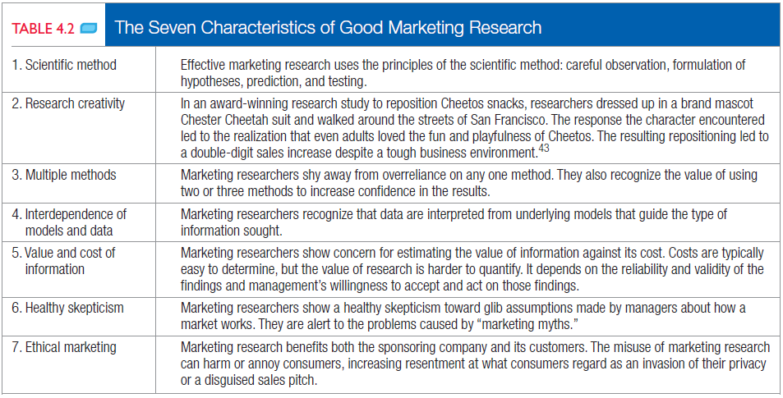
Barriers to the Effective Use of Marketing Research

Slide 40
Measuring Marketing Productivity
An important task of marketing research is to assess efficiency & effectiveness of marketing activities.
Marketers are increasingly being held accountable for their investments and must be able to justify marketing expenditures to senior management.
Two complementary approaches to measuring marketing productivity are;
Marketing Metrics, &
Marketing-mix Modeling

Slide 41
Measuring Marketing Productivity
MARKETING METRICS
It is a set of measures that helps marketers to quantify, compare, & interpret their marketing performance.
They can be used by brand managers to justify & design marketing programs & by senior management to decide on financial allocations.
Firms must give priority to measuring & reporting marketing performance through marketing metrics.

Slide 42
Measuring Marketing Productivity
Evaluation can be split into two parts;
SHORT-TERM RESULTS
They often reflect profit & loss concerns as shown by sales turnover, shareholder value, or some combination of two.

Slide 43
Measuring Marketing Productivity
Evaluation can be split into two parts;
CHANGES IN BRAND EQUITY
They could include
Customer awareness, attitudes, & behaviors;
Market share;
Relative price premium;
Number of complaints;
Distribution & availability;
Total number of customers;
Perceived quality, loyalty, & retention.

Slide 44
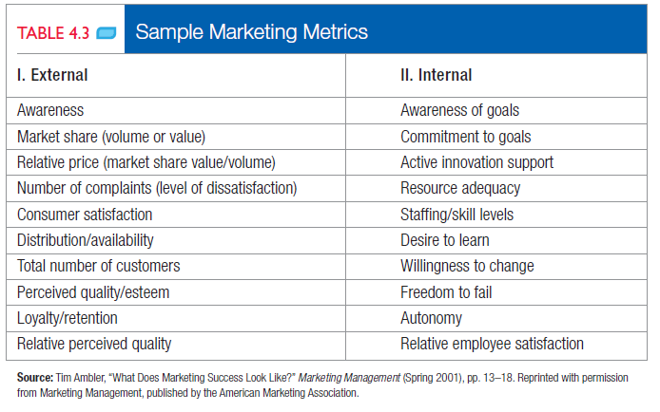
Measuring Marketing Productivity

Slide 45
Measuring Marketing Productivity
MARKETING-MIX MODELLING
Marketing mix models analyze data from a variety of sources, such as retailer scanning data, company shipment data, pricing, media, & promotion spending data, to understand more precisely the effects of specific marketing activities.
To deepen understanding, marketers can conduct multivariate analyses, such as regression analysis, to sort through how each marketing element influences marketing outcomes such as brand, sales or market share.

Slide 46
Measuring Marketing Productivity
MARKETING DASHBOARDS
Management can assemble a summary set of relevant internal & external measures in a marketing dashboard for synthesis & interpretation.
Marketing Dashboards are like the instrument panel in a car or plane, visually displaying real-time indicators to ensure proper functioning.
They are only as good as the info on which they’re based, but sophisticated visualization tools are helping bring data alive to improve understanding & analysis.

Slide 47
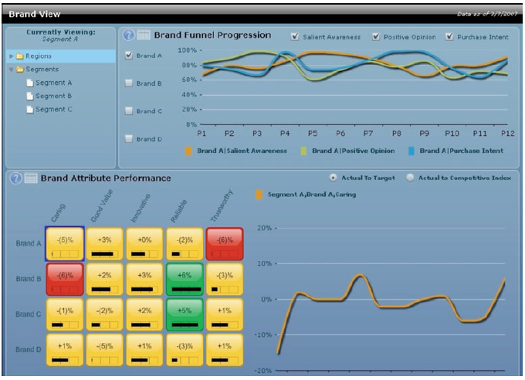
Measuring Marketing Productivity

Slide 48
Measuring Marketing Productivity
Companies should include two key market-based scorecards reflecting performance as input to the marketing dashboards;
A CUSTOMER-PERFORMANCE SCORECARD records how well the company is doing year after year on such customer-based performance, like the followings;
Percentage of new customers to average number of customers,
Percentage of lost customers to average number of customers,
Percentage of win-back customers to average number of customers, etc.

Slide 49
Measuring Marketing Productivity
Companies should include two key market-based scorecards reflecting performance as input to the marketing dashboards;
A STAKEHOLDER-PERFORMANCE SCORECARD tracks the satisfaction of various constituencies who have a critical interest in & impact on the company’s performance:
Employees, suppliers, banks, distributors, retailers, & stockholders.
Management should take action when one or more groups register increased or above-norm levels of dissatisfaction.

Slide 50
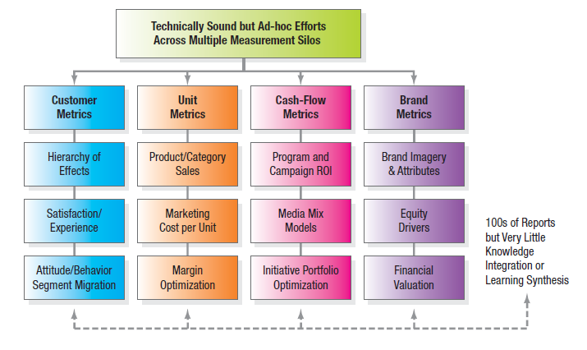
Measuring Marketing Productivity

Slide 51
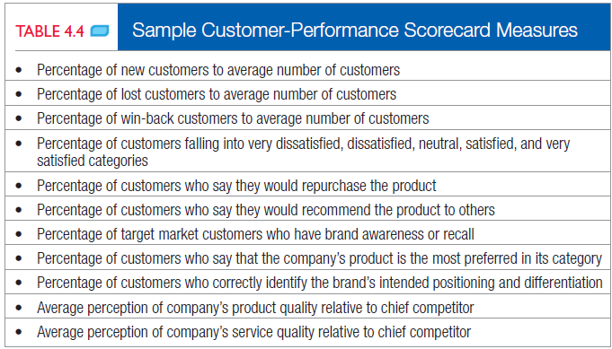
Measuring Marketing Productivity

Slide 52
The End

