Slide 1
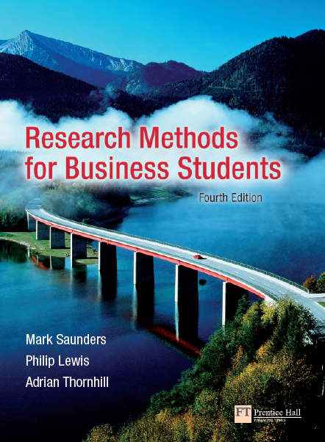

Slide 2

Instructor
Morteza Maleki, PhD

Slide 3
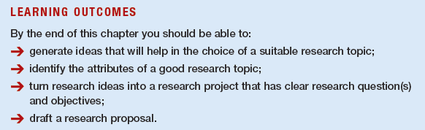

Slide 4
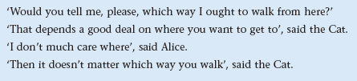
Without being clear about what you are going to research it is difficult to plan how you are going to research it.

Slide 5
If the researcher is undertaking the research project as part of a course of study, the most important attribute will be that it meets the examining body’s requirements and, in particular, that it is at the correct level.
The research topic must be something the researcher is capable of undertaking and one that excites the researcher’s imagination.
  Skills development
  Genuine Interest in the Title
  Financial & Time Resources
  The researcher must be reasonably certain of gaining access to any data he/she might need to collect.

Slide 6
For most topics, it is important that the issues within the research are capable of being linked to theory (Raimond, 1993).
One of the attributes of a good topic is clearly defined research questions and objectives.
  These will, along with a good knowledge of the literature, enable you to assess the extent to which your research is likely to provide fresh insights into the topic.

Slide 7
If you have already been given a research idea (perhaps by an organization) you will need to ensure that your questions and objectives relate clearly to the idea (Kervin, 1999).
It is also important that your topic will have a symmetry of potential outcomes:
  The results will be of similar value whatever the researcher finds out (Gill and Johnson, 2002).
  Whatever the outcome, the researcher needs to ensure he/she has the scope to write an interesting project report.

Slide 8
Finally, it is important to consider your career goals (Creswell, 2002).
  If you wish to become an expert in a particular subject area or industry sector, it is sensible to use the opportunity to develop this expertise.

Slide 9
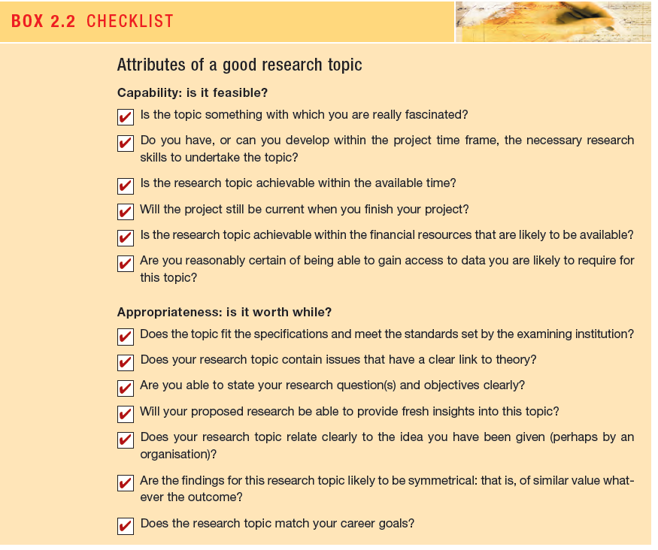

Slide 10
Generating Research Ideas
There is a range of techniques that can be used to find and select a topic that you would like to research:
  Rational Thinking
  Creative Thinking
These techniques will generate one of two outcomes:
  One or more possible project ideas that you might undertake;
  Absolute panic because nothing in which you are interested or which seems suitable has come to mind (Jankowicz, 2005).

Slide 11
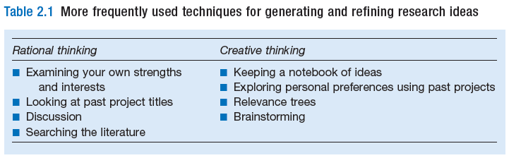

Slide 12
Examining Own Strengths and Interests
  It is important that the researchers choose a topic in which they are likely to do well and, if possible, already have some academic knowledge.
  Jankowicz (2005) suggests that one way of doing this is to look at those assignments for which the researchers have received good grades.
  In addition they may, as part of their reading, be able to focus more precisely on the sort of ideas about which they wish to conduct their research.

Slide 13
Looking at Past Project Titles
  A common way of looking at past projects is to scan a list of past project titles for anything that captures the researchers’ imagination.
    Titles that look interesting or which grab your attention should be noted down, as should any thoughts you have about the title in relation to your own research idea.
  In this process the fact that the title is poorly worded or the project report received a low mark is immaterial.
    What matters is the fact that you have found a topic that interests you.

Slide 14
Discussion
  Colleagues, friends and university tutors are all good sources of possible project ideas.
  Often project tutors will have ideas for possible student projects, which they will be pleased to discuss with you.
  Ideas can be obtained by talking to practitioners and professional groups (Gill and Johnson, 2002).

Slide 15
Searching the Literature
  Sharp et al. (2002) discuss types of literature that are of particular use for generating research ideas; these include:
    Articles in academic and professional journals;
    Reports;
    Books

Slide 16
Review Articles
  These articles contain both a considered review of the state of knowledge in that topic area and pointers towards areas where further research needs to be undertaken.
Reports
  Reports may also be of use;
  The most recently published are usually up to date and, again, often contain recommendations that may form the basis of your research idea.
Books
  Books by contrast are less up to date than other written sources;
  They do, however, often contain a good overview of research that has been undertaken, which may suggest ideas to you.

Slide 17
Keeping a Notebook of Ideas
  It involves simply noting down any interesting research ideas as you think of them and, of equal importance, what sparked off your thought.
    You can then pursue the idea using more rational thinking techniques later.

Slide 18
Exploring Personal Preferences using Past Projects
  To do this Raimond (1993) suggests that you:
    Select six projects that you like.
    For each of these six projects note down your first thoughts in response to three questions:
      What appeals to you about the project?
      What is good about the project?
      Why is the project good?
    Select three projects that you do not like.
    For each of these three projects note down your first thoughts in response to three questions
      What do you dislike about the project?
      What is bad about the project?
      Why is the project bad?

Slide 19
Relevance Trees
  Here, you start with a broad concept from which you generate further (usually more specific) topics.
    Each of these topics forms a separate branch from which you can generate further, more detailed sub-branches.
    As you proceed down the sub-branches more ideas are generated and recorded.

Slide 20
Brainstorming
  To brainstorm, Moody (1988) suggests that you:
    Define your problem – that is, the sorts of ideas you are interested in – as precisely as possible.
      In the early stages of formulating a topic this may be as vague as ‘I am interested in marketing but don’t know what to do for my research topic.’
    Ask for suggestions, relating to the problem.
    Record all suggestions, observing the following rules:
      No suggestion should be criticized or evaluated in any way before all ideas have been considered.
      All suggestions, however wild, should be recorded and considered.
      As many suggestions as possible should be recorded.

Slide 21
  Brainstorming (Con…)
  Review all the suggestions and explore what is meant by each.
  Analyse the list of suggestions and decide which appeal to you most as research ideas and why.

Slide 22
Refining Research Ideas
  The Delphi Technique
    This involves using a group of people who are either involved or interested in the research idea to generate and choose a more specific research idea (Robson, 2002).
To use this technique you need:
  To brief the members of the group about the research idea (they can make notes if they wish);
  At the end of the briefing to encourage group members to seek clarification and more information as appropriate;

Slide 23
  To ask each member of the group, including the originator of the research idea, to generate independently up to three specific research ideas based on the idea that has been described (they can also be asked to provide a justification for their specific ideas);
  To collect the research ideas in an unedited and non-attributable form and to distribute them to all members of the group;
  Second cycle of the process (steps 2 to 4) in which individuals comment on the research ideas and revise their own contributions in the light of what others have said;
  Subsequent cycles of the process until a consensus is reached.
    These either follow a similar pattern (steps 2 to 4) or use discussion, voting or some other method.

Slide 24
  The Preliminary Study
    Even if you have been given a research idea, it is still necessary to refine it in order to turn it into a research project.
      Some authors, for example Bennett (1991), refer to this process as a preliminary study.
    For some research ideas, this will be no more than a review of some of the literature.
      This can be thought of as the first iteration of your critical literature review.
    For others, it may include revisiting the techniques discussed earlier in this section as well as informal discussions with people who have personal experience of and knowledge about your research ideas.

Slide 25
  Integrating Ideas
  Jankowicz (2005) suggests a process called ‘working up and narrowing down’.
  It involves classifying each research idea first into its area, then its field, and finally the precise aspect in which you are interested.
    These represent an increasingly detailed description of the research idea.
For example, your initial area, based on examining your course work, might be accountancy.
After browsing some recent journals and discussion with colleagues this becomes more focused on the field of financial accounting methods.
With further reading, the use of the Delphi technique and discussion with your project tutor you decide to focus on the aspect of activity-based costing.

Slide 26
  Refining Topics given by your Employing Organization
  If, as a part-time student, your manager gives you a topic, this may present particular problems; you therefore need to achieve a balance.
    It may be something in which you are not particularly interested.
    You will have to weigh the advantage of doing something useful to the organization against the disadvantage of a potential lack of personal motivation.
  Often the project your manager wishes you to undertake is larger than that which is appropriate for your course project.
    It may be possible to complete both by isolating an element of the larger organizational project that you find interesting and treating this as the project for your course.

Slide 27
Writing Research Questions
  One of the key criteria of your research success will be whether you have a set of clear conclusions drawn from the data you have collected.
    The extent to which you can do that will be determined largely by the clarity with which you have posed your initial research questions.
  Defining research questions is not a straightforward matter.
  It is important that the question is sufficiently involved to generate the sort of project that is consistent with the standards expected of you.
    Selecting too easy or too difficult research questions is strongly prohibited.

Slide 28
  Clough and Nutbrown (2002) use what they call the ‘Goldilocks test’ to decide if research questions are either ‘too big’, ‘too small’, ‘too hot’ or ‘just right’.
  Questions that are too big probably need significant research funding because they demand too many resources.
  Questions that are too small are likely to be of insufficient substance.
  Questions that are too ‘hot’ may be so because of sensitivities that may be aroused as a result of doing the research.
  Research questions that are ‘just right’, are those that are ‘just right for investigation at this time, by this researcher in this setting’.

Slide 29
  McNiff and Whitehead (2000) make the point that the research question may not emerge until the research process has started and is therefore part of the process of ‘progressive illumination’.
    They note that this is particularly likely to be the case in practitioner action research.

Slide 30
  It is often a useful starting point in the writing of research questions to begin with one general focus research question that flows from your research idea.
    This may lead to several more detailed questions or the definition of research objectives.

Slide 31
Writing research objectives
  Research Objectives are more generally acceptable to the research community as evidence of the researcher’s clear sense of purpose and direction.
  They are likely to lead to greater specificity than research or investigative questions.
    Research objectives require more rigorous thinking, which derives from the use of more formal language.

Slide 32
Maylor and Blackmon (2005) recommend that personal objectives may be added to the list of research objectives.
  These may be concerned with your specific learning objectives from completion of the research (e.g. to learn how to use a particular statistical software package or improve your word processing ability) or more general personal objectives such as enhancing your career prospects through learning about a new field of your specialism.
Maylor and Blackmon suggest that such personal objectives would be better were they to pass the well-known SMART test.

Slide 33
  Specific. What precisely do you hope to achieve from undertaking the research?
  Measurable. What measures will you use to determine whether you have achieved your objectives? (e.g. secured a career-level first job in software design).
  Achievable. Are the targets you have set for yourself achievable given all the possible constraints?
  Realistic. Given all the other demands upon your time, will you have the time and energy to complete the research on time?
  Timely. Will you have time to accomplish all your objectives in the time frame you have set?

Slide 34
The Importance of Theory in Writing Research Questions and Objectives
  Theory is defined by Gill and Johnson (2002:229) as ‘a formulation regarding the cause and effect relationships between two or more variables, which may or may not have been tested’.

Slide 35
Some examples of theories within organizations:
  Classical Management Theory
    Henry Fayol (1841-1925, France)
    FW Taylor (1856-1915, The Unites)
    Max Weber (1864-1924, Germany)
  Human Relations Theory
    Elton Mayo (1933)
    Hawthorn Studies (1924-1932)
  Neo-human Relations Theory
    Maslow
    McGregor
    Herzberg
    Likert
    Argyris
  System Theory
    Bertalanffy’s (1951) basic work 'General Systems Theory'.
    Sociologists like Niklas Luhmann (1994)
    Miller and Rice (1967) likened the commercial and industrial organisation to biological organisms.

Slide 36
Clarifying what theory is not
Sutton and Staw (1995) make a useful contribution to the clarification of what theory is by defining what it is not.
  References. Listing references to existing theories and mentioning the names of such theories may look impressive.
    But what is required if a piece of writing is to ‘contain theory’ is that a logical argument to explain the reasons for the described phenomena must be included.
  The key word here is ‘why’: why did the things you describe occur? What is the logical explanation?

Slide 37
  Data. Sutton and Staw argue that data merely describe which empirical patterns were observed: theory explains why these patterns were observed or are expected to be observed.
    ‘The data do not generate theory – only researchers do that’ (Sutton and Staw, 1995:372).
  Lists of variables. Sutton and Staw argue that a list of variables which constitutes a logical attempt to cover the determinants of a given process or outcome do not comprise a theory.
    Simply listing variables which may predict an outcome is insufficient.
    What is required for the presence of theory is an explanation of why predictors are likely to be strong predictors.

Slide 38
  Diagrams. Boxes and arrows can add order to a conception by illustrating patterns and causal relationships but they rarely explain why the relationships have occurred.
    Sutton and Staw (1995:374) note that ‘a clearly written argument should preclude the inclusion of the most complicated figures – those more closely resembling a complex wiring diagram than a comprehensible theory’.
  Hypotheses or predictions. Hypotheses can be part of a sound conceptual argument.
    But they do not contain logical arguments about why empirical relationships are expected to occur.

Slide 39
Sutton and Staw (1995:375) sum up by stating that
  “Theory is about the connections between phenomena, a story about why events, structure and thoughts occur.
  Theory emphasizes the nature of causal relationships, identifying what comes first as well as the timing of events.
  Strong theory, …, delves into underlying processes so as to understand the systematic reasons for a particular occurrence or nonoccurrence”.

Slide 40
Whetten (1989) contends that if the presence of theory is to be guaranteed, the researcher must ensure that what is passing as good theory includes a plausible, coherent explanation for why certain relationships should be expected in our data.
The definition demonstrates that ‘theory’ has a specific meaning.
  It refers to situations where if A is introduced B will be the consequence.
Therefore the marketing manager may theorize that the introduction of loyalty cards by a supermarket will lead to customers being less likely to shop regularly at a competitor supermarket.

Slide 41
Every purposive decision we take is based on theory: that certain consequences will flow from the decision.
… every managers’ meeting that features a number of decisions will be a meeting that is highly theory dependent (Gill and Johnson, 2002).
Kerlinger and Lee (2000) the purpose of examining relationships between two or more variables is to explain and predict these relationships.
Gill and Johnson (2002:33) neatly tie these purposes of theory to their definition:

Slide 42
Mackenzie (2000a, 2000b) believe that much research yield ambiguous conclusions because they only ask questions which reveal the state of affairs as they exist.
What they do not ask is questions which help those using the research results to draw meaningful conclusions as to why the state of affairs is as it is.
  If meaningful conclusions cannot be drawn, then appropriate actions cannot be taken to remedy such deficiencies that the research reveals.

Slide 43
Phillips and Pugh (2005) distinguish between research and what they call intelligence gathering, using what Mackenzie (2000a, 2000b) calls ‘knobless items’, which is just the gathering of facts.
  What is the relative proportion of undergraduates to postgraduates reading this book?
  What is the current spend per employee on training in the UK?
  What provision do small businesses make for bad debts?
This is often called descriptive research and may form part of your research project.

Slide 44
Phillips and Pugh contrast such ‘what’ questions with ‘why’ questions.
  Why do British organizations spend less per head on training than German organizations?
  Why are new car purchasers reluctant to take out extended warranties on their vehicles?
  Why do some travelers still prefer to use cross-channel ferries as opposed to the Channel Tunnel?
Such questions go ‘beyond description and require analysis’.
They look for ‘explanations, relationships, comparisons, predictions, generalizations and theories’ (Phillips and Pugh, 2005:48).

Slide 45
Although intelligence gathering will play a part in your research, it is unlikely to be enough.
You should be seeking to explain phenomena, to analyze relationships, to compare what is going on in different research settings, to predict outcomes and to generalize; then you will be working at the theoretical level.

Slide 46
Creswell (2002) talks of ‘grand theories’, usually thought to be the province of the natural scientists (e.g. Darwin and Newton).
He contrasts these with ‘middle-range theories’, which lack the capacity to change the way in which we think about the world but are nonetheless of significance.
  Some of the theories of human motivation well known to managers would be in this category.
Most of us are concerned with ‘substantive theories’ that are restricted to a particular time, research setting, group or population or problem.

Slide 48
Writing a research proposal is a crucial part of the research process.
If you are applying for research funding, or if your proposal is going before an academic research committee, then you will know that you will need to put a great deal of time into the preparation of your proposal.
However, even if the official need for a proposal is not so vital it is still a process that will repay very careful attention.

Slide 49
The purposes of the research proposal
  Organising your ideas
  Convincing your audience
  Contracting with your ‘client’

Slide 50
  Organising your ideas
  Writing can be the best way of clarifying our thoughts.
  This is a valuable purpose of the proposal.
  Not only will it clarify your thoughts but it will help you to organise your ideas into a coherent statement of your research intent.

Slide 51
Convincing your audience
  However coherent your ideas and exciting your research plan, it counts for little if the proposal reveals that what you are planning to do is simply not possible.
  As part of research methods courses many tutors ask students to draft a research proposal.
  This is then discussed with a tutor.
    What usually happens is that this discussion is about how the proposed research can be amended so that something more modest in scope is attempted.
    Initially work that is not achievable in the given timescale is proposed.
    The student’s task is to amend their initial ideas and convince the module tutor that the proposed research is achievable within the time and other resources available.

Slide 52
Contracting with your ‘client’
  Acceptance of your proposal by the client would be part of the contract that existed between you.
  So it is with your proposal to your project tutor or academic committee.
  Acceptance implies that your proposal is satisfactory.
  While this is obviously no guarantee of subsequent success, it is something of comfort to you to know that at least you started your research journey with an appropriate destination and journey plan.
  It is for you to ensure that you do not get lost!

Slide 53
The content of the research proposal
  Title
  Background
  Research questions and objectives
  Method
  Timescale
  Resources
  References

Slide 54
Criteria for evaluating research proposals
  The extent to which the components of the proposal fit together
  The viability of the proposal
  The absence of preconceived ideas

Slide 55
The End

