Slide 1
Instructor
Morteza Maleki, PhD

Slide 2
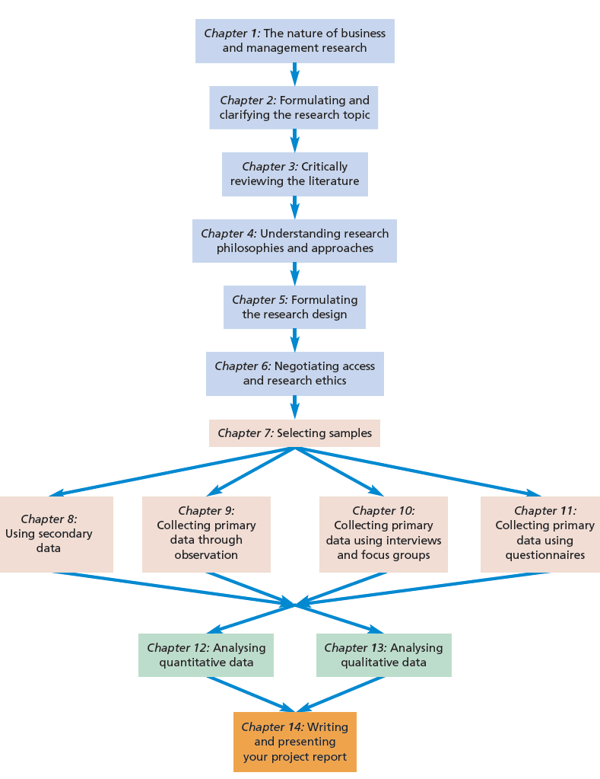

Slide 4
Questions of research methods are of secondary importance to questions of which paradigm is applicable to your research (Guba and Lincoln, 1994).
Paradigm is the basic belief system or world view that guides the investigation, not only in choices of method but in ontologically and epistemologically fundamental ways.
Notes:
paradigm = پارادایم، الگو

Slide 5
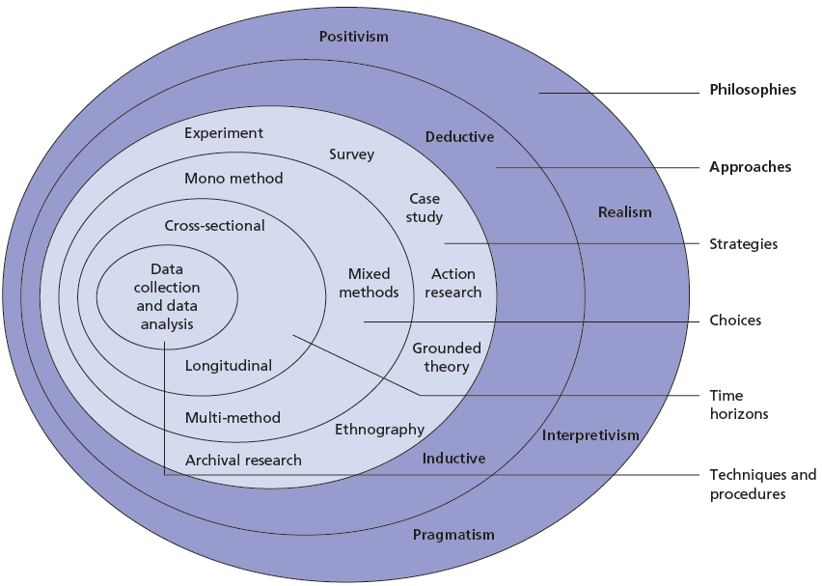

Slide 6
Understanding Research Philosophy why research philosophy is important?
Research Philosophy relates to the development of knowledge and the nature of that knowledge.
As business and management researchers, we need to be aware of the philosophical commitments we make through our choice of research strategy since this has significant impact not only on what we do but we understand what it is we are investigating.
The relationship between knowledge and the process by which it is developed

Slide 7
Understanding Research Philosophy why research philosophy is important?
A particular research question rarely falls neatly into only one philosophical domain as suggested in the ‘onion’.
But what practical use is an understanding of your philosophical position?
It is of practical benefit to understand the taken-for-granted assumptions that we all have about the way the world works.

Slide 8
Pragmatism: do you have to adopt one position?
Pragmatism argues that the most important determinant of the epistemology, ontology and axiology you adopt is the research question;
One may be more appropriate than the other for answering particular questions.
It avoids the researcher engaging in what they see as rather pointless debates about such concepts as truth and reality (Tashakkori and Teddlie, 1998).
You should study what interests you and is of value to you, study in the different ways in which you deem appropriate, and use the results in ways that can bring about positive consequences within your value system (Tashakkori and Teddlie 1998)
Notes:
Pragmatism = مصلحت گرایی، فسفه عملی ontology = هستی شناسی axiology = ارزش شناسی

Slide 9
Ontology what assumptions do we make about the way in which the world works?
Ontology is concerned with nature of reality.
This raises questions of the assumptions researchers have about the way the world operates and the commitment held to particular view.
The two aspects of ontology include:
Objectivism portrays the position that social entities exist in reality external to social actors concerned with their existence.
Subjectivism holds that social phenomena are created from the perceptions and consequent actions of those social actors concerned with their existence.
Notes:
Objectivism = مادی گرایی Subjectivism = ذهن گرایی

Slide 10
Ontology what assumptions do we make about the way in which the world works?
Remenyi et al. (1998:35) stress the necessity to study ‘the details of the situation to understand the reality or perhaps a reality working behind them’.
Social Constructionism, which follows from the interpretivist philosophy that it is necessary to explore the subjective meanings motivating the actions of social actors in order for the researcher to be able to understand these actions.
For instance, individual customers will perceive different situations in varying ways as a consequence of their own view of the world.
These different interpretations are likely to affect their actions and the nature of their social interaction with others.
Notes:
Social Constructionism = ساختار گرایی اجتماعی interpretivist philosophy = فلسفه تفسیرگرایی

Slide 11
Ontology what assumptions do we make about the way in which the world works?
Smircich (1983) noted that objectivists would tend to view the culture of an organization as something that the organization ‘has’.
YET, the subjectivist’s view would be that culture is something that the organization ‘is’ as a result as a process of continuing social enactment.

Slide 12
Ontology what assumptions do we make about the way in which the world works?
Management theory and practice has leaned towards treating organization culture as a variable, something that the organization ‘has’:
Something that can be manipulated, changed in order to produce the sort of state desired by managers.
The subjectivist viewpoint, however, argue that culture is something that is created and re-created through a complex array of phenomena which include social interactions and physical factors such as office layout to which individuals attach certain meanings, rituals and myths.
It is the meanings that are attached to these phenomena by social actors within the organization that need to be understood in order for the culture to be understood.

Slide 13
Epistemology what is acceptable knowledge in a particular field of study?
Epistemology concerns what constitutes acceptable knowledge in a field of study, which is of three types:
Positivism
Realism
Interpretivism
Notes:
Epistemology = معرفت شناسی

Slide 14
Epistemology what is acceptable knowledge in a particular field of study?
Positivism
The positivists prefer ‘working with an observable social reality and that the end product of such research can be law-like generalizations similar to those produced by the physical and natural scientists’ (Remenyi et al. 1998:32).
Only phenomena that you can observe will lead to the production of credible data.
To generate a research strategy to collect these data, you are likely to use existing theory to develop hypotheses.
These hypotheses will be tested and confirmed, in whole or part, or refuted, leading to the further development of theory which then may be tested by further research.
Notes:
Positivism = فلسفه عملی و مثبت

Slide 15
Epistemology what is acceptable knowledge in a particular field of study?
In positivist approach, research is undertaken, as far as possible, in a value-free way.
The researcher is independent of and neither affects nor is affected by the subject of the research’ (Remenyi et al. 1998:33).
They will be likely to use a highly structured methodology in order to facilitate replication (Gill and Johnson 2002).
The emphasis will be on quantifiable observations that lend themselves to statistical analysis.

Slide 16
Epistemology what is acceptable knowledge in a particular field of study?
Realism
This approach posits that what the senses show us as reality is the truth: that objects have an existence independent of the human mind.
There is a reality quite independent of the mind.
In this sense, realism is opposed to idealism, the theory that only the mind and its contents exist.

Slide 17
Epistemology what is acceptable knowledge in a particular field of study?
There are two types of realism
Direct Realism
Direct realism says that what you see is what you get: what we experience through our senses portrays the world accurately.
Critical Realism
Critical realism argues that what we experience are sensations, the images of the things in the real world, not the things directly.
Critical realists point out how often our senses deceive us.

Slide 18
Epistemology what is acceptable knowledge in a particular field of study?
Critical realism claims that there are two steps to experiencing the world.
There is the thing itself and the sensations it conveys.
There is the mental processing that goes on sometime after that sensation meets our senses.
Direct realism says that the first step is enough.

Slide 19
Epistemology what is acceptable knowledge in a particular field of study?
Interpretivism
Interpretivism advocates that it is necessary for the researcher to understand differences between humans in our role as social actors.
This emphasizes the difference between conducting research among people rather than objects such as trucks and computers.
Notes:
Interpretivism

Slide 20
Epistemology what is acceptable knowledge in a particular field of study?
The heritage of this strand of interpretivism comes from two intellectual traditions:
Phenomenology
It refers to the way in which we as humans make sense of the world around us.
Symbolic interactionism
Here, we are in a continual process of interpreting the social world around us
We interpret the actions of others with whom we interact and this interpretation leads to adjustment of our own meanings and actions.
Notes:
Phenomenology = پدیده شناسی Symbolic interactionism = کنش متقابل نمادین

Slide 21
Axiology what roles do our values play in our research choices?
Axiology is a branch of philosophy that studies judgments about value.
The role that your own values play in all stages of the research process is of great importance if you wish your research results to be credible.
Heron (1996) argues that our values are the guiding reason of all human action.
Researchers demonstrate axiological skill by being able to articulate their values as a basis for making judgments about what research they are conducting and how they go about doing it.
Notes:
Axiology = علم ارزش ها

Slide 22
Axiology what roles do our values play in our research choices?
There is the possibility of writing your own statement of personal values in relation to the topic you are studying.
This may be more evidently applicable to some research topics than others.
For instance, those topics concerned with personal career development may be obvious candidates for this process.

Slide 23
Axiology what roles do our values play in our research choices?
A statement of values may be of use both to you as the researcher and those parties with whom you have contact in your research.
The use to you would be a result of your ‘being honest with yourself’ about quite what your values are, which might heighten your awareness of value judgements
Other relevant parties connected with your research may include any fellow researchers, your supervisor and the university research ethics committee.
Being clear about your own value position may help you in deciding what is appropriate ethically and arguing your position in the event of queries about decisions you have made.

Slide 24
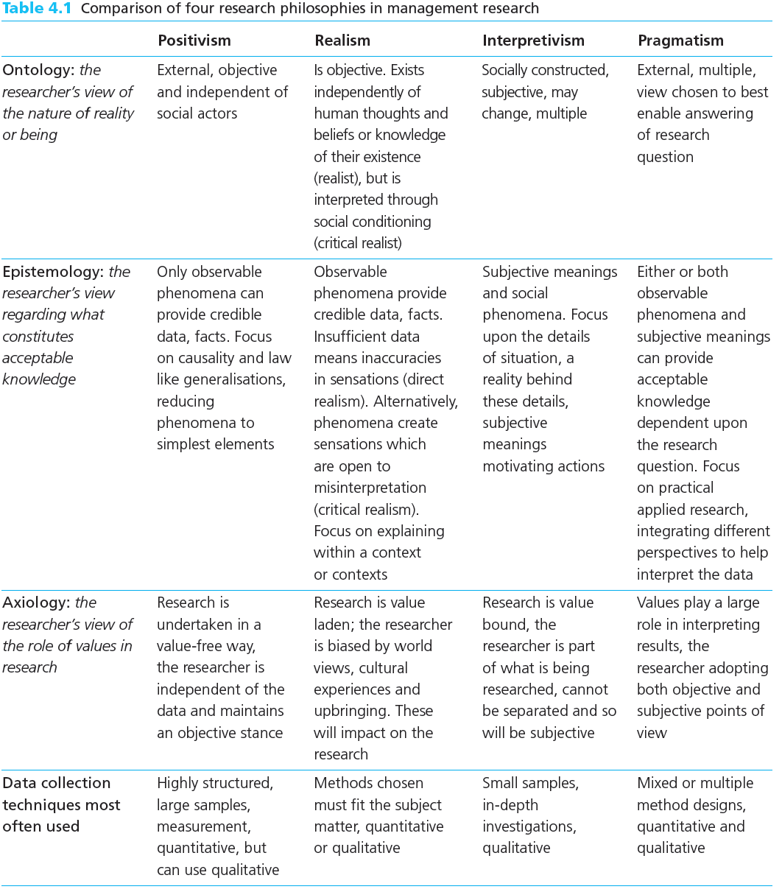

Slide 25
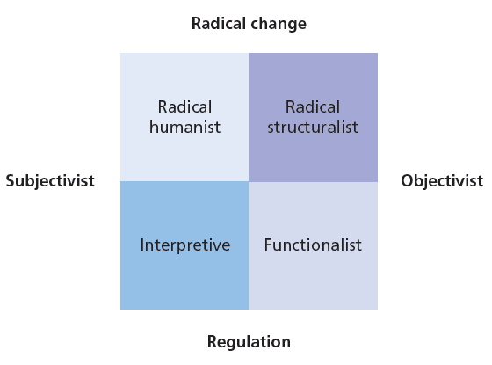
Research paradigms
A paradigm is a way of examining social phenomena from which particular understandings of these phenomena can be gained and explanations attempted.

Slide 26
Research paradigms
Radical change relates to a judgement about the way organizational affairs should be conducted and suggests ways in which these affairs may be conducted in order to make fundamental changes to the normal order of things.
Regulation seeks to explain the way in which organizational affairs are regulated and offer suggestions as to how they may be improved within the framework of the way things are done at present.

Slide 27
Research paradigms
Burrell and Morgan (1982) note that the purposes of the four paradigms are:
To help researchers clarify their assumptions about their view of the nature of science and society;
To offer a useful way of understanding the way in which other researchers approach their work;
To help researchers plot their own route through their research;
To understand where it is possible to go and where they are going.

Slide 28
Research paradigms
Functionalist Paradigm
This is located on the objectivist and regulatory dimensions.
It is regulatory in that you will probably be more concerned with a rational explanation of why a particular organizational problem is occurring and developing a set of recommendations set within the current structure of the organization's current management.
It is often problem-oriented in approach, concerned to provide practical solutions to practical problems (Burrell and Morgan, 1982).
For instance, an evaluation study of a communication strategy to assess its effectiveness and make recommendations as to the way in which it may be made more effective.

Slide 29
Research paradigms
Interpretive Paradigm
The philosophical position to which this refers (interpretivism) is the way we as humans attempt to make sense of the world around us.
The concern you would have working within this paradigm would be to understand the fundamental meanings attached to organizational life.
Far from emphasizing rationality, it may be that the principal concern you have here is discovering irrationalities.
Burrell and Morgan (1982) note that everyday life is accorded the status of a miraculous achievement.
Your concern here would not be to achieve change in the order of things, it would be to understand and explain what is going on.

Slide 30
Research paradigms
Radical Humanist Paradigm
The radical change dimension adopts a critical perspective on organizational life.
Working within this paradigm you would be concerned with changing the status quo, or in Burrell and Morgan’s (1979:32) words ‘to articulate ways in which humans can transcend the spiritual bonds and fetters which tie them into existing social patterns and thus realize their full potential’.

Slide 31
Research paradigms
Radical Structuralist Paradigm
Here your concern would be to approach your research with a view to achieving fundamental change based upon an analysis of such organizational phenomena as power relationships and patterns of conflict.
It is involved with structural patterns with work organizations such as hierarchies and reporting relationships and the extent to which these may produce dysfunctionalities.

Slide 32
Research approaches
Research Approaches
The extent to which you are clear about the theory at the beginning of your research raises an important question concerning the design of your research project.
This is whether your research should use the deductive approach, in which you develop a theory and hypotheses and design a research strategy to test the hypothesis, or the inductive approach, in which you would collect data and develop theory as a result of your data analysis.
Insofar as it is useful to attach these research approaches to the different research philosophies, deduction owes more to positivism and induction to interpretivism.

Slide 33
Research approaches
Deduction: Testing Theory
Deduction involves the development of a theory that is subjected to a rigorous test.
It is the dominant research approach in the natural sciences, where laws present the basis of explanation, allow the anticipation of phenomena, predict their occurrence and therefore permit them to be controlled (Collis and Hussey 2003).

Slide 34
Research approaches
Robson (2002) lists five sequential stages through which deductive research will progress:
Deducing a hypothesis (a testable proposition about the relationship between two or more concepts or variables) from the theory;
Expressing the hypothesis in operational terms (that is, indicating exactly how the concepts or variables are to be measured), which propose a relationship between two specific concepts or variables;

Slide 35
Research approaches
Testing this operational hypothesis
Examining the specific outcome of the inquiry (it will either tend to confirm the theory or indicate the need for its modification);
If necessary, modifying the theory in the light of the findings.
An attempt is then made to verify the revised theory by going back to the first step and repeating the whole cycle.

Slide 36
Research approaches
Characteristics of Deduction
First, there is the search to explain causal relationships between variables.
To test this hypothesis, you utilize another characteristic, the collection of quantitative data.
Therefore you would need to employ a further important characteristic of deduction approach, controls to allow the testing of hypotheses.
Your research would use a highly structured methodology to facilitate replication (Gill and Johnson, 2002).

Slide 37
Research approaches
In order to pursue the principle of scientific rigor, deduction dictates that the researcher should be independent of what is being observed.
An additional important characteristic of deduction is that concepts need to be operationalized in a way that enables facts to be measured quantitatively.
Here, the principle of reductionism is applied;
This holds that problems as a whole are better understood when they are reduced to the simplest possible elements.
The final characteristic of deduction is generalization.
In order to be able to generalize statistically about regularities in human social behavior it is necessary to select samples of sufficient numerical size.

Slide 38
Research approaches
Induction: Building Theory
The emergence of the social sciences in the 20th century led social science researchers to be wary of deduction.
They were critical of an approach that enabled a cause–effect link to be made between particular variables without an understanding of the way in which humans interpreted their social world.
Developing such an understanding is, of course, the strength of an inductive approach.
Followers of induction would also criticize deduction because of its tendency to construct a rigid methodology that does not permit alternative explanations of what is going on.

Slide 39
Research approaches
Research using an inductive approach is likely to be particularly concerned with the context in which such events were taking place.
Therefore, the study of a small sample of subjects might be more appropriate than a large number as with the deductive approach.
Researchers in this tradition are more likely to work with qualitative data and to use a variety of methods to collect these data in order to establish different views of phenomena (Easterby-Smith et al. 2008).

Slide 40
Research approaches
Why is the choice that I make about my research approach important?
First, it enables you to take a more informed decision about your research design.
It is the overall configuration of a piece of research involving questions about what kind of evidence is gathered and from where, and how such evidence is interpreted in order to provide good answers to your initial research question.
Second, it will help you to think about those research strategies and choices that will work for you and, crucially, those that will not.
Third, knowledge of the different research traditions enables you to adapt your research design to cater for constraints.

Slide 41
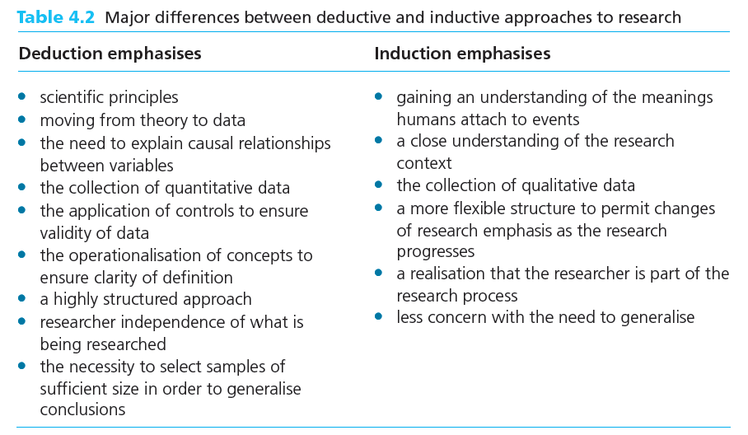
Research approaches

Slide 42
The End

