Slide 1
Instructor
Morteza Maleki, PhD

Slide 3
Components of a Modern Marketing Information Systems
The major responsibility for identifying significant marketplace changes falls to the company’s marketers;
They have disciplined methods for collecting info,
They spend more time than anyone else interacting with customers & observing competition & other outside firms & groups.

Slide 4
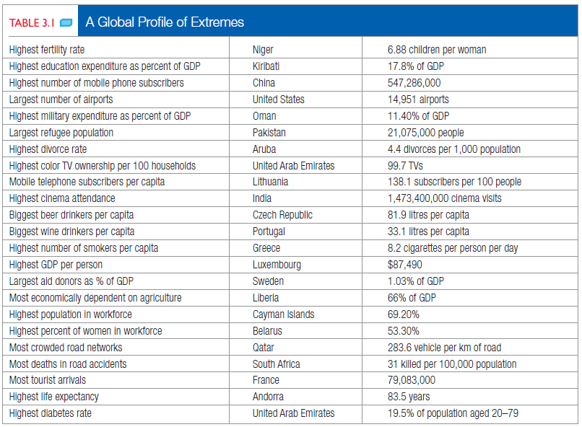
Components of a Modern Marketing Information Systems

Slide 5
Components of a Modern Marketing Information Systems
Some managers complain about
Not knowing how to get hold of critical information,
Getting too much information that they can not use & too little that they really need, &
Getting important info too late.

Slide 6
Components of a Modern Marketing Information Systems
Companies with superior info enjoy a competitive advantage.
They can choose their markets better,
They can develop better offerings, &
They can execute better marketing planning.

Slide 7
Components of a Modern Marketing Information Systems
Marketing Information System (MIS)
Every firm must organize & distribute a continuous flow of info to its marketing managers.
MIS consists of people, equipment, & procedures to gather, sort, analyze, evaluate, & distribute needed, timely, & accurate info to marketing decision makers.
It relies on internal company’s records, marketing intelligence activities, & marketing research.
The company’s MIS should be a cross between
What managers think they need,
What they really need, &
What is economically feasible.

Slide 8
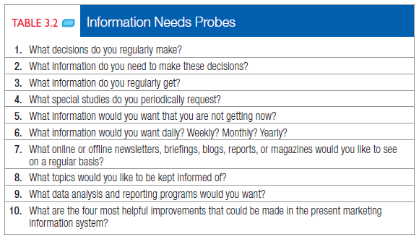
Components of a Modern Marketing Information Systems

Slide 9
Internal Records
Marketing managers rely on internal reports of orders, sales, prices, costs, inventory levels, receivables, payables, & so on, by which they can spot important opportunities & problems.

Slide 10
Internal Records
Order-to-Payment Cycle
The heart of the internal record system is the order-to-payment cycle.
Sales representatives, dealers, & customers send orders to firm.
The sales department prepares invoices, transmit copies to various departments, & back-orders out-of-stock items.
Shipped items generate shipping & billing documents that go to various departments.
Companies need to perform these steps quickly & accurately, because customers favor firms that can promise timely delivery.
Companies are using the Internet & extranets to improve the speed, accuracy, & efficiency of the order-to-payment cycle.

Slide 11
Internal Records
Sales Information Systems
Marketing managers need timely & accurate reports on current sales.
Wal-Mart, for instance, operates a sales & inventory data warehouse that captures data on every item, for every customer, for every store, every day, and refreshes it every hour.
Technological gadgets are revolutionizing sales info systems & allowing representatives to have up-to-second information.

Slide 12
Internal Records
Sales Information Systems
Companies must carefully interpret the sales data so as not to draw the wrong conclusions;
Michael Dell gave this illustration:
“If you have three yellow mustangs sitting on a dealer’s lot & a customer wants a red one, the salesman maybe really good at figuring out how to sell the yellow mustang. So the yellow mustang gets sold, & the signal gets sent back to the factory that, hey, people want yellow mustang.”

Slide 13
Internal Records
Database, Data Warehousing, & Data Mining
Today, companies organize their info into databases—customer databases, product databases, salesperson databases--& then combine data from the different databases.
A company can rank its customers according to purchase recency, frequency, & monetary value (RFM) & send the new offers to only the highest scoring customers.
Besides saving on mailing expenses, this manipulation of data can often achieve a double-digit response rate.

Slide 14
Internal Records
Database, Data Warehousing, & Data Mining (con..)
By hiring analysts skilled in sophisticated statistical methods, companies can “mine” the data & garner fresh insights into neglected customer segments, recent customer trends, & other useful information.

Slide 15
Marketing Intelligence
The internal records system supplies results data, but the marketing intelligence system supplies happenings data.
The Marketing Intelligence Systems (MIS) is a set of procedures & sources managers use to obtain everyday info about developments in the marketing environment.

Slide 16
Marketing Intelligence
Marketing managers collect marketing intelligence by
Reading books, newspapers, & trade publications,
Talking to customers, suppliers, and distributors,
Monitoring “social media” on the Internet via online discussion groups,
E-mailing lists & blogs, &
Meeting with other company managers.

Slide 17
Marketing Intelligence
A company can take several steps to improve the quality of its marketing intelligence;
Train & motivate the sales force to spot & report new developments,
Motivate distributors, retailers, & other intermediaries to pass along important intelligence,
Network externally,
Set up a customer advisory panel,
Take advantage of government data resources,
Purchase info from outside suppliers
Use online customer feedback systems to collect competitive intelligence

Slide 18
Analyzing the Macro-Environment
NEEDS & TRENDS
Enterprising individuals & companies manage to create solutions to unmet customer needs.
There is difference between fads, trends, & megatrends;
A FAD is unpredictable, short-lived & without social, economic, & political significance;
The company can cash on them, yet getting it right is more a matter of luck & good timing than anything else.

Slide 19
Analyzing the Macro-Environment
A TREND is a direction or sequence of events that has some momentum & durability.
Trends are more predictable & durable than fads; a trend reveals the shape of future & provides many opportunities.
A MEGATREND has been described as large social, economic, political, & technological changes that are slow to form, & once in place, they influence us for some time—between seven to ten years, or longer.

Slide 20
Analyzing the Macro-Environment
IDENTIFYING THE MAJOR FORCES
Macro-environmental forces & trends are “non-controllable”, which the company must monitor & to which it must respond.
A series of challenges firms face are;
The steep decline of the stock market, which affected savings, investment, & retirement funds,
Increasing unemployment,
Corporate scandals, &
The rise of terrorism

Slide 21
Analyzing the Macro-Environment
Hence, the firms must monitor six major forces;
Demographic Environment,
Economic Environment,
Social-cultural Environment,
Natural Environment,
Technological Environment, &
Political-legal Environment

Slide 22
Analyzing the Macro-Environment
The Demographic Environment
The main demographic force that marketers monitor is population, because people make up markets.
Marketers are keenly into
The size & growth rate of population in cities, regions, & nations,
Age distribution & ethnic mix,
Educational levels,
Household patterns, &
Regional characteristics & movements

Slide 23
Analyzing the Macro-Environment
ECONOMIC ENVIRONMENT
The available purchasing power in an economy depends on current income, prices, savings, debt, & credit availability.
Marketers must pay careful attention to trends affecting purchasing power, because they can have strong impact on business, especially for companies whose products are geared to high-income & price-sensitive consumers.

Slide 24
Analyzing the Macro-Environment
Income Distribution
The marketers need to understand the distribution of income to reach more meaningful conclusions about taking specific decisions.
Changes in economic well-being of the population creates opportunities for companies in terms of higher demand for existing products & services as well as for new offers.
For several product categories, the demand is likely to increase as a result of growth in income & the number of households with greater purchasing powers.

Slide 25
Analyzing the Macro-Environment
SOCIAL-CULTURAL ENVIRONMENT
Society shapes the beliefs, values, & norms that largely define consumer tastes & preferences.
People have a world view that, almost unconsciously, defines their relationships to themselves, to others, to organizations, to society, to nature & to the universe.
Values, attitudes, & aspirations of people vary significantly across different customer groups & regions.
This implies the need to conduct customized research on consumption behavior & attitudes, specific to products & services that the marketer is interested in.
Each element of marketing decision needs to be fine-tuned to reflect the needs, aspirations, & attitudes of consumers who show distinctiveness in preferences & habits across consumer segments.

Slide 26
Analyzing the Macro-Environment
NATURAL ENVIRONMENT
The deterioration of the natural environment is a major global problem.
Consumers often appear conflicted about product decisions that affect the natural environment.
One research study showed that although 80% of U.S. consumers said environmental safety influenced their decision to buy a product, only a little over half asserted that they bought recycled or environmentally safe products.

Slide 27
Analyzing the Macro-Environment
Corporate environmentalism is the recognition of the importance of environmental issues facing the firm and the integration of those issues into the firm’s strategic plans.
Marketers practicing corporate environmentalism need to be aware of the threats & opportunities associated with four major trends in the natural environment;
The shortage of raw materials, especially water,
The increased cost of energy,
Increased pollution levels, &
The changing role of governments

Slide 28
Analyzing the Macro-Environment
TECHNOLOGICAL ENVIRONMENT
One of the most dramatic forces in people’s life
Every new technology is a force for “creative destruction”.
In the time between major innovations, an economy can stagnate.
In the meantime, the minor innovations fill the gap.
They require less risk, but they can also divert research effort away from major breakthroughs.

Slide 29
Analyzing the Macro-Environment
New technology create major long-term consequences that are not always foreseeable.
For instance, the contraceptive pills helped lead to smaller families, more working wives, & larger discretionary incomes—resulting in higher expenditures on vacation travel, durable goods, & luxury items.
Marketers should follow four trends in technology;
Accelerating pace of change
Unlimited opportunities for innovation
Varying R&D budgets
Increased regulation of technological change

Slide 30
Analyzing the Macro-Environment
POLITICAL-LEGAL ENVIRONMENT
The political & legal environment consists of laws, government agencies, & pressure groups that influence & limit various orgs and individuals.
Sometimes these laws create new opportunities for businesses;
Mandatory recycling laws have given the recycling industry a major boost & spurred the creation of dozens of new companies making new products from recycled materials.

Slide 31
Analyzing the Macro-Environment
Increase in Business Legislation
Business legislation has four purposes;
To protect companies from unfair competition,
To protect consumers from unfair business practices.
To protect the interest of society from unbridled business behavior, &
To charge businesses with the social costs created by their products or production processes
Companies generally establish legal review procedures & promulgate ethical standards to guide their marketing managers;
As more businesses take place in cyberspace, marketers must establish new parameters for doing electronic business ethically.

Slide 32
Analyzing the Macro-Environment
Growth of Special-interest Groups
An important force affecting business is the consumerist movement.
It is an organized movement by the citizens & the government to strengthen the rights & powers of buyers in relation to sellers.

Slide 33
Analyzing the Macro-Environment
Consumer Protection Act, of India (1986) focuses on 6 rights of consumers;
SAFETY; the right to be protected against the marketing of goods & services that are hazardous to life & property.
INFORMATION; to protect consumers against unfair trade practices, & the right to be informed about quality, quantity, purity, standard, & price.
CHOICE; the right to choose a variety of products & services at competitive prices.
REPRESENTATION; the right to be heard & be assured that the consumer’s interests are received due considerations at appropriate forums.
REDRESSAL; the right to seek redressal against unfair & restrictive trade practices, & unscrupulous exploitation of consumers.
CONSUMER EDUCATION; the right to consumer education.

Slide 34
The End

