Slide 1
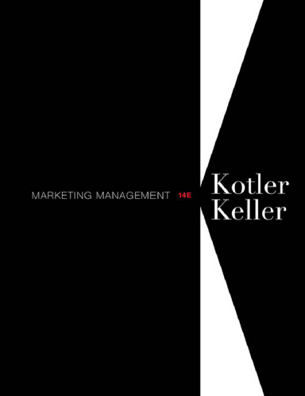
Instructor
Morteza Maleki, PhD

Slide 3
Subjects to be covered in this Chapter;
Building Customer Value, Satisfaction and Loyalty (4-14)
Total Customer Satisfaction (16-22)
Product and Service Quality (24-27)
Maximizing Customer Lifetime Value (29-52)
Customer Database and Database Management (54-58)

Slide 4
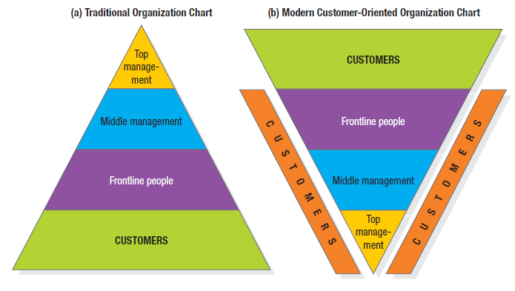
Building Customer Value, Satisfaction, & Loyalty
Creating loyal customers is at the heart of every business.

Slide 5
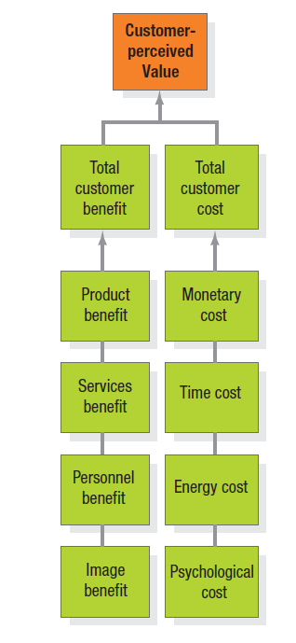
Building Customer Value, Satisfaction, & Loyalty
CUSTOMER PERCEIVED VALUE
Customers tend to be value maximizers, within the bounds of search costs & limited knowledge, mobility, & income.
Customers estimate which offer will deliver the most perceived value & act on it.
Whether the offer lives up to the expectations affects customer satisfaction & the probability that the customer will purchase the product again.

Slide 6
Building Customer Value, Satisfaction, & Loyalty
Customer Perceived Value (CPV) is the difference between the prospective customer’s evaluation of all the benefits & all the cost of an offering & the perceived alternatives.

Slide 7
Building Customer Value, Satisfaction, & Loyalty
Total Customer Benefit is the perceived monetary value of the bundle of economic, functional, & psychological benefits customers expect from a given market offering because of the products, services, personnel, & image involved.

Slide 8
Building Customer Value, Satisfaction, & Loyalty
Total Customer Cost is the perceived bundle of costs customers expect to incur in evaluating, obtaining, using, & disposing of the given market offering, including monetary, time, energy, & psychological costs.

Slide 9
Building Customer Value, Satisfaction, & Loyalty
Steps in conducting Customer Value Analysis;
Identify the major attributes & benefits that customer values,
Assess the quantitative importance of the different attributes & benefits,
Assess the company’s & competitors’ performances on the different customer values against their rated importance.
Examine how customers in a specific segment rate the company’s performance against a specific major competitor on an individual attribute or benefit basis,
Monitor customer values over time.

Slide 10
Building Customer Value, Satisfaction, & Loyalty
Choices & Implications
Buyers operate under various constraints & occasionally make choices that give more weight to their personal benefit than to the company’s benefit.
Implications of CPV model are;
The seller must assess the total customer benefit & total customer cost associated with each competitor’s offer in order to know how his/her offer rates in the buyers’ mind.

Slide 11
Building Customer Value, Satisfaction, & Loyalty
The seller who is at a CPV disadvantage has two alternatives;
To increase total customer benefit
This calls for strengthening or augmenting the economical, functional, & psychological benefits of the offering’s product, services, personnel, & image.
To decrease total customer cost
This calls for reducing the buyer’s costs by reducing the price or cost of ownership & maintenance, simplifying the ordering & delivery process, or absorbing some buyer risk by offering a warranty.

Slide 12
Building Customer Value, Satisfaction, & Loyalty
Delivering High Customer Value
Consumers have varying degrees of loyalty to specific brands, stores, & companies.
Loyalty is a deeply held commitment to rebuy or repatronize a preferred product or service in the future despite situational influences & marketing efforts having the potential to cause switching behavior.

Slide 13
Building Customer Value, Satisfaction, & Loyalty
Value Proposition consists of the whole cluster of benefits the company promises to deliver; it is more than the core positioning the offering.
It is a statement about the experience customers will gain from the company’s market offering & from their relationship with the supplier.
The brand must represent a promise about the total experience the customers can expect.
Whether the promise is kept depends on the company’s ability to manage its value delivery system.

Slide 14
Building Customer Value, Satisfaction, & Loyalty
The Value Delivery System includes all the experiences the customer will have on the way to obtaining & using the offering
At the heart of a good value delivery system is a set of core business processes that help to deliver distinctive consumer value.

Slide 15
Subjects to be covered in this Chapter;
Building Customer Value, Satisfaction and Loyalty (4-14)
Total Customer Satisfaction (16-22)
Product and Service Quality (24-27)
Maximizing Customer Lifetime Value (29-52)
Customer Database and Database Management (54-58)

Slide 16
Total Customer Satisfaction
Whether the buyer is satisfied after purchase depends on the offer’s performance in relationship to the buyer’s expectations, & whether the buyer interprets any deviations between the two.
Satisfaction is a person’s feelings of pleasure or disappointment that result from comparing a product’s perceived performance (or outcome) to their expectations.
If the performance falls short of expectations, the customer is dissatisfied.
If the performance matches the expectations, the customer is satisfied.
If the performance exceeds expectations, the customer is highly satisfied, or delighted.

Slide 17
Total Customer Satisfaction
Creating high customer satisfaction might not be the ultimate goal of the company.
The company might be able to increase its profitability by means other than increased satisfaction (by improving manufacturing process or investing more on R&D).
The company has many stakeholders, including employees, dealers, suppliers, & stockholders; spending more to increase customer satisfaction might divert funds from increasing the satisfaction of other “partners”.
The company must operate on the philosophy that it is trying to deliver a high level of customer satisfaction subject to delivering acceptable levels of satisfaction to the other stakeholders, given its total resources.

Slide 18
Total Customer Satisfaction
Expectations result from past buying experience; friends’ & associates’ advice; & marketers’ & competitors’ info & promises;
If marketers raise expectations too high, the buyer is likely to be disappointed.
If the company sets the expectations too low, it won’t attract enough buyers (although it will satisfy those who buy).
Successful companies are raising expectations & delivering performance to match.

Slide 19
Total Customer Satisfaction
MONITORING SATISFACTION
A highly satisfied customers generally
Stays loyal longer,
Buys more as the company introduces new products & upgrade existing products
Talks favorably to others about the company & its products,
Pays less attention to competing brands & is less sensitive to price,
Offers product or service ideas to the company, &
Costs less to serve than new customers because transactions can become routine

Slide 20
Total Customer Satisfaction
Measurement Techniques
Periodic surveys, tracking customer satisfaction directly & also ask additional question to measure repurchase intention & the respondents’ likelihood or willingness to recommend the company to others.
Companies can monitor their customer loss rate & contact customers who have stopped buying or who have switched to another supplier to find out why.
Companies can hire mystery shoppers to pose as potential buyers & report on strong & weak points experienced in buying the company’s & the competitor’s products.

Slide 21
Total Customer Satisfaction
Influence of customer satisfaction
For customer-centered companies, customer satisfaction is both a goal & marketing tool.
The Internet provides a tool for consumers to quickly spread bad word of mouth—or good word of mouth—to the rest of the world.
Companies that do achieve high customer satisfaction ratings make sure their target market knows it.

Slide 22
Total Customer Satisfaction
Customer Complaints
Customers are dissatisfied with their purchases about 25% of the time but that only about 5% complain.
The other 95% either feeling complaining is not worth the effort, or they do not know how or to whom to complain, & they just stop buying.
Customers who have complained to an org & had their complaint satisfactorily resolved tell an average of 5 people about the good treatment.
The average dissatisfied customer grips to 11 people.
The best thing the company can do is to make it easy for the customer to complain.

Slide 23
Subjects to be covered in this Chapter;
Building Customer Value, Satisfaction and Loyalty (4-14)
Total Customer Satisfaction (16-22)
Product and Service Quality (24-27)
Maximizing Customer Lifetime Value (29-52)
Customer Database and Database Management (54-58)

Slide 24
Product & Service Quality
Satisfaction will also depend on product & service quality.
Quality is the totality of features & characteristics of a product or service that bear on its ability to satisfy stated or implied needs.
The seller can deliver a quality whenever its product or service meets or exceeds the customers’ expectations.

Slide 25
Product & Service Quality
We need to distinguish between conformance quality & performance quality.
One product, say Lexus, provides higher performance quality than another product, say Hyundai; Lexus rides smoother, goes faster, & lasts longer.
Yet we can say that both product, say Lexus & Hyundai, deliver the same conformance quality if all the units deliver their respective promised quality.

Slide 26
Product & Service Quality
Impact of Quality
Product & service quality, customer satisfaction, & company profitability are intimately connected.
Higher levels of quality result in higher level of customer satisfaction, which support higher prices & (often) lower costs.
Total Quality: Total Quality is everyone’s job, just as marketing is everyone’s job.

Slide 27
Product & Service Quality
Marketers play several roles in helping their companies define & deliver high quality goods & services to target customers.
First, they bear the major responsibility for correctly identifying the customers' needs & requirements.
Second, they must communicate customer expectations properly to product designers.
Third, they must make sure that customers’ orders are filled correctly & on time.
Fourth, they must check that customers have received proper instructions, training & technical assistance in the use of the product.
Fifth, they must stay in touch with customers after the sale to ensure that they are satisfied & remain satisfied.
Sixth, they must gather customer ideas for product & service improvements & convey them to the appropriate departments.

Slide 28
Subjects to be covered in this Chapter;
Building Customer Value, Satisfaction and Loyalty (4-14)
Total Customer Satisfaction (16-22)
Product and Service Quality (24-27)
Maximizing Customer Lifetime Value (29-52)
Customer Database and Database Management (54-58)

Slide 29
Maximizing Customer Lifetime Value
Ultimately, marketing is the art of attracting & keeping profitable customers.
It is not always the company’s largest customers who yield the most profit.
The largest customers can demand considerable service & receive the deepest discount.
The smallest customers pay full price & receive minimal service, but the cost of transacting with them can reduce their profitability.
The midsize customers who receive good service & pay nearly full price are often the most profitable.

Slide 30
Maximizing Customer Lifetime Value
Customer Profitability
A Profitable Customer is a person, household, or company that over time yields a revenue stream that exceeds by an acceptable amount the company’s cost stream for attracting, selling, & servicing that customer.
The emphasis is on the lifetime stream of revenue & cost, not on the profit from a particular transaction.

Slide 31
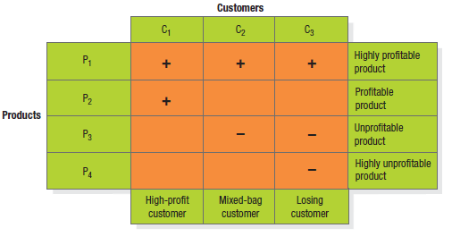
Maximizing Customer Lifetime Value
Customer Profitability Analysis (CPA)
What can the company do about customers 2 & 3?
It can raise the price of its less profitable products or eliminate them.
It can try to sell customers 2 & 3 its profit making products.

Slide 32
Maximizing Customer Lifetime Value
CPA is best conducted with the tools of an accounting technique called activity-based costing (ABC).
The company estimates all revenue coming from the customer, less all costs.
The costs should include
The cost of making & distributing the products & services,
The cost of taking phone calls from the customer,
The cost of travelling to visit the customer,
The cost of paying for entertainment & gifts—all the company’s resources that go into serving that customer.

Slide 33
Maximizing Customer Lifetime Value
Then, the company can classify customers into different profit tiers;
Platinum customers—most profitable customers ,
Gold customers—profitable customers ,
Iron customers—low profitability but desirable for volume, &
Lead customers—unprofitable & undesirable customers

Slide 34
Maximizing Customer Lifetime Value
Customer Portfolio
Customers are made up of different groups defined in terms of their loyalty, profitability, & other factors.
A firm’s customer portfolio can consist of a combination of “acquaintances”, “friends”, & “partners” that are constantly changing.
The three types of customers will differ in their product needs, their buying, selling, & servicing activities, & their acquisition costs & competitive advantage.

Slide 35
Maximizing Customer Lifetime Value
CLV calculations provide a formal quantitative framework for planning customer investment & help markets adopt a long-term perspective.
One challenge in applying CLV concepts is to arrive at reliable cost & revenue estimates.

Slide 36
Maximizing Customer Lifetime Value
Cultivating Customer Relationships
Maximizing customer value means cultivating long-term customer relationships.
Today’s economy is supported by information businesses.
Info has the advantages of being easy to differentiate, customize, personalize, & dispatch over networks at incredible speed.
But info cuts both ways;
For instance, customers now have a quick & easy means of doing comparison shopping through web sites.

Slide 37
Maximizing Customer Lifetime Value
CUSTOMER RELATIONSHIP MANAGEMENT
CRM is the process of carefully managing detailed info about individual customers & all customer “touch points” to maximize customer loyalty.
A Customer Touch Point is any occasion on which a customer encounters the brand & product—from actual experience to personal or mass communication to causal observation.
CRM enables companies to provide excellent real time customer service through the effective use of individual account info.
Based on what they know about each valued customer, companies can customize market offerings, services, programs, messages, & media.

Slide 38
Maximizing Customer Lifetime Value
One-to-One Marketing
A four-step framework for one-to-one marketing is (Peppers & Rogers);
Identify your prospects & customers,
Differentiate customers in terms of their needs & their value to your company,
Interact with individual customers to improve your knowledge about their individual needs & to build stronger relationships, &
Customize products, services, & messages to each customer.

Slide 39
Maximizing Customer Lifetime Value
One-to-One marketing works best for companies that
Normally collect a great deal of individual customer info,
Carry a lot of products that can be cross-sold,
Carry products that need periodic replacement or upgrading, &
Sell products of high value.

Slide 40
Maximizing Customer Lifetime Value
Increasing Value of the Customer Base
A key driver of shareholder value is the aggregate value of the customer base.
Winning companies improve the value of their customer base by excelling at strategies such as the following;
Reducing the rate of customer defection,
Increasing the longevity of the customer relationship,
Enhancing the growth potential of each customer through “share of wallet”, cross-selling, & up-selling,
Making low-profit customers more profitable or terminating them, &
Focusing disproportionate effort on high value customers.

Slide 41
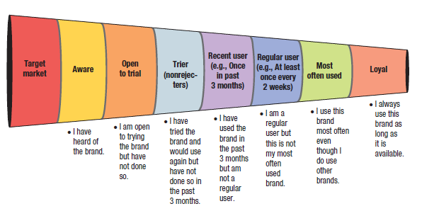
Maximizing Customer Lifetime Value

Slide 42
Maximizing Customer Lifetime Value
ATTRACTING & RETAINING CUSTOMERS
Companies seeking to expand their profits & sales must spend considerable time & resources searching for new customers.
To generate leads, companies
Develop ads & place them in media that will reach new prospects;
Send direct mail & make phone calls to possible new prospects;
Send their salespeople to participate in trade shows where they might find new leads;
Purchase names from list brokers, and so on

Slide 43
Maximizing Customer Lifetime Value
Reducing Defection
It is not enough to attract new customers; the company must keep them & increase their businesses.
Too many companies suffer from high customer churn or defection.
To reduce the defection rate, the company must;
Define & measure its defection rate,
Distinguish the causes of customer attrition & identify those that can be managed better,
Compare the lost profit equal to the CLV from a lost customer to the costs to reduce the defection rate.

Slide 44
Maximizing Customer Lifetime Value
Retention Dynamism
Satisfied customers constitute the company’s Customer Relationship Capital .
If the company products were to be sold, the acquiring company would pay not only for the plant & equipment & the brand name, but also for the delivered customer base—the number & value of the customers who would do business with the new firm.

Slide 45
Maximizing Customer Lifetime Value
Some Interesting Facts On Customer Retention
Acquiring new customers cost five times more than satisfying & retaining current customers.
Average companies loses 10% of its customers each year.
A 5% reduction in customer defection rate can increase profit by 25% to 85% depending on the industry.
The customer profit rate tends to increase over the life of the retained customer due to increased purchases referrals, & price premiums & reduced operating costs to service.

Slide 46
Maximizing Customer Lifetime Value
BUILDING LOYALTY
Companies can create strong customer bond by;
Creating superior products, services, & experience for the target market,
Getting cross-departmental participation in planning & managing the customer satisfaction & retention process,
Integrating the “voice of the customer” to capture the stated & unstated needs or requirements in all business decisions,
Organizing & making accessible a database of info on individual customer needs preferences, contacts, purchase frequency, & satisfaction,
Making it easy for customers to reach appropriate company personnel & express their needs, perceptions, & complaints,
Assessing the potential of frequency programs & club marketing programs, &
Running award programs recognizing outstanding employees.

Slide 47
Maximizing Customer Lifetime Value
There are four important marketing activities that companies are using to improve loyalty & retention;
Interacting with customers,
Developing loyalty programs,
Personalizing marketing, &
Creating institutional ties

Slide 48
Maximizing Customer Lifetime Value
Interacting with customers
Listening to customers is crucial to CRM.
Some companies have created an ongoing mechanism that keeps senior managers permanently plugged in to frontline customer feedback.
But listening is part of the story.
It is also important to be a customer advocate &, as much as possible, take the customers’ side on issues, understanding their point of view.

Slide 49
Maximizing Customer Lifetime Value
Developing Loyalty Programs
Two customers loyalty programs companies can offer are frequency programs (FP), & club marketing programs.
Frequency Programs are designed to provide rewards to customers who buy frequently & in substantial amounts.
They can help build long-term loyalty with high CLV customers, creating cross-selling opportunities in the process.
Club Membership Programs can be open to everyone who purchases a product or service, or it can be limited to an affinity group or to those willing to pay a small fee.
Though open clubs are good for building a database or snagging customers from competitors, limited membership clubs are more powerful long-term loyalty builders.

Slide 50
Maximizing Customer Lifetime Value
Personalizing Marketing
Company personnel can create strong bonds with customers by individualizing & personalizing relationships.
Thoughtful companies turn their customers into clients;
Customers maybe nameless to the institution; clients can not be nameless.
Customers are served as part of larger segments; clients are served on an individual basis.
Customers are served by anyone who happens to be available; clients are served by the professional assigned to them.

Slide 51
Maximizing Customer Lifetime Value
Creating Institutional Ties
The company may supply customers with special equipment or computer links that help customers manage orders, payroll, & inventory.
Customers are less inclined to switch to another supplier when this would involve high capital costs, high search costs, or the loss of loyal-customer discounts.

Slide 52
Maximizing Customer Lifetime Value
WIN-BACKS
Regardless of the nature of the category or how hard companies may try, some customers inevitably become inactive or drop out.
The challenge is to reactive dissatisfied customers through win-back strategies.
It is often easier to re-attract ex-customers—because the company knows their names & history—than to find new ones.
The key is to analyze the causes of customer defection through exit interviews & lost-customer surveys & win back only those who have strong profit potential.

Slide 53
Subjects to be covered in this Chapter;
Building Customer Value, Satisfaction and Loyalty (4-14)
Total Customer Satisfaction (16-22)
Product and Service Quality (24-27)
Maximizing Customer Lifetime Value (29-52)
Customer Database and Database Management (54-58)

Slide 54
Customer Database and Database Management
In order to know the customer, the company must collect the info & store it in a database from which to conduct database marketing.
A Customer Database is an organized collection of comprehensive info about individual customers or prospects that is current, accessible, & actionable for such marketing purposes as lead generation, lead qualification, sale of a product or service, or maintenance of customer relationships.
Database Marketing is the process of building, maintaining, & using customer databases & other databases—products, suppliers, resellers—to connect, transact, & build customer relationships.

Slide 55
Customer Database and Database Management
A Business Database would contain business customers
Past purchases;
Past volumes, prices, & profits;
Buyer team member names (ages, birthdays, hobbies, & favorite foods);
Status of current contracts;
An estimate of the suppliers share of the customer’s business;
Competitive suppliers;
Assessment of competitive strengths & weaknesses in selling & serving the accounts; &
Relevant buying practices, patterns, & policies

Slide 56
Customer Database and Database Management
DATAWAREHOUSE & DATAMINING
Data Warehouse is a place where the info collected by the company’s contact centers are saved & organized.
Marketers can capture, query & analyze it to draw inferences about an individual customer’s needs & responses.
Datamining is a process through which marketing statisticians can extract useful info about individuals, trends, & segments from the mass of data.
It uses sophisticated statistical & mathematical techniques such as cluster analysis automatic interaction detection, predictive modeling, & neutral networking.

Slide 57
Customer Database and Database Management
In general, companies can use their databases in five ways;
To identify prospects,
To decide which customers should receive a particular offer,
To deepen customer loyalty,
To reactivate customer purchases, &
To avoid serious customer mistakes.

Slide 58
Customer Database and Database Management
DOWNSIDE OF DATABASE MARKETING & CRM
Four problems can prevent a firm from effectively using CRM;
Building & maintaining a customer database requires a large investment in computer hardware, database software, analytical programs, communication links, & skilled personnel.
It is difficult to get everyone in the company to be customer oriented & to use the available info.
Not all customers want a relationship with a company, & they may resent knowing that the company has collected that much personal info about them.
Assumptions behind CRM may not always hold true;
For instance, it may not cost less to serve more loyal customers; high-volume customers often know their value to a company & can leverage it to extract premium service &/or price discounts.

Slide 59
The End

