Slide 1
Instructor
Morteza Maleki, PhD

Slide 2
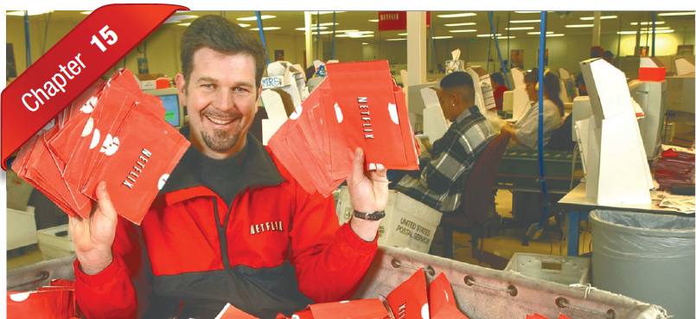

Slide 3
Managing Channels & Value Networks
Marketing Channels are sets of interdependent organizations involved in the process of making a product or service available for use or consumption.
They are the set of pathways a product or service follows after production, culminating in purchase and used by the final end user.
In the United States, channel members as a group have historically earned margins that account for 30 percent to 50 percent of the ultimate selling price.
In contrast, advertising typically has accounted for less than 5 percent to 7 percent of the final price.

Slide 4
Managing Channels & Value Networks
There are three types of intermediaries;
Merchants
They buy, take title to, and resell the merchandise.
Agents
They search for customers and may negotiate on the producers’ behalf but do not take title to the goods.
Facilitators
They assist in the distribution process but neither take title to the goods nor negotiate purchases or sales.

Slide 5
Managing Channels & Value Networks
The Importance of Channels
A marketing channel system is a particular marketing channels a firm employs.
One of the chief roles of marketing channels is to convert potential buyers into a profitable buyers.
Marketing channels must not just serve markets, they must also make markets.
The channels chosen affect all other marketing decisions.
Channel decisions include relatively long-term commitments with other firms as well as a set of policies and procedures.
Channel choices depend on the company’s marketing strategy with respect to segmentation, targeting and positioning.

Slide 6
Managing Channels & Value Networks
Push vs. Pull Strategies in Managing Intermediaries
A push strategy uses the manufacturers’ salesforce, trade promotion money, or other means to include intermediaries to carry, promote, & sell the product to end users; it is appropriate where
There is low brand loyalty in a category
Brand choice is made in the store
The product is an impulse item
Product benefits are well understood

Slide 7
Managing Channels & Value Networks
In a pull strategy, the manufacturer uses advertising, promotion, and other forms of communication to persuade consumers to demand the product from intermediaries, thus inducing the intermediaries to order it; it is appropriate when
There is high brand loyalty and high involvement in the category
Consumers are able to perceive differences between brands
Consumers choose the brand before they go to the store

Slide 8
Managing Channels & Value Networks
Channel Development
The channel systems evolves as a function of
Local opportunities & conditions,
Emerging threats and opportunities,
Company resources and capabilities, etc.
A new firm typically starts as a local operation selling as a fairly circumscribed market, using existing intermediaries.
A few manufacturers’ sales agents,
A few wholesalers,
Several established retailers,
A few trucking companies, &
A few warehouses.

Slide 9
Managing Channels & Value Networks
After branching into new markets, firms use different channels in different markets
In smaller markets, it might sell directly to the retailers; in larger markets, it might sell through distributors.
In rural areas, it might work with general-goods merchants; in urban areas, with limited line merchants.
In one part of the country, it might grant exclusive franchises; in another, it might sell through all outlets willing to handle the merchandise.
In one country, it might use international sales agents; in another country, it might partner with a local firm.

Slide 10
Managing Channels & Value Networks
Customers expect channel integration, characterized by features such as
The ability to order a product online and pick it up at a convenient retail location
The ability to return an online ordered product to a nearly store of the retailer
The right to receive discounts and promotional offers based on total online and offline purchases.

Slide 11
Managing Channels & Value Networks
Understanding Customer Needs
Consumers may choose the channels they prefer based on a number of factors:
The price
Product assortment,
The convenience of the channel option,
Their own particular shopping goals (economic, social, experiential)

Slide 12
Managing Channels & Value Networks
Nunes & Cespedes categorization of buyers:
Habitual Shoppers purchase from the same places in the same manner over time.
High-value deal seekers know their needs and “channel surf” a great deal before buying at the lowest possible price.
Variety-loving shoppers gather info in many channels, take advantage of high-touch services, and then buy in their favorite channel, regardless of price.
High-involvement shoppers gather info in all channels, make their purchase in a low-cost channel, but take advantage of customer support from high-touch channel.

Slide 13
Managing Channels & Value Networks
Survey in France, Germany, & the UK:
Service Quality Customers
Who cared most about the variety and performance of the product in stores as well as the service provided
Price/value customers
Who were most concerned about spending their money wisely
Affinity customers
Who primarily sough stores that suited people like themselves or the members of groups they aspired to join.
In France, shoppers place more importance on service and quality; in the UK, affinity; and in Germany, in price and value.

Slide 14
Managing Channels & Value Networks
Value Networks
A value network is a system of partnerships and alliances that a firm creates to source, augment, and deliver its offerings.
It includes a firm’s suppliers and its suppliers’ suppliers, and its immediate customers and their end customers.
It also includes valued relations with others such as university researchers & government approval agencies.

Slide 15
Managing Channels & Value Networks
This has several insights to the company
The company can estimate whether more money is made upstream or downstream, in case it might want to integrate backward or forward.
The company is more aware of disturbances anywhere in the supply chain that might cause costs, prices, or supplies to change suddenly.
Companies can go online with their business partners to carry on faster and more accurate communications, transactions, and payments to reduce costs, speed up info, and increase accuracy.

Slide 16
Managing Channels & Value Networks
Managing a value network means making increasing investments in information technology (IT) and software.
Firms have introduced supply chain management (SCM) software and invited such software firms as SAP and Oracle to design comprehensive enterprise resource planning (ERP) systems to manage cash flow, manufacturing, human resources, purchasing, and other major functions within a unified framework.
Marketers have traditionally focused on the side of the value network that looks toward the customer, adopting customer relationship management (CRM) software and practices.

Slide 17
The Role of Marketing Channels
Why would a producer delegate some of the selling job to intermediaries?
Through their contacts, experience, specialization, and scale of operation, intermediaries make goods widely available and accessible to target markets.
They can get effectiveness & efficiency by using intermediaries.
Many producers lack the financial resources and experiences to sell directly on their own.

Slide 18
The Role of Marketing Channels

Slide 19
The Role of Marketing Channels
Channel Functions & Flows
There are five flows in marketing channels;
Physical Flow
Title Flow
Payment Flow
Information Flow
Promotion Flow
A manufacturer selling a physical product and services might require three channels;
Sales channel,
Delivery channel
Service channel

Slide 20
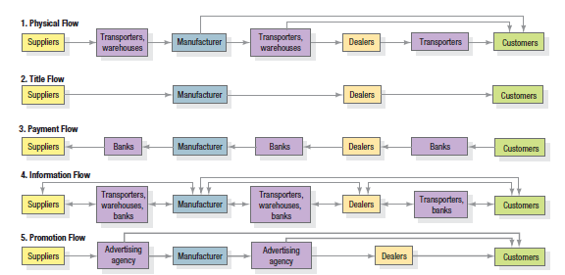
The Role of Marketing Channels

Slide 21
The Role of Marketing Channels
All channel functions have three things in common;
They use up scarce resources,
They can often be performed better through specialization, &
They can be shifted among channel members.
The question is not whether various channel functions need to be performed—they must be—but rather, who is to perform them.

Slide 22
The Role of Marketing Channels
Channel Levels
There four channel levels:
A zero-level channel (direct marketing channel)
One-level channel
Two-level channel
Three level channel

Slide 23
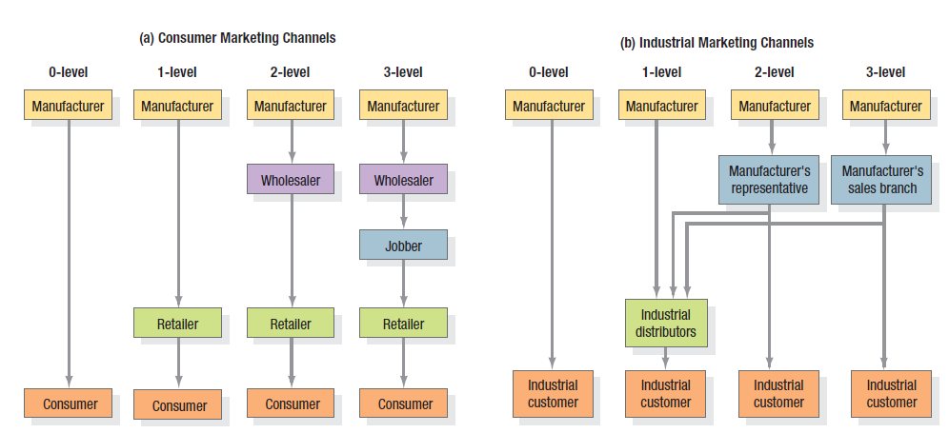
The Role of Marketing Channels

Slide 24
The Role of Marketing Channels
Channels normally describe a forward movement of products from source to user, but there are also reverse-flow channels.
The reverse-flow channels are important in the following cases:
To reuse products or containers (such as refillable chemical carrying drums)
To refurbish products (such as circuit boards or computers for resale)
To recycle products (such as paper)
To dispose of products or packaging (waste products)

Slide 25
The Role of Marketing Channels
Intermediaries in this reverse-flow channels are:
Manufacturer’s redemption centers,
Community groups,
Traditional intermediaries such as soft drink intermediaries,
Trash collection specialists,
Recycling centers,
Trash recycling brokers, &
Central processing warehousing.

Slide 26
The Role of Marketing Channels
Service Sector Channels
As Internet & other technologies advance, service industries such as banking, insurance, travel and stock buying and selling are operating through new channels.
Marketing channels also keep changing in person marketing.
Besides live and programme entertainment, entertainers, musicians and other artists can reach prospective and existing fans online in many ways.
Their own websites
Social community sites, such as Facebook and Twitter
Third party Websites

Slide 27
The Role of Marketing Channels
Politician must also choose a mix of channels.
Mass media
Rallies
Coffee hours
Spot TV ads
Email
Blogs
Social network sites, etc.
Schools develop “educational-dissemination systems”.
Hospitals develop “health-delivery systems”.

Slide 28
Channel Design & Strategies
Designing a marketing channel system requires:
Analyzing Customers’ Desired Service Output Levels
Establishing Objectives & Constraints
Identifying Major Channel Alternatives
Evaluating Major Channel Alternatives

Slide 29
Channel Design & Strategies
Analyzing Customers Desired Service Output Levels
Channels Produce Five Service Outputs
Desired Lot Size
Waiting & Delivery Time
Spatial Convenience
Product Variety
Service Backup
Providing greater service outputs means increasing channel costs & raising prices for customers; different customers have different service needs.

Slide 30
Channel Design & Strategies
Establishing Objectives & Constraints
Marketers should state their channel objectives in terms of the service output levels they want to provide and the associated cost and support levels.
Under competitive conditions, channel members should arrange their functional tasks to minimize costs and still provide desired levels of service.
Planners can identify several market segments based on desired service and choose the best channels for each.

Slide 31
Channel Design & Strategies
Establishing Objectives & Constraints …
Product characteristics;
Perishable products require more direct marketing.
Bulky products requires channels that minimize the shipping distance and the amount of handling.
Nonstandard products, like custom-built machinery, are sold directly by company’s sales representatives.
Products requiring installation or maintenance services, like heating & cooling systems, are usually sold and maintained by the company or a franchised dealer.
High unit value products like generators and turbines, are often sold through a company salesforce rather than intermediaries.

Slide 32
Channel Design & Strategies
Other companies’ (competitors’) strategies
Characteristics of the business environments
Economic Conditions
Legal regulations & restrictions

Slide 33
Channel Design & Strategies
Identifying Major Channel Alternatives
The channel alternative is described by three items:
The Types of Available Business Intermediaries
The Number of Intermediaries Needed
The Terms & Responsibilities of Each Channel Member

Slide 34
Channel Design & Strategies
Types of Intermediaries
A firm needs to identify the types of intermediaries available to carry on its channel work.
Companies should search for innovative marketing channels.
Sometimes, a company chooses a new or unconventional channel because of the difficulty, cost, or ineffectiveness of working with the dominant channel.
The company will encounter less competition during the initial move into this channel.

Slide 35
Channel Design & Strategies
Number of Intermediaries
Three strategies in choosing the number of intermediaries:
Exclusive Distribution
Selective Distribution
Intensive Distribution
Exclusive Distribution means severely limiting the number of intermediaries.
Its appropriate when the producer wants to maintain control over the service level & outputs offered by the resellers, & it often includes exclusive dealing arrangements.
It is used in the distribution of new automobiles, some major appliances, & some women apparel brands.

Slide 36
Channel Design & Strategies
In Intensive Distribution, the manufacturer places the goods or services in as many outlets as possible.
It is generally used for items such as snack foods, soft drinks, newspapers, candies, and gums, products the consumer seeks to buy frequently or in a variety of location.
The Selective Distribution strategy relies on more than a few but less than all of the intermediaries willing to carry a particular product.
It makes sense for established companies & for new companies seeking distributors.

Slide 37
Channel Design & Strategies
Terms & Responsibilities of Channel Members
Each channel member must be treated respectfully & given the opportunity to be profitable.
The main elements in the “trade-relations mix” in the channels are:
Price Policy
Conditions of Sales
Distributors’ Territorial Rights
Mutual Services & Responsibilities

Slide 38
Channel Design & Strategies
Price Policy calls for the producer to establish a price list and schedule of discounts and allowances that intermediaries see as equitable and sufficient.
Conditions of Sales refers to payment terms and producer guarantees. Most producers grant cash discounts to distributors for early payment.
They might also offer a guarantee against defective merchandise or price declines, creating an incentive to buy larger quantities.
Distributors’ Territorial Rights define the distributors’ territories and the terms under which the producer will enfranchise other distributors. Distributors normally expect to receive full credit for all sales in their territory, whether or not they did the selling.
Mutual Services & Responsibilities must be carefully spelled out, especially in franchised and exclusive agency channels.

Slide 39
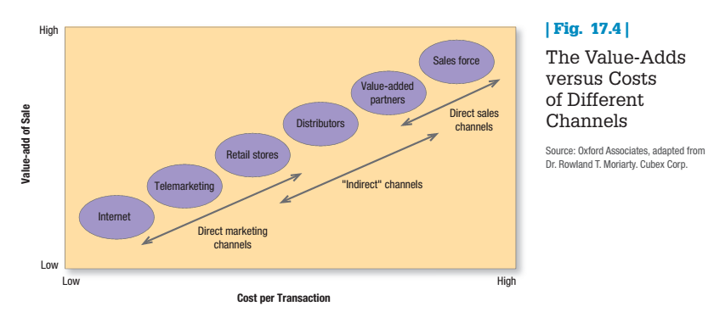
Channel Design & Strategies
Evaluating the Major Channel Alternatives
Economic Criteria
Each channel alternative will produce a different levels of sales & costs
Firms will try to align customer & channels to maximize channel at the lowest overall costs.
Yet, sellers try to replace high-cost channels with low-cost channels as long as the value added per sale is sufficient.

Slide 40
Channel Design & Strategies
Evaluating the Major Channel Alternatives
Control Criteria
Using a sales agency can pose a control problem and Technical Know-how Problem.
Agents may concentrate on the customers who buy the most, not necessarily those who buy the manufacturer’s goods.
They might not master the technical details of the company’s product or handle its promotion materials effectively.
Adaptive Criteria
To develop a channel, members must commit to each other for a specified period of time.
Yet these commitments invariably reduce the producer’s ability to respond to change and uncertainty.
The producer needs channel structures and policies that provide high adaptability.

Slide 41
Channel-Management Decisions
After a company has chosen a channel system, it must select, train, motivate, & evaluate individual intermediaries for each channel.
It must modify channel design and arrangements over time, including the possibility of expansion into international markets.
Selecting Channel Members
To customers, the channel members are the company.
Channel member features before selection:
The number of years in business
Other lines carried
Growth & profit record
Financial strength
Cooperativeness
Service reputation

Slide 42
Channel-Management Decisions
Training & Motivating Channel Members
The company should plan and implement careful training programs, market research programs, & other capability programs to improve intermediaries performance.
Channel Power is the ability to alter channel members’ behavior so that they take actions they would not have taken otherwise.
Types of power to elicit cooperation:
Coercive Power
Reward Power
Legitimate Power
Expert Power
Referent Power
Objectively Observable
Subjectively Observable

Slide 43
Channel-Management Decisions
Coercive power. A manufacturer threatens to withdraw a resource or terminate a relationship if intermediaries fail to cooperate.
This power can be effective, but its exercise produces resentment and can lead the intermediaries to organize countervailing power.
Reward power. The manufacturer offers intermediaries an extra benefit for performing specific acts or functions.
Reward power typically produces better results than coercive power, but intermediaries may come to expect a reward every time the manufacturer wants a certain behavior to occur.

Slide 44
Channel-Management Decisions
Legitimate power. The manufacturer requests a behavior that is warranted under the contract.
As long as the intermediaries view the manufacturer as a legitimate leader, legitimate power works.
Expert power. The manufacturer has special knowledge the intermediaries value. Once the intermediaries acquire this expertise, however, expert power weakens.
The manufacturer must continue to develop new expertise so intermediaries will want to continue cooperating.
Referent power. The manufacturer is so highly respected that intermediaries are proud to be associated with it.
Companies such as IBM, Caterpillar, and Hewlett-Packard have high referent power.

Slide 45
Channel-Management Decisions
Channel Partnerships
To streamline the supply chain and cut costs, many manufacturers and retailers have adopted efficient consumer response (ECR) practices to organize their relationships in three areas:
Demand-side Management or collaborative practices to stimulate consumer demand by promoting joint marketing & sales activities.
Supply-side Management or collaborative practices to optimize supply (with focuses on joint logistics supply chain activities)
Enablers & Integrators or collaborative information technology & process improvement tools to support joint activities that reduce operational problems, allow greater standardization, etc.

Slide 46
Channel-Management Decisions
Evaluating Channel Members
Producers must periodically evaluate intermediaries’ performance against standards like:
Sales-quota attainment
Average inventory levels
Customer delivery time
Treatment of damaged & lost goods
Cooperation in promotional and training programs
Underperformers need to be counseled, retrained, motivated, or terminated.

Slide 47
Channel-Management Decisions
Modifying Channel Design & Arrangements
Companies might modify the channels when
The distribution channel is not working as planned
Consumer buying patterns change
The market expands
New competition arises
Innovative distribution channels emerge
The products move into later stages in the product life cycle

Slide 48
Channel Integration & Systems
Vertical Channel Systems
A conventional marketing channel comprises an independent producer, wholesaler(s), & retailer(s).
Each is a separate business seeking to maximize its own profits, even it reduces profit for the system as a whole.
No channel member has a complete or substantial control over other members.

Slide 49
Channel Integration & Systems
A vertical marketing system (VMS) comprises a producer, wholesaler(s), & retailer(s) acting as a unified system.
One channel member, the channel captain, owns the others or franchises them or has so much power that they all cooperate.
VMSs arose as a result of strong channel members’ attempts to control channel behavior and eliminate the conflict that results when independent members pursue their own objectives.

Slide 50
Channel Integration & Systems
There are three types of VMSs:
Corporate VMS
It combines successive stages of production & distribution under a single ownership.
Administered VMS
It coordinates successive stages of production & distribution through the size and power of one of the members.

Slide 51
Channel Integration & Systems
Contractual VMS
It consists of independent firms at different levels of production and distribution, integrating their programs on a contractual basis to obtain more economies or sales impact than they could achieve alone.
They are of three types:
Wholesaler-sponsored voluntary chains
Retailer cooperatives
Franchise organizations

Slide 52
Channel Integration & Systems
The most advanced supplier distributor arrangement for administered VMS relies on administration Programming.
It builds a planned, professionally managed, vertical marketing system that meets the needs of both manufacturer and distributors.
The manufacturer establishes a department within the company called distributor relations planning.
Its job is to identify distributor needs and build up merchandising programs to help each distributor operate as efficiently as possible.
This department and distributor jointly plan merchandising goals, inventory levels, space and visual merchandising plans, sales-training requirements, and advertising and promotion plans.

Slide 53
Channel Integration & Systems
Different Types of Franchising
Manufacturer-sponsored retailer franchise
Like Ford
Manufacturer-sponsored wholesaler franchise
Like Coca Cola
Service-firm-sponsored retailer franchise
A service firm organizes a whole system for bringing its service efficiently to consumers.
McDonald, Dominos, etc.

Slide 54
Channel Integration & Systems
Horizontal Channel Systems
Two or more unrelated companies put together resources or programs to exploit an emerging marketing opportunity.
Each company lacks the capital, know-how, production or marketing resources, or it is afraid of the risks.
The companies might work with each other on a temporary or permanent basis or create a joint venture company.
For example, post offices selling insurance or mutual funds,

Slide 55
Channel Integration & Systems
Integrating Multichannel Marketing Systems
Multichannel marketing occurs when a single firm uses two or more marketing channels to reach one or more customer segments.
An integrated marketing channel system is one in which the strategies and tactics of selling through one channel reflect the strategies and tactics of selling through other channels.
Benefits of adding more channels:
Increased Market Coverage
Lower Channel Costs
More Customized Selling

Slide 56
Managing Channels & Value Networks
Hybrid Channels/Multichannel Marketing
Multichannel Marketing is using two or more marketing channels to reach customer segments in one market area.
Successful companies are multiplying the number of “go-to-market” or hybrid channels in any one market area.
For instance, HP
Uses its salesforce to sell to large accounts,
Outbound telemarketing to sell to medium-sized accounts,
Direct mail with an inbound member to sell to small accounts,
The retailers to sell still smaller accounts, &
The Internet to sell specialty items

Slide 57
Managing Channels & Value Networks
Each channel can target a different segment of buyers, or different need states for one buyer, to deliver the right products in the right places in the right way at the least cost.
When this doesn’t happen, channel conflict, excessive cost, or insufficient demand can result.
Research has shown that multichannel customers can be more valuable to marketers.
Nordstrom found that its multichannel customers spend four times as much as those who only shop through one channel,
He suggests that this effect is stronger for hedonic products (apparel and cosmetics) than for functional products (office and garden supplies).

Slide 58
Managing Channels & Value Networks
There is a trade-off among channels.
New channels typically introduce conflict and problems with control and cooperation.
Two or more may end up competing for the same customers.
Companies need to think through their channel architecture and determine which channels should perform which functions.

Slide 59
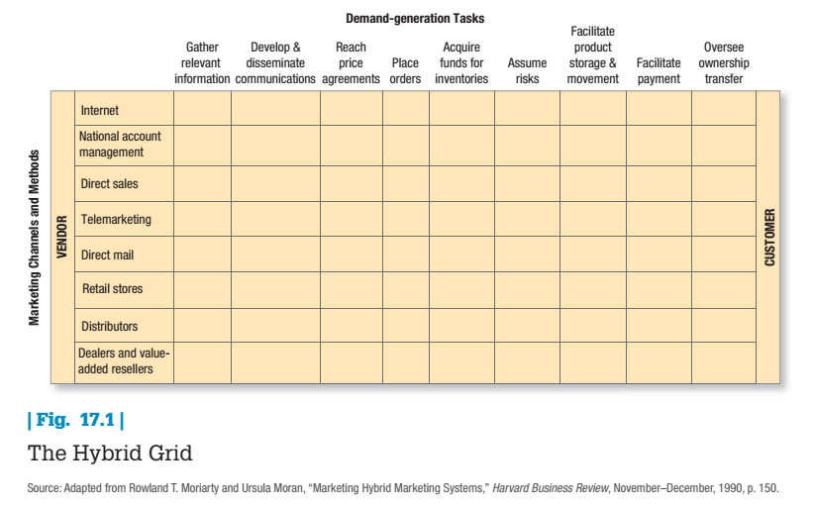

Slide 60
Conflict, Cooperation & Competition
The interests of independent business entities do not always coincide.
Channel conflict is generated when one channel member’s actions prevent another channel from achieving its goals.
Channel coordination occurs when channel members arte brought together to advance the goals of the channel, as opposed to their own potentially incompatible goals.
The major questions to ask are:
What types of conflict arise in channels?
What causes channel conflict?
What can marketers do to resolve conflict situation?

Slide 61
Conflict, Cooperation & Competition
Types of Conflict & Competition
Vertical Channel Conflict
It means a conflict between different levels within the same channel.
Horizontal Channel Conflict
It involves conflict between members at the same level within the channel.
Multichannel Conflict
It exists when the manufacturer has established two or more channels that sell to the same market.

Slide 62
Conflict, Cooperation & Competition
Causes of Channel Conflict
Goal Incompatibility
Unclear Roles & Rights
Differences in Perception
Intermediaries’ Dependence on the Manufacturer

Slide 63
Conflict, Cooperation & Competition
Managing Channel Conflicts
Adoption of Superordinate Goals
Exchange of Employees
Joint Membership in Trade Associations
Co-Optation
An effort by one organization to win the support of the leaders of another organization by including them in advisory councils, boards of directors, & the like.
Diplomacy, Mediation or Arbitration
Legal Recourse

Slide 64
Ecommerce & Marketing Practices
E-business describes the use of electronic means and platforms to conduct a company’s business.
E-commerce means that the company or site offers to transact or facilitate the selling of products & services online.
E-purchasing means companies decide to purchase goods, services, and info from various online suppliers.
E-marketing describes company efforts to inform buyers, communicate, promote, and sell its products & services over the Internet.

Slide 65
Ecommerce & Marketing Practices
Online Retailers compete among themselves in terms of three key aspects of a transaction:
Customer interaction with the Web Site
Delivery of the product
Ability to address problems when they occur.

Slide 66
Ecommerce & Marketing Practices
Pure-Click Companies
These are companies that have launched a website without any previous existence.
There are several kinds of pure-click companies:
Search Engines
Internet Service Providers (ISPs)
Commerce Sites
Transaction Sites
Content Sites
Enabler Sites

Slide 67
Ecommerce & Marketing Practices
Often online shoppers select an item for purchase but fail to complete the transaction:
The most significant inhibitors are the absence of pleasurable experiences, social interaction, & personal consultation with a company representative.
Ensuring security & privacy online remains important.
Customers must find websites trustworthy, even if it represents an already highly credible offline firm.
More activity is being conducted on business-to-business sites including:
B2B auction sites
Spot exchanges
Online product catalogs
Barter sites

Slide 68
Ecommerce & Marketing Practices
Brick-and-Click Companies
These are existing companies that have added an online site for information or e-commerce.
Adding an ecommerce channel create the threat of a backlash from retailers, brokers, agents, and other intermediaries.
How to sell both through intermediaries and online?
There are at least three strategies for trying to gain acceptance from intermediaries:
Offer different brands or products on the Internet.
Offer offline partners higher commissions to cushion the negative impacts on sales.
Take orders on the website but have retailers deliver & collect payment.

Slide 69
Ecommerce & Marketing Practices
M-Commerce
Consumers & business people no longer need to be near a computer and send & receive information.
All they need is a cell phone or personal digital assistance (PDA).
While they are on the move, they can connect to the Internet
To check stock prices, the weather, sports score;
Send and receive email messages;
Place online orders.
A whole field called telematics places wireless Internet-connected computers in the dashboards of cars & trucks, and makes more home appliances (such as computers) wireless so they can be used anywhere in or near the home.

Slide 70
The End

