Slide 1
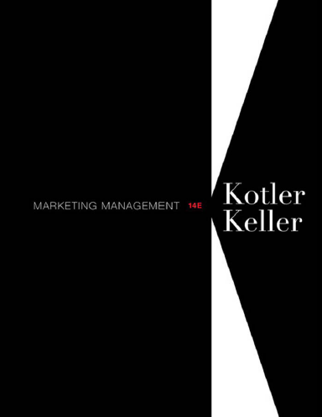
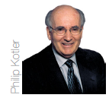
Instructor
Morteza Maleki, PhD

Slide 3
Introduction
To be successful, the firm must communicate the benefits and value of its offer to target customers.
Many communications tools and techniques are available for the firm;
Personal Selling
Advertising
Direct marketing
Packaging
Publicity
Public relations
Sales promotion
Trade Shows
Product placement
Websites
Email
Quasi-personal communication
Viral Marketing
Word of Mouth Marketing
These whole methods of communication are both blessing and Curse to the marketing professionals
The problem: the difficulty, in time and cost, of coordinating multiple messages to multiple targets, to produce a coherent, consistent, and integrated whole

Slide 4
Integrated Marketing Communication
Integrated Marketing Communication (IMC) is a concept of marketing communications planning that recognizes the added value of a comprehensive plan.
Such a plan evaluates the strategic roles of variety of communication disciplines & combines these disciplines to provide clarity, consistency and maximum impact through the seamless integration of the messages (American Association of Advertising Agencies).
IMC captures the idea of coordinating all communications messages with the right communication tools and techniques to the right audience, at the right times.

Slide 5
The Changing View of the Communication
Old Method
Limited media/vehicle choices
Siloed communications effort
Customers are only communications target
Mass communication
Broad appeal
New Method
Proliferating media/vehicle choices
Integrated communications effort
Multiple communications targets-including employees, shareholders, suppliers, complementers, and governments
Interactive communication
Targeted messaging

Slide 6
Challenges of IMC
External Challenges
Noise
Multiple Info Sources about the Firm
Competitive Communications
Evolving Communication Technologies
The Regulators
Public perception of Communication Techniques
Internal Challenges
We don’t need it.
We’ve already done that.
It’s an unnecessary expense.
We need different messages for different audiences.

Slide 7
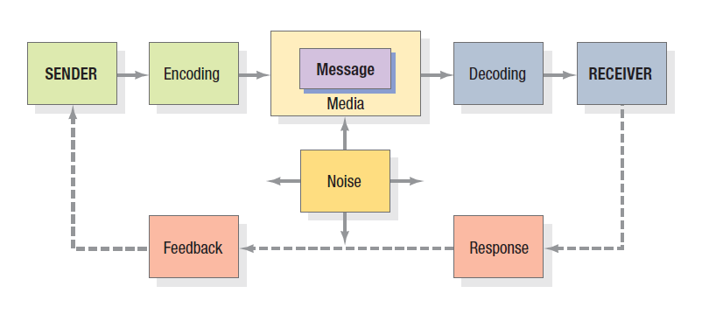
Communication Process & Tools
Communication Process

Slide 8
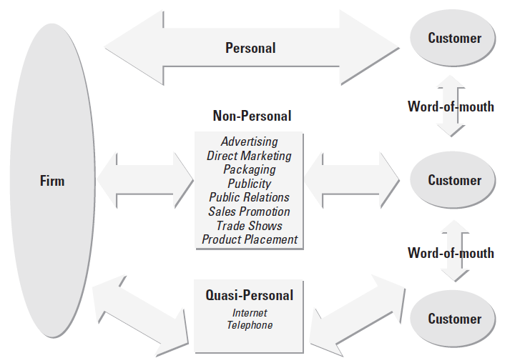
Communication Process & Tools
Communication Tools

Slide 9
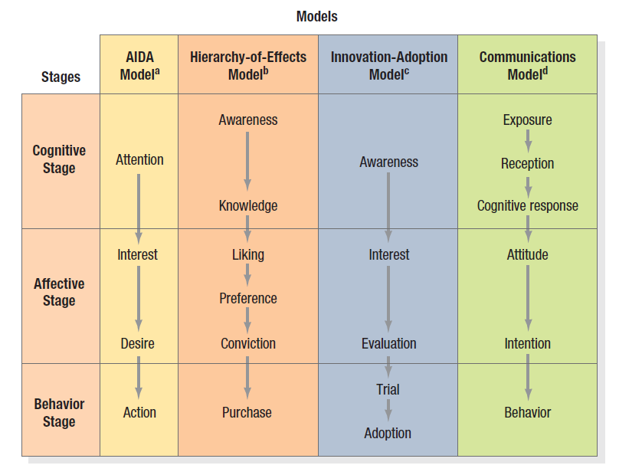
Communication Process Models
Micromodel of the Communication Process
Micromodels of marketing communications concentrate on consumers’ specific responses to communications.
E.K. Strong, the Psychology of Selling, New-York, McGraw Hill, 1925, p. 9
Robert J. Lavidge & Garry A. Steiner, “a Model for Predictive Measurement of Advertising Effectiveness, Journal of Marketing, (October 1961): 61
Everett M. Rogers, Diffusion of Innovation (New-York: Free Press, 1962), pp. 79-86
Various Sources

Slide 10
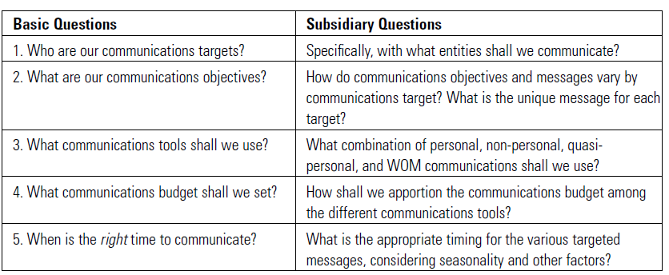
Developing the Communication Strategy
Critical Questions for Developing Communication Strategy

Slide 11
Developing the Communication Strategy
Who are our communication targets?
Two major types of communications targets:
Directly related to the firm’s offers
Not directly related to such offers

Slide 12
Developing the Communication Strategy
Communication strategies fall into one of two types;
Pull
Communications focus on direct customers.
The subcomponent manufacturers places its effort on component manufacturers (CMs).
The SM expects CMs to communicate with finished-goods manufacturers and other indirect customers further down the channel.
Push
Communications focus on indirect customers further down the channel.
SM might place its effort on final consumers or end-user customers.
Its goal is to persuade these customers to purchase finished goods and encourage the SM’s direct customers to buy its products.

Slide 13
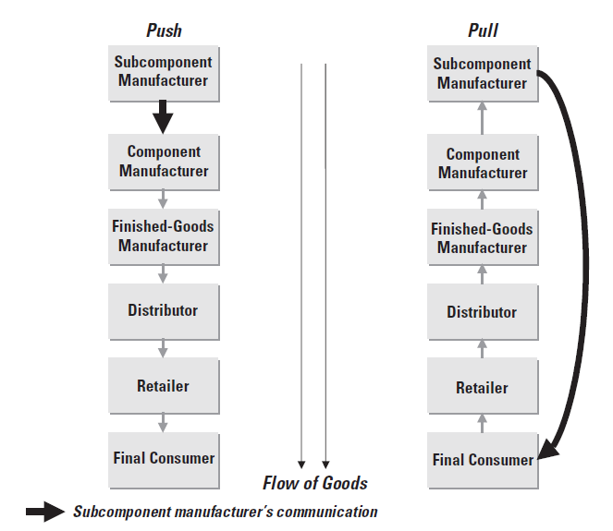
Developing the Communication Strategy

Slide 14
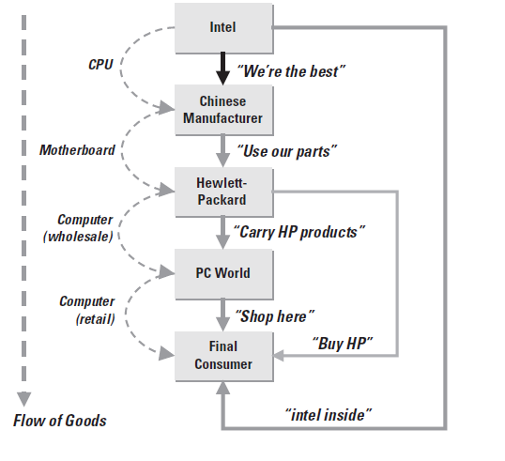
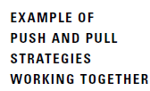
Developing the Communication Strategy
Combination of Push & Pull Strategies
FMCG firms like Henkel, P&G, and Unilever rely heavily on pull-based advertising directed at consumers
But, because of concentration in retail distribution and the emergence of powerful chains they place major push efforts at retailers.

Slide 15
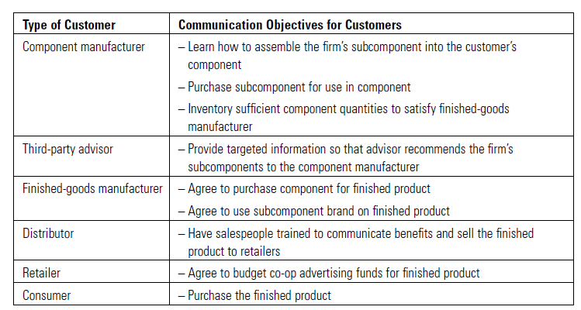
Developing the Communication Strategy
What are our communication objectives?
The firm’s long-run marketing communications objectives are to increase sales units or revenues.
But achieving other objectives, like communications clarity and comprehending the firm’s value proposition, may be prior requirements.
Communication Targets
Direct or indirect customers
Competitors and complementers
The firm tries to influence their actions so that its offering is more favorably positioned.

Slide 16
Developing the Communication Strategy
Communications objectives also depend on
The age of the firm’s business
The type of the firm’s business and market conditions
In new markets, the firm must necessarily focus on identifying, qualifying, communicating, and selling to non-users.
Conversely, if the firm is well-placed in a mature market, its objectives will probably focus more on retaining current customers.

Slide 17
Developing the Communication Strategy
What communication tools shall we use?
The firm’s choice of communication tools is derived by communication objectives;
To build awareness for a new product among a broad consumer group
Advertising is probably more effective than sending salespeople door-to-door.
If the objective is selling sophisticated capital goods to large industrial companies
Personal selling would likely be more productive

Slide 18
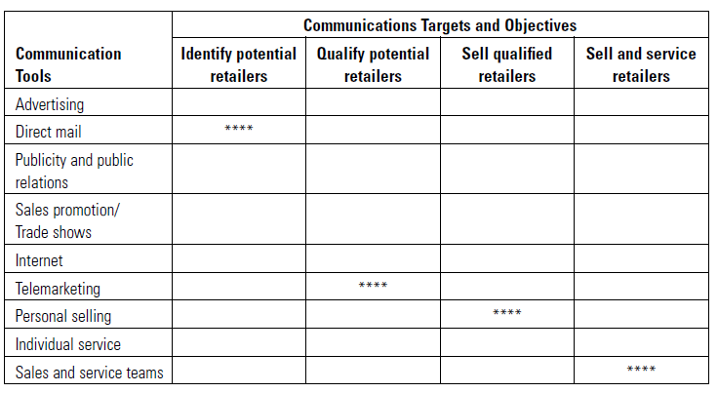
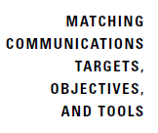
Developing the Communication Strategy

Slide 19
Developing the Communication Strategy
Typically, firms use different communications tools for push and pull communication strategies.
Pull strategies.
Firms generally spend heavily on advertising to generate pull.
These fixed cost expenditures require large cash outflows for uncertain revenues.
Pull strategies are therefore generally more popular with well-financed large firms than with small firms.
Push strategies.
Firms generally incur high variable costs from margins, discounts, and sales commissions earned by intermediaries like wholesalers and retailers.
These payments directly relate to the firm’s sales, limiting cash outflows.
Smaller firms favor push strategies.
Budgeting and timing of the firm’s communications efforts are critical for determining the most effective communications strategy.

Slide 20
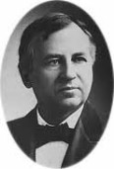
Developing the Communication Strategy
What communication budget shall we set?
Determining how much to spend on marketing communications or promotion is a daunting task.
John Wanamaker (Department Store Magnate)
John Wanamaker was a United States merchant, religious leader, civic and political figure, considered by some to be the father of modern advertising and a "pioneer in marketing." Wanamaker was born in Philadelphia, Pennsylvania.
I know that half of my advertising is wasted, but I do not know which half.

Slide 21
Developing the Communication Strategy
There are four common methods to decide on the promotion budget:
Affordable Method
Percentage of Sales Method
Competitive-Parity Method
Objective-&-Task Method
In theory, the total communication budget should be established in a manner so that the marginal profit from the last communication dollar just equals the marginal profit from the last dollar in the best non communication use.

Slide 22
Developing the Communication Strategy
Integrating Communication Efforts
Firms should strive for four types of integration:
Integrate communications for all targets in a single market segment strategy.
Integrate communications with other marketing implementation variables like product, price, distribution, and service.
Integrate communications for all targets in several market segments.
Integrate communications for all targets — market segment, market, business, and corporate.

Slide 23
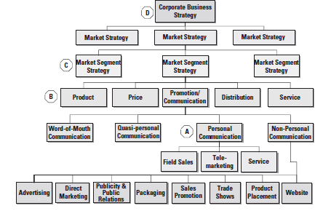
Developing the Communication Strategy

Slide 24
Deciding on the Marketing Communication Mix
Companies are always searching for ways to gain efficiency by replacing one communications tools with others.
The substitutability among communications tools explains why marketing functions need to be coordinated.

Slide 25
Deciding on the Marketing Communication Mix
Characteristics of Marketing Communication Mix
Advertising
Pervasiveness
Amplified Expressiveness
Impersonality
Sales Promotion
Communication
Incentive
Invitation

Slide 26
Deciding on the Marketing Communication Mix
Public Relations & Publicity
High Credibility
Ability to catch Buyers Off-guard
Dramatization
Events or Experiences
Relevant
Involving
Implicit

Slide 27
Deciding on the Marketing Communication Mix
Direct & Interactive Marketing
Customized
Up-to-Date
Interactive
Word -of-Mouth Marketing
Credible
Personal
Timely

Slide 28
Deciding on the Marketing Communication Mix
Personal Selling
Personal Interaction
Cultivation
Response

Slide 29
Deciding on the Marketing Communication Mix
Factors in Setting the Marketing Communication Mix
Type of Product Market
Communication mix allocation vary between consumer and business markets.
Consumer marketers tend to spend comparatively more on sales promotions and advertising.
Business marketers tend to spend comparatively more on personal selling.

Slide 30
Deciding on the Marketing Communication Mix
Buyer Readiness Stage
Communication tools vary in cost effectiveness at different stages of buyer readiness.
Advertising and publicity plays the most important roles in the awareness building stage.
Customer comprehension is primarily affected by advertising and personal selling.
Customer conviction is influenced mostly by personal selling.
Closing the sale is influenced mostly by personal selling and sales promotions.
Reordering is mostly affected by personal selling and sales promotion, and somewhat by reminder advertising.

Slide 31
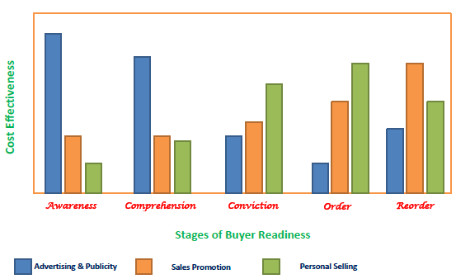
Deciding on the Marketing Communication Mix

Slide 32
Deciding on the Marketing Communication Mix
Product Life-cycle Stage
Communication tools also vary in cost effectiveness at different stages of the product life cycle;
In the introduction stage, advertising, events and experiences, and publicity have the highest cost-effectiveness, followed by personal selling to gain distribution coverage and sales promotion and direct marketing to induce trial.
In the growth stage, demand has its own momentum through word-of-mouth.
In the maturity stage, advertising, events, and experiences and personal selling all become more important.
In the decline stage, sales promotion continues strong, other communication tools reduced, and salespeople give the product only minimal attention.

Slide 33
The End

